Slide 1
Border Control: Sandboxing Accelerators
Lena E. Olson, Jason Power, Mark D. Hill, David A. Wood
University of Wisconsin-Madison
MICRO-48 December 8th, 2015

Slide 2
Executive Summary
Accelerators access shared host memory
+ Performance, programmability
- Bugs, malicious design?
Protect host from accelerator wild reads/writes
Border Control
provides full host memory safety (sandboxing)
does not degrade performance
Performance overhead ~0.48%

Slide 3
What is an accelerator?
Broadly:
Specialized hardware that can perform a
subset of computation tasks with
higher performance and/or lower energy
than a CPU.

Slide 4
Accelerators are Pervasive
(GP)GPUs
ISPs
DSPs
Cryptographic
Neuromorphic
Approximate
Database
…..

Slide 5
Accelerators are Programmable
HSA Model: host, accelerator share memory
Shared Physical Memory
avoid copying data
Shared Virtual Memory
pointer-is-a-pointer semantics
improved programmability

Slide 6
Untrusted Accelerators
May be designed by 3rd parties
May have bugs
Even CPUs have bugs sometimes!
May be malicious
An incorrect accelerator with access to shared physical memory is a threat!

Slide 7
Threat Model
Protect host from incorrect or malicious accelerators that could perform
stray reads, violating confidentiality
stray writes, violating integrity
of host processes that do and do NOT run on the accelerator

Slide 8
Principle of Least Privilege
Every program and every user of the system should operate using the least set of privileges necessary to complete the job. Primarily, this principle limits the damage that can result from an accident or error.
Jerome Saltzer
hardware component
Border Control Authors

Slide 9
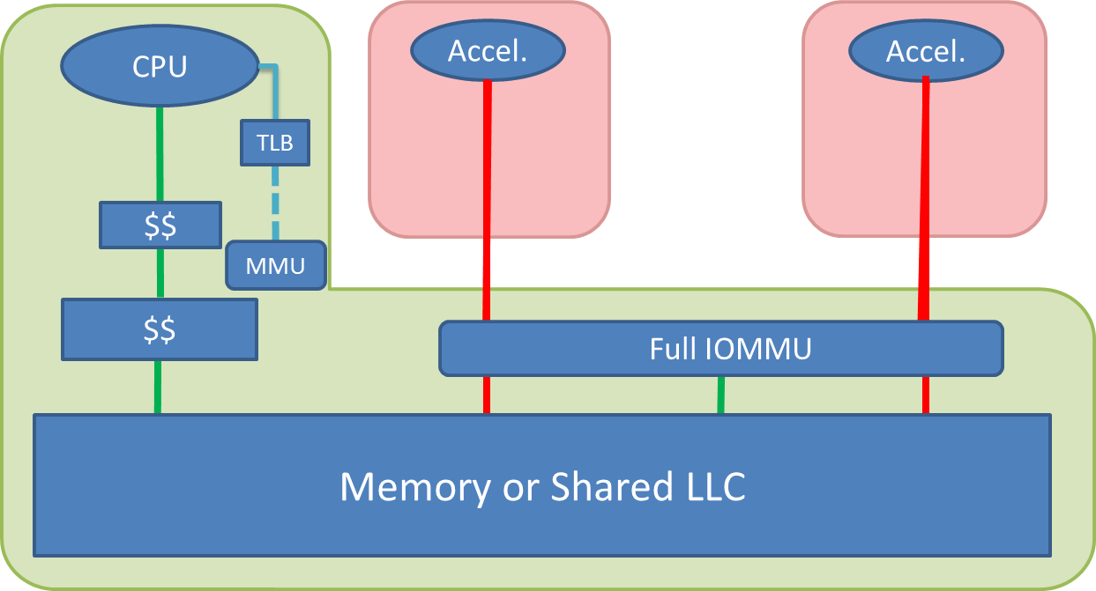

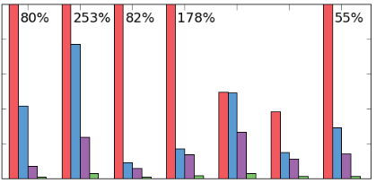
Outline
Motivation
Current Systems
Border Control
Evaluation

Slide 10
Direct Physical Address
CPU
Accel.
Accel.
TLB
$$
MMU
$$
Memory or Shared LLC
Trusted data path
Address translation path
Untrusted data path
Translation update path

Slide 11

Full IOMMU
CPU
Accel.
Accel.
TLB
$$
MMU
$$
Full IOMMU
Memory or Shared LLC
Trusted data path
Address translation path
Untrusted data path
Translation update path

Slide 12
Bypassable IOMMU (Baseline)
Mem req:
Virtual addr = V
CPU
Accel.
Accel.
TLB
TLB
TLB
$$
$$
$$
MMU
$$
Mem req:
Phys. addr = P
IOMMU
Memory or Shared LLC
OS Memory (Q)
Process Memory (P)
Trusted data path
Address translation path
Untrusted data path
Translation update path

Slide 13
Bypassable IOMMU (Baseline)
CPU
Accel.
Accel.
Mem req:
Phys. addr = P
Mem req:
Phys. addr = Q
TLB
TLB
TLB
$$
$$
$$
MMU
$$
IOMMU
Memory or Shared LLC
OS Memory (Q)
Process Memory (P)
Trusted data path
Address translation path
Untrusted data path
Translation update path

Slide 14
Outline
Motivation
Current Systems
Border Control
Evaluation

Slide 15
Bypassable IOMMU (Baseline)
CPU
Accel.
Accel.
TLB
TLB
TLB
$$
$$
$$
MMU
$$
IOMMU
Memory or Shared LLC
OS Memory (Q)
Process Memory (P)
Trusted data path
Address translation path
Untrusted data path
Translation update path

Slide 16


Border Control
CPU
Accel.
Accel.
TLB
TLB
TLB
$$
$$
$$
MMU
$$
Border Control
Border Control
IOMMU
Memory or Shared LLC
OS Memory (Q)
Process Memory (P)
Trusted data path
Address translation path
Untrusted data path
Translation update path

Slide 17
Border Control
Mem req:
Virtual addr = V
CPU
Accel.
Accel.
TLB
TLB
TLB
$$
$$
$$
MMU
$$
Border Control
Mem req:
Phys. addr = P
Border Control
Mem req:
Phys. addr = P
IOMMU
Memory or Shared LLC
OS Memory (Q)
Process Memory (P)
Trusted data path
Address translation path
Untrusted data path
Translation update path

Slide 18

Border Control
CPU
Accel.
Accel.
Mem req:
Phys. addr = Q
TLB
TLB
TLB
$$
$$
$$
MMU
$$
Border Control
Border Control
IOMMU
Memory or Shared LLC
OS Memory (Q)
Process Memory (P)
Trusted data path
Address translation path
Untrusted data path
Translation update path

Slide 19
Border Control: Implementation
One Border Control instance per accelerator
Protection Table
In system memory
Contains all needed permissions by PPN
Sufficient for correct design
0.006% physical memory overhead
Border Control Cache (BCC)
Caches recent permissions
Each entry covers 512 4KB pages

Slide 20
Protection Table Design
Flat physically indexed table in memory
PPN | R | W
0 | 0 | 0
1 | 1 | 1
2 | 1 | 0
3 | 0 | 0
2 bits (R/W) per physical page
Initialized to 0 (no permission)
Lazily updated on IOMMU translation
Checked on all accelerator memory requests
●●●
N-4 | 0 | 0
N-3 | 1 | 0
N-2 | 1 | 0
N-1 | 0 | 0

Slide 21
More details in paper!
Design of Border Control Cache
Actions: translation, page table updates, etc.
IBM CAPI
Multiprocess accelerators
Large pages
…..

Slide 22
Outline
Motivation
Current Systems
Border Control
Evaluation

Slide 23
Methodology
GPGPU → accelerator safety stress-test
Simulator: gem5-gpu
Moderately-threaded: single core
Highly-threaded: eight cores
Rodinia Benchmarks
Baseline: fast but unsafe bypassable IOMMU

Slide 24
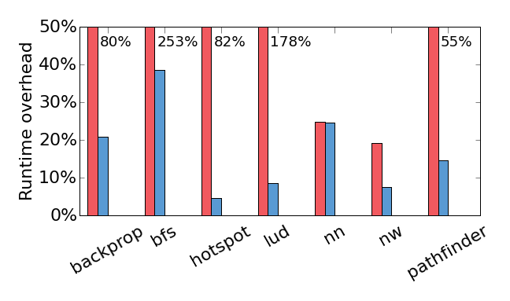
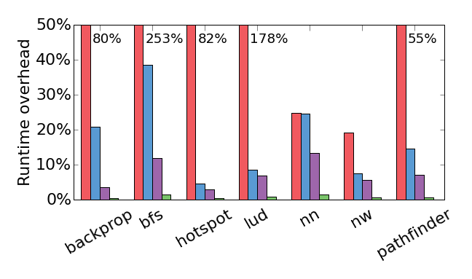
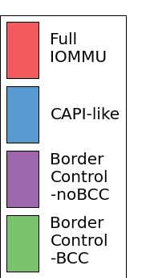
Border Control Overheads
Moderately-Threaded GPU
Takeaway: Average 0.48% performance overhead

Slide 25
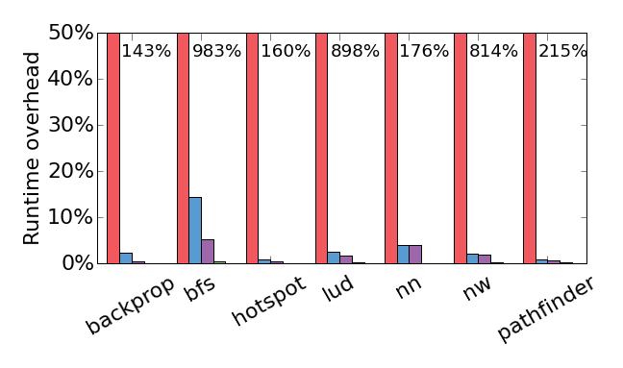
Border Control Overheads
Highly-Threaded GPU
Takeaway: Average 0.15% performance overhead

Slide 26
Conclusion
Accelerators pose new security questions¹
Border Control provides full memory access protection / sandboxing
with minimal impact on performance
and low storage overhead
1. “Security Implications of Third-Party Accelerators” by Olson, Sethumadhavan, and Hill, CAL 2015

Slide 27
Questions?

Slide 28
IBM CAPI
CPU
Accel.
Accel.
TLB
TLB
TLB
$$
$$
$$
MMU
$$
IOMMU
Memory or Shared LLC
OS Memory (Q)
Process Memory (P)
Trusted data path
Address translation path
Untrusted data path
Translation update path

Slide 29
TLB Shootdown Steps
If page was read-only:
update entry in Protection Table and BCC
If page was read-write:
Invalidate entry in TLB
Flush dirty blocks from page in accelerator cache
Update entry in Protection Table and BCC

Slide 30
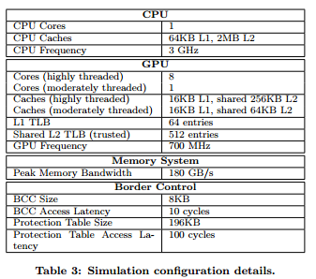
Simulation Parameters

Slide 31
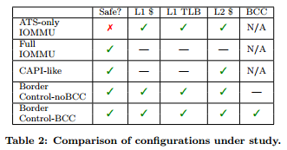
Comparison of Configurations

Slide 32
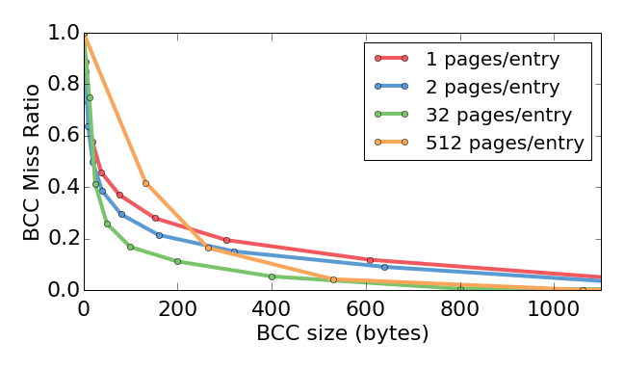
Border Control Cache
Takeaway: A small (1KB) BCC is sufficient for our workloads

Slide 33
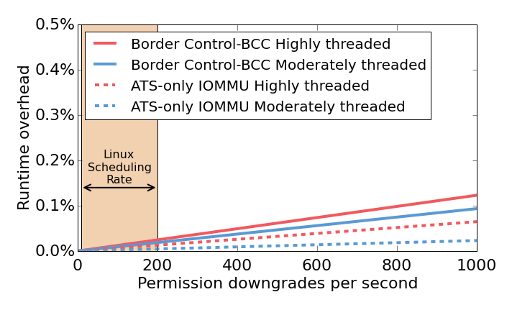
Border Control Flush Overhead
Takeaway: Permission downgrades affect performance, but not much

Slide 34
Information Flow Tracking
Goal: track untrusted information, prevent it from modifying sensitive data / control
e.g., prevent buffer overflow in software
Hardware-assisted techniques: prevent threats from bugs in software (same address space) – different threat than Border Control
Hardware (e.g. Tiwari et al., ISCA 2011) – very powerful technique, but high area/runtime overhead and not transparent to software

Slide 35
Mondriaan
Replacement for traditional page table + TLB
Allows fine-grained permissions
Border Control is independent of the policy for deciding permissions
But permission granularity might mean alternate Protection Table organizations are better

