Slide 1
GPU Register File Virtualization
Hyeran Jeon*¥, Gokul Subramanian Ravi€, Nam Sung Kim‡, and Murali Annavaram¥
University of Southern California¥
San Jose State University*
University of Wisconsin-Madison€
University of Illinois, Urbana-Champaign‡

Slide 2
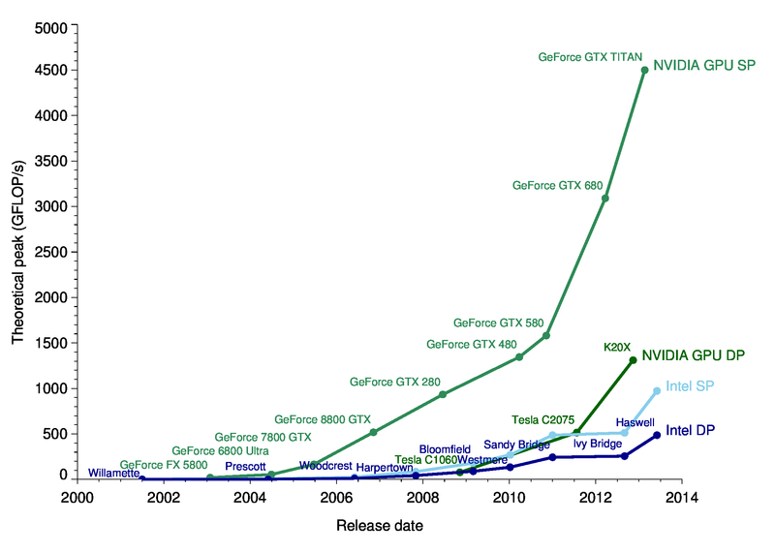
GPGPU became one of the most promising high performance computing engines
  It is everywhere (even in your laptop)
  It can run any program written in CUDA/OpenCL
  It outperforms CPU for data parallel tasks

Slide 3
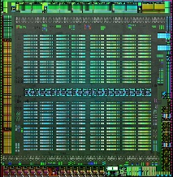
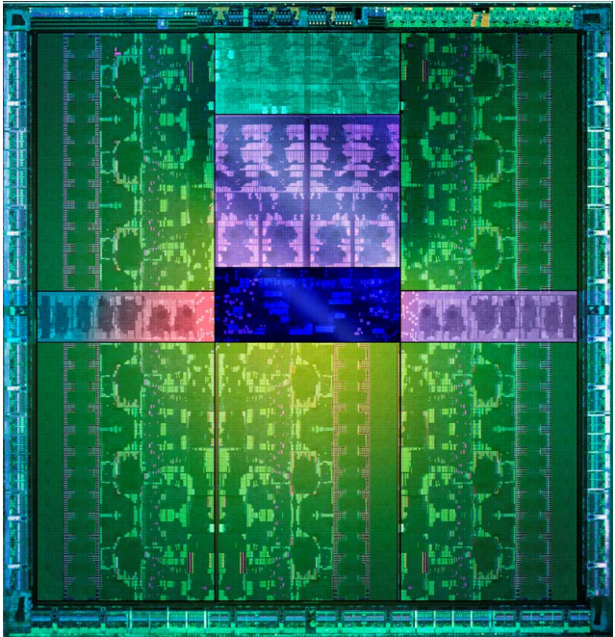
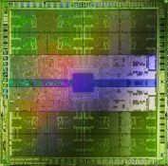
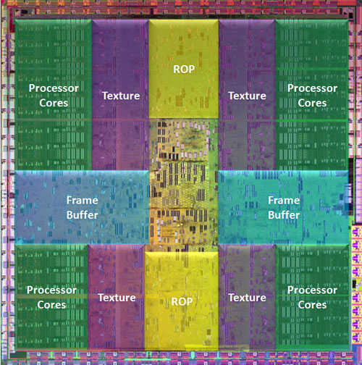
GM200 Maxwell (2015)
4MB Register File
GK110 Kepler (2013)
3.8MB Register File
1.5MB L2 shared cache
GF110 Fermi (2010)
2MB Register File
GT200 Tesla (2008)
1.9MB Register File
768KB L2 shared cache

Slide 4
Why GPGPU has such a large register file?
To enable frequent thread switching without
paying context switching penalty,
GPUs incorporate large register file.
Register File
warp0
warp1
t0
t1
t2
t31
r0
r1
r2
..
r14
r0
r1
r2
..
r14
r0
r1
r2
..
r14
r0
r1
r2
..
r14
Context
switch
GPU
. . .
t0
t1
t2
t31
r0
r1
r2
..
r14
r0
r1
r2
..
r14
r0
r1
r2
..
r14
r0
r1
r2
..
r14
. . .
Stack

Slide 5
Why GPGPU has such a large register file?
To enable frequent thread switching without
paying context switching penalty,
GPUs incorporate large register file.
Register File
warp0
warp1
t0
t1
t2
t31
r0
r1
r2
..
r14
r0
r1
r2
..
r14
r0
r1
r2
..
r14
r0
r1
r2
..
r14
GPU
. . .
t0
t1
t2
t31
r0
r1
r2
..
r14
r0
r1
r2
..
r14
r0
r1
r2
..
r14
r0
r1
r2
..
r14
. . .

Slide 6
Why GPGPU has such a large register file?
Register File
t0
t1
t2
t31
r0
r1
r2
..
r14
r0
r1
r2
..
r14
r0
r1
r2
..
r14
r0
r1
r2
..
r14
Large register file
Pros: Fast context switch
Cons: High power consumption
Register file is the most power hungry on-chip memory in GPGPU
Do we really need separate set of registers for each warp?
Warp 0
. . .
Register file in Fermi
can accommodate
48 warps per SM
(128KB RF per SM)
t0
t1
t2
t31
r0
r1
r2
..
r14
r0
r1
r2
..
r14
r0
r1
r2
..
r14
r0
r1
r2
..
r14
Warp 1
. . .
. . .
t0
t1
t2
t31
r0
r0
r0
. . .
r0
r14
r14
r14
r14
t0
t1
t2
t31
r0
r1
r2
..
r14
r0
r1
r2
..
r14
r0
r1
r2
..
r14
r0
r1
r2
..
r14
Warp 47
. . .

Slide 7
How do we get here?
Significant power reduction
only by shrinking the size

Slide 8
Register liveness
  Register liveness
    Live register: a register that contains a value that is consumed by following instruction(s)
    Dead register: a register that contains a value that is not consumed by following instruction (i.e. registers that are lastly read before next write in the code execution)
defined
Ld r1, 0(r0)
Add r2, r1, r0
. . .
Sub r1, r3, r4
. . .
used
r1 is live
r1 is dead
re-defined

Slide 9
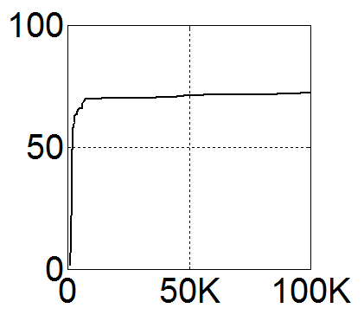
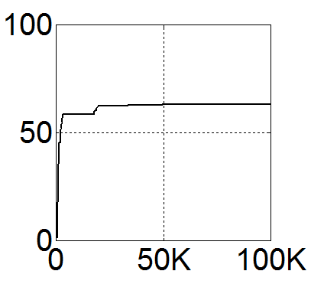
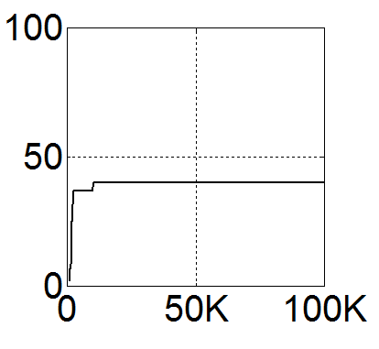
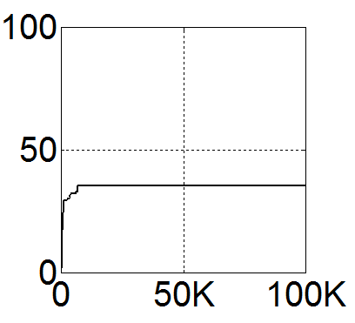
Not all registers are live all the time
  Fraction of live registers among compiler allocated registers is measured
  Significant fraction of registers are dead
  → Exploit the underutilization to shrink register file size
LPS
backprop
hotspot
gaussian
< Fraction of live registers among compiler reserved registers captured during the execution >
(X-axis: cycle, Y-axis: utilization(%))

Slide 10
Observations
THE REASON OF REGISTER SPACE UNDERUTILIZATION IN GPGPU

Slide 11
Register activity patterns within a warp
3 representative register lifetime patterns are captured from an actual benchmark, matrixMul of CUDA SDK v3.0 (default compile options are used)
At compile time, none of the registers can be removed because they are concurrently alive, even though during very short time
r3: dead
r2: Long lived
Live
Dead
time
r3: Short lived
(r0) Several Writes and Reads within a loop
(r2) Writes and immediate Reads within a loop and Reads after loop
(r3) Last Read before loop
(r3) Writes after loop
r0: Short lived but frequently accessed

Slide 12
Register space waste for short lived registers
Suppose single register in a warp is dead for a long time
What if there are N warps? (N can be several hundred in near future)
Due to warp scheduling (i.e. greedy, two-level), their lifetimes do not overlap
Live
Dead
time
. . .
WarpN-R3
. . .
N registers
Warp3-R3
Warp2-R3
time
Warp1-R3
dead

Slide 13
Register space waste for short lived registers
Single short lived register usage in a kernel code causes hundreds of register space allocation in GPGPU
  Hundreds of dead registers burn power without any contribution to the program correctness
Live
Dead
time
. . .
WarpN-R3
. . .
N registers
Warp3-R3
Warp2-R3
time
Warp1-R3
IDEA: Register Sharing
. . .
time
1 physical register

Slide 14
Register virtualization
EXPLOITING THE UNDERUTILIZED REGISTER SPACE FOR BETTER POWER EFFICIENCY

Slide 15
Register file virtualization
Map large architected register file to smaller physical register file
  Register sharing across warps
  Register allocation minimization
Large architected register file
Warp0 (r0, r1, r2 ..)
Warp1 (r0, r1, r2 ..)
. . .
WarpN (r0, r1, r2 ..)
p0, p1, p2, …
Smaller physical register file

Slide 16
How register file virtualization works?
Share register file across warps
Reallocate the dead register space for another warp’s register
Warp0’s r3
p0
p1
p2
p3
p4
p5
.
.
.
Active
Register
Window
2 Level Warp Scheduler
Pending Warp Queue
write register
2
3
4
Execution
Units
Ready Warp Queue
.
.
.
.
0
1
write r3
A Register Bank
Sub-array

Slide 17
How register file virtualization works?
Share register file across warps
Reallocate the dead register space for another warp’s register
Warp0’s r3
p0
p1
p2
p3
p4
p5
.
.
.
Active
Register
Window
Warp1’s r3
2 Level Warp Scheduler
Pending Warp Queue
write register
2
3
4
Execution
Units
Ready Warp Queue
.
.
.
.
1
0
write r3
A Register Bank
Sub-array

Slide 18
How register file virtualization works?
Share register file across warps
Reallocate the dead register space for another warp’s register
release
Warp0’s r3
X
p0
p1
p2
p3
p4
p5
.
.
.
Active
Register
Window
Warp1’s r3
2 Level Warp Scheduler
Pending Warp Queue
fetch register
2
3
4
Execution
Units
Ready Warp Queue
.
.
.
.
0
1
last read r3
A Register Bank
Sub-array

Slide 19
How register file virtualization works?
Share register file across warps
Reallocate the dead register space for another warp’s register
p0
p1
p2
p3
p4
p5
.
.
.
Active
Register
Window
Warp1’s r3
2 Level Warp Scheduler
Pending Warp Queue
2
3
0
4
Cycles later…
Execution
Units
Ready Warp Queue
.
.
.
.
0
2
issue
1
warp 0 is stuck at
memory stall
→ Schedule out
A Register Bank
Sub-array

Slide 20
How register file virtualization works?
Share register file across warps
Reallocate the dead register space for another warp’s register
Warp2’s r3
p0
p1
p2
p3
p4
p5
.
.
.
Active
Register
Window
Warp1’s r3
2 Level Warp Scheduler
Pending Warp Queue
write register
3
4
0
Execution
Units
Ready Warp Queue
.
.
.
.
2
1
write r3
A Register Bank
Sub-array

Slide 21
Compiler and Architectural support

Slide 22
Where can registers be released?
Warps traverse diverged flows sequentially
Register release point needs to be carefully determined
Write A
Read A
.
.
Read A
Release A
.
.
Write A
Basic Block

Slide 23
Where can registers be released?
Warps traverse diverged flows sequentially
Register release point needs to be carefully determined
Write A
Write A
Write A
❶
Write A
Read A
Read A
❷
Release A
Release A
Already released
Already released
❶
❷
Read A
❷
Read A
Read A
❶
❷
Read A
Read A
❶
Read A
Release A
Basic Block

Slide 24
How to represent the release?
Compiler can embed release information into the kernel code
Option 1 ) Embed release information within each instruction
  Instruction format and decoding logic should be changed
Option 2 ) Add specialized release instructions (Our choice)
  Opcode of release instructions should be added
  We leverage existing metadata instruction decoding logic (details in paper)
0x80 .pir 001000...000010000
0x88 add $r4 $r5 $r0
... ...
0xE8 mov $r0 $r2
0xF0 shl $r4 $r0
0xF8 mad $r3 $r5 $r2 $r1
keep
release
10-bit Per Branch
Release Flag OP code
- $r5 $r0
54-bit Release Flag
####
001 000 … 000 000 110
######
####
010010 … 001100 000001
######
10-bit Per Instruction Release Flag OP code
54-bit Release Flag
reg1
reg9
< Per-Instruction Release instruction >
< Per-Branch Release instruction >

Slide 25
How to release and rename registers?
w5: add $r3 $r0 $r2
Physical Register Availability Flag
P0 1 2 3 4 5 . . . . 1023
❶ Warp 5 wants to read $r0
and the release flags are
→ release $r0
1 0 1 1 1 1 . . . . 0
0 1 0
PHYS. REG ID
. . .
P0
P8
P2
P5
. . .
SM
SIMT Cluster 0
SIMT Cluster 1
SIMT Cluster 7
P3
P3
.
.
.
.
.
.
P3
P7
. . .
.
.
.
P2
P7
.
.
.
P2
.
.
.
P7
P2
P1
.
.
.
P1
.
.
.
.
.
.
P1
P6
P6
.
.
.
P5
P5
P6
P0
P0
.
.
.
P5
.
.
.
P0
P4
P4
.
.
.
P1023
P1023
P4
P1022
P1022
P1023
P1021
P1021
P1022
P1020
P1020
P1021
P1020
Register
Banks
Occupied
Available
Renaming Table

Slide 26
How to release and rename registers?
w5: add $r3 $r0 $r2
Physical Register Availability Flag
max # regs
per thread
X
+
P0 1 2 3 4 5 . . . . 1023
❷ After reading $r0 from $P0,
remove the mapping information
1 0 1 1 1 1 . . . . 0
PHYS. REG ID
. . .
P0
P8
P2
P5
. . .
SM
SIMT Cluster 0
SIMT Cluster 1
SIMT Cluster 7
P3
P3
.
.
.
.
.
.
P3
P7
. . .
.
.
.
P2
P7
.
.
.
P2
.
.
.
P7
P2
P1
.
.
.
P1
.
.
.
.
.
.
P1
P6
P6
.
.
.
P5
P5
P6
P0
P0
.
.
.
P5
.
.
.
P0
P4
P4
.
.
.
P1023
P1023
P4
P1022
P1022
P1023
P1021
P1021
P1022
P1020
P1020
P1021
P1020
Register
Banks
Occupied
Available
Renaming Table

Slide 27
How to release and rename registers?
w5: add $r3 $r0 $r2
Physical Register Availability Flag
P0 1 2 3 4 5 . . . . 1023
❷ After reading $r0 from $P0,
remove the mapping information
0 0 1 1 1 1 . . . . 0
PHYS. REG ID
. . .
-
P8
P2
P5
. . .
SM
SIMT Cluster 0
SIMT Cluster 1
SIMT Cluster 7
P3
P3
.
.
.
.
.
.
P3
P7
. . .
.
.
.
P2
P7
.
.
.
P2
.
.
.
P7
P2
P1
.
.
.
P1
.
.
.
.
.
.
P1
P6
P6
.
.
.
P5
P5
P6
P0
P0
.
.
.
P5
.
.
.
P0
P4
P4
.
.
.
P1023
P1023
P4
P1022
P1022
P1023
P1021
P1021
P1022
P1020
P1020
P1021
P1020
Register
Banks
Occupied
Available
Renaming Table

Slide 28
How to release and rename registers?
w3: mov $r2 $r0
Physical Register Availability Flag
P0 1 2 3 4 5 . . . . 1023
❸ When another warp (w3) wants
to write a new value to its register,
$P0 is remapped
0 0 1 1 1 1 . . . . 0
PHYS. REG ID
. . .
-
P8
P2
P5
. . .
SM
SIMT Cluster 0
SIMT Cluster 1
SIMT Cluster 7
$P0
P3
P3
.
.
.
.
.
.
P3
P7
. . .
.
.
.
P2
P7
.
.
.
P2
.
.
.
P7
P2
P1
.
.
.
P1
.
.
.
.
.
.
P1
P6
P6
.
.
.
P5
P5
P6
P0
P0
.
.
.
P5
.
.
.
P0
P4
P4
.
.
.
P1023
P1023
P4
P1022
P1022
P1023
P1021
P1021
P1022
P1020
P1020
P1021
P1020
Register
Banks
Occupied
Available
Renaming Table

Slide 29
How to release and rename registers?
w3: mov $r2 $r0
Physical Register Availability Flag
P0 1 2 3 4 5 . . . . 1023
❸ When another warp (w3) wants
to write a new value to its register,
$P0 is remapped
1 0 1 1 1 1 . . . . 0
PHYS. REG ID
. . .
-
P8
P2
P5
. . .
SM
SIMT Cluster 0
SIMT Cluster 1
SIMT Cluster 7
$P0
P3
P3
.
.
.
.
.
.
P3
P7
. . .
.
.
.
P2
P7
.
.
.
P2
.
.
.
P7
P2
P1
.
.
.
P1
.
.
.
.
.
.
P1
P6
P6
.
.
.
P5
P5
P6
P0
P0
.
.
.
P5
.
.
.
P0
P4
P4
.
.
.
P1023
P1023
P4
P1022
P1022
P1023
P1021
P1021
P1022
P1020
P1020
P1021
P1020
Register
Banks
Occupied
Available
Renaming Table

Slide 30
Physical register usage is cut by average of 16% due to register virtualization (Up to 44%)
  - ran optimally compiled applications (–maxrregcount compile option) on GPGPU-Sim v3.2.1
  - used PTXPlus simulation option to reflect realistic register allocation

Slide 31
Now, can we get here?

Slide 32
Yes, for the applications that use no more than 64KB/SM registers under register reallocation
The other applications need some throttling method
to run on 50% smaller register file

Slide 33
GPU-Shrink
WARP SCHEDULER FOR DEADLOCK AVOIDANCE

Slide 34
GPU-Shrink
Deadlock avoidance for register under-provisioning
With slight modification on warp scheduler, register file can be safely shrunk
CTA 0
CTA 1
Ex. 50% shrink
warp0
warp1
warp0
warp1
r1, c1-w1
Ready Queue
r1, c1-w0
c0-w0
c0-w1
c1-w0
c1-w1
r1, c0-w1
r1, c0-w0
r0, c1-w1
Each warp uses 2 registers, r0 and r1
r0, c1-w0
r0, c0-w1
r0, c0-w0
Register File

Slide 35
GPU-Shrink
Deadlock avoidance for register under-provisioning
With slight modification on warp scheduler, register file can be safely shrunk
r1, c0-w1
Ready Queue
r1, c0-w0
c0-w0
c0-w1
c1-w0
c1-w1
r0, c1-w1
r0, c1-w0
r0, c0-w1
Each warp uses 2 registers, r0 and r1
r0, c0-w0
Register File

Slide 36
GPU-Shrink
Deadlock avoidance for register under-provisioning
GPU-Shrink reserves a CTA-worth registers to guarantee at least one CTA can finish the execution without deadlock
Ready Queue
c0-w0
c0-w1
c1-w0
c1-w1
Each warp uses 2 registers, r0 and r1
Register File
available register count: 5
allocated registers for CTA0: 0
allocated registers for CTA1: 0
+
≥ a CTA register
demand (4 regs)

Slide 37
GPU-Shrink
Deadlock avoidance for register under-provisioning
GPU-Shrink reserves a CTA-worth registers to avoid deadlock
Ready Queue
c0-w0
c0-w1
c1-w0
c1-w1
Each warp uses 2 registers, r0 and r1
r0, c0-w0
Register File
available register count: 4
allocated registers for CTA0: 1
allocated registers for CTA1: 0
+
≥ a CTA register
demand (4 regs)

Slide 38
GPU-Shrink
Deadlock avoidance for register under-provisioning
GPU-Shrink reserves a CTA-worth registers to avoid deadlock
Ready Queue
c0-w1
c1-w0
c1-w1
c0-w0
r0, c0-w1
Each warp uses 2 registers, r0 and r1
r0, c0-w0
Register File
available register count: 3
allocated registers for CTA0: 2
allocated registers for CTA1: 0
+
≥ a CTA register
demand (4 regs)

Slide 39
GPU-Shrink
Deadlock avoidance for register under-provisioning
GPU-Shrink reserves a CTA-worth registers to avoid deadlock
Ready Queue
c1-w0
c1-w1
c0-w0
c0-w1
r0, c1-w0
r0, c0-w1
Each warp uses 2 registers, r0 and r1
r0, c0-w0
Register File
available register count: 2
allocated registers for CTA0: 2
allocated registers for CTA1: 1
+
≥ a CTA register
demand (4 regs)

Slide 40
GPU-Shrink
Deadlock avoidance for register under-provisioning
GPU-Shrink reserves a CTA-worth registers to avoid deadlock
Assign higher priority to CTA0
Ready Queue
✓
✓
?
c1-w1
c0-w0
c0-w1
c1-w0
r0, c1-w1
r0, c1-w0
r0, c0-w1
Each warp uses 2 registers, r0 and r1
r0, c0-w0
available register count: 2
allocated registers for CTA0: 2
allocated registers for CTA1: 1
available register count: 1?
allocated registers for CTA0: 2
allocated registers for CTA1: 2?
+
+
≥ a CTA register
demand (4 regs)
Register File
< a CTA register
demand (4 regs)
CTA0 can’t finish execution with only 1 available register
Decline the request!

Slide 41
GPU-Shrink
Deadlock avoidance for register under-provisioning
A CTA that uses the maximum # registers is assigned higher priority so that the CTA finishes the execution as early as possible
Assign higher priority to CTA0
Ready Queue
✓
✓
r1, c0-w0
c0-w0
c0-w1
c1-w0
c1-w1
r0, c1-w0
r0, c0-w1
Each warp uses 2 registers, r0 and r1
r0, c0-w0
Register File
available register count: 1
allocated registers for CTA0: 3
allocated registers for CTA1: 1
+
≥ a CTA register
demand (4 regs)

Slide 42
GPU-Shrink
Deadlock avoidance for register under-provisioning
A CTA that uses the maximum # registers is assigned higher priority so that the CTA finishes the execution as early as possible
Assign higher priority to CTA0
Ready Queue
r1, c0-w1
✓
✓
r1, c0-w0
c0-w1
c0-w0
c1-w0
c1-w1
r0, c1-w0
r0, c0-w1
Each warp uses 2 registers, r0 and r1
r0, c0-w0
Register File
available register count: 4
allocated registers for CTA0: 1
allocated registers for CTA1: 0
+
≥ a CTA register
demand (4 regs)

Slide 43
GPU-Shrink
Deadlock avoidance for register under-provisioning
The remaining CTAs resume their execution by using the released registers
Cycles later…
CTA0 finishes its execution
Ready Queue
r1, c0-w1
✓
✓
r1, c0-w0
c0-w1
c0-w0
c1-w0
c1-w1
r0, c1-w0
r0, c0-w1
Each warp uses 2 registers, r0 and r1
r0, c0-w0
available register count: 4
allocated registers for CTA1: 1
available register count: 4
allocated registers for CTA0: 1
allocated registers for CTA1: 0
+
+
≥ a CTA register
demand (4 regs)
Register File
≥ a CTA register
demand (4 regs)
After warps in CTA0 release their registers,
warps in CTA1 can resume their execution
with the released registers.

Slide 44
Energy Saving
Register file virtualization + GPU-Shrink enables to safely shrink register file
50% smaller register file saves register file energy by 38%
Power gating escalates the energy saving to 42%
0.58

Slide 45
Performance Impact
GPU-Shrink 50% derived almost 0% performance overhead on average
As a comparison, when applications are recompiled with 50% fewer registers, performance overhead was 73%

Slide 46
Summary
Inefficient register utilization is observed in massive parallel processor execution
Register virtualization allows warps to share physical registers thereby eliminating unnecessary register allocations
GPU-shrink allows an aggressive register file under-provisioning without any deadlock and performance overhead

Slide 47
Thank you

