Slide 1




DynaMOS: Dynamic Schedule Migration for Heterogeneous Cores
Shruti Padmanabha, Andrew Lukefahr, Reetuparna Das, Scott Mahlke
Micro-48, Waikiki, Hawaii
December 14, 2015
University of Michigan
Electrical Engineering and Computer Science

Slide 2
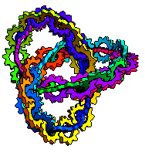

2-wide
In-order (InO) Execution
2-wide
Out-of-order
(OoO) Execution
Program
Order
Dependency
Graph
1
1
4
1
1
4
2
2
5
2
2
5
3
3
4
3
6
3
6
4
5
5
6
6
Reordering instructions → 2x performance!
Reordering hardware → 6x power!
Notes:
OoO achieves optimal schedules for its resources
At the cost of power-hungry hardware
- ROB, RAT, Issue logic

Slide 3
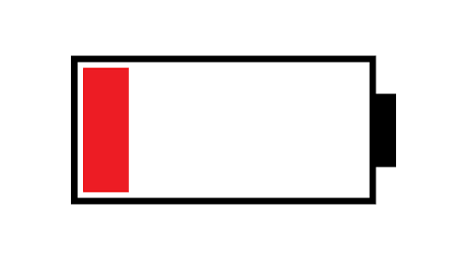
Redundancy on OoO
Create optimal reordered schedule!
Program
Traces
OoO
Core
Redundantly
Code repeats!
  90% probability of creating similar schedules for 70% of traces!

Slide 4
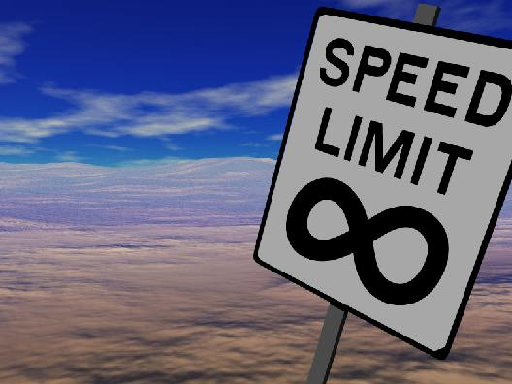

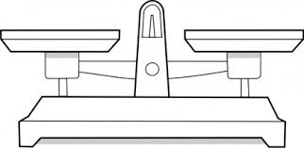
Objective
Expose and eliminate wasteful work on the expensive OoO hardware
Without significantly hurting performance

Slide 5

Background:
Heterogeneity In Hardware
Many hardware designs of varying capabilities on the same chip
  OoOs, In-orders, Accelerators, FPGAs…
Most efficient hardware chosen for application
ARM’s big.LITTLE, Nvidia’s Tegra-3, Intel Xeon+FPGA, AMD Fusion…

Slide 6
Background:
Fine-grained Heterogeneous Architectures
OoO
Backend
L2$
Shared Frontend
L1$
Controller
RF
InO
Backend
RF
*Composite Cores: Pushing Heterogeneity into a Core, Lukefahr et al, Micro 2012
Minimize transfer overhead
Allow application migration at the granularity of 100s of instructions

Slide 7
DynaMOS: Dynamic Schedule Migration for Heterogeneous Cores
OoO
Backend
Program
Traces
Trace
$
InO
Backend
Memoize!
Achieve near OoO performance with near InO hardware!

Slide 8
Motivation - Oracle
  DynaMOS can potentially execute 80% of the application on an InO core, to achieve 95% of an OoO core’s performance
Performance loss capped at 5%
  Memoization works for regular benchmarks with predictable control/data flow
  Benchmarks with unpredictable control/data flow are not memoizable

Slide 9
DynaMOS: Challenges
1
Detect profitable traces to memoize – Intelligent trace-based predictor
Determine a trace boundary
Find repeatability in schedules
Determine profitability of memoizing a trace
OoO
Backend
L1
I$
1
Trace generation & Selection
Trace
$
InO
Backend

Slide 10
DynaMOS: Challenges
1
Detect profitable traces to memoize – Intelligent trace-based predictor
2
Guarantee correct execution of reordered schedule on InO – OinO mode
OoO
Backend
L1
I$
1
Trace generation & Selection
Trace
$
InO
Backend
OinO HW
2

Slide 11
Designing the OinO Mode
2
Correctness Factor | OoO | OinO
Memory disambiguation detection | Load Store Queue | Specialized LSQ
False register dependencies | Register renaming | 2 – level renaming
Divergence from predicted behavior or interrupts | Reorder buffer and Register Alias Table | Atomic commit
a
b
PRF
LSQ
Trace Commit
Fetch
Decode
Back-end
Trace complete?
InO Core
*Modifications for OinO mode are shaded in blue

Slide 12

Handling False Dependencies
a
True Dependency (RAW)!
Seq # | Original Assembly
1(HEAD) | ldr r2, [r2]
2 | add r5, r2, #4
3 | ldr r2, [r3]
Seq # | After Reordering on OoO
1(HEAD) | ldr r2, [r2]
3 | ldr r2, [r3]
2 | add r5, r2, #4
OoO reorders independent instructions
False Dependency (WAW)!
Level 1:
Intra trace dependencies
Done on the OoO
Physical Register File
PR 2
2.0
2.1
2.2
2.3
Overhead:
Bigger PRF on InO!
Memoized Trace on OinO
ldr r2.1, [r2.0]
ldr r2.2, [r3.0]
add r5.1, r2.1, #4
Access indexed physical location
Constraint:
Only 4 PR per Arch Register!

Slide 13

Handling False Dependencies
a
Level 2:
Inter trace dependencies
Done by the OinO
IT | Memoized Trace on OinO
 | ldr r2.1, [r2.0]
I | ldr r2.2, [r3.0]
 | add r5.1, r2.1, #4
Rotating
Physical Register File
PR 2
2.2
2.3
2.0
2.1
PR 2
2.0
2.1
2.2
2.3
Committed Offset Ptr
 | ldr r2.1, [r2.0]
II | ldr r2.2, [r3.0]
 | add r5.1, r2.1, #4

Slide 14
Handling memory disambiguation
b
(i) Trace Selected by OoO
(iii) Trace Memoized In Tr$
Seq # | Prog Order (Mem)
0 | Str 1
1 | Ld 1
2 | Str 2
3 | Ld 2
4 | Ld 3
Memoized Trace (Mem)
Ld 3
Str 2
Ld 1
Ld 2
Str 1
Seq #
4
2
1
3
0
Ld 3
(ii) Encode Mem Position With Trace
Str 2
(iv) Allocate OinO LSQ entries in
Seq # Order
Overhead:
LSQ structure and Seq# table per trace
Load/Store Queue
4 | 3 | 2 | 1 | 0
(v) Check Younger Mem Ops for Aliasing

Slide 15
Evaluation Methodology
Architectural Feature | Parameters
Big Core | 3 wide O3 @ 2GHz 12 stage pipeline 128 ROB Entries 128 entry PRF, 32 entry LSQ
Little Core | 3 wide InOrder @ 2GHz 8 stage pipeline 128 entry PRF, 32 entry LSQ
Memory System | 32 KB L1 i/d cache, 2 cycle access 4KB Trace cache, 1 cycle access 1MB L2 cache, 15 cycle access 1GB Main Mem, 80 cycle access
Simulator | Gem5
Energy Model | McPAT
Benchmarks | SPEC 2k6, compiled for ARM ISA Simulated for a total of 108 simpoints of 300M instructions each
  Overheads:
  Hardware overheads induce 8% increase in the power of InO
  4kB Trace $ adds 10% to the leakage energy

Slide 16
Utilization of Little
Bar 1 = Composite Core
(No Memoization)
Bar 2 = DynaMOS
(With Memoization)
%OoO
%InO
%OinO
Performance loss capped at 5%
  Worst-case DynaMOS performance ~ Composite Cores
  Little executes both low-performance traces and traces with high memoizability

Slide 17
Energy Savings

Slide 18
Additional Results in the Paper
Sensitivity studies to different microarchitecture configurations of OoO and InO
  Equal widths in both cores allows the simplest memoization, leading to best results
Comparison studies to Loop Caches and Execution Caches
  Switching over the InO core saves the most energy
Sensitivity studies to the size of the Trace Cache and various other constraints imposed in OinO

Slide 19
Summary
Out-of-order cores create similar schedules for repeating code
  Wasteful use of expensive resources
DynaMOS: Exploit fine-grained heterogeneity to allow sharing of OoO schedules with InO cores
  Allows 32% energy savings over only an OoO core with a 5% performance loss
More details and comparison to related work in the paper

Slide 20
DynaMOS: Dynamic Schedule Migration for Heterogeneous Cores
MAHALO!
QUESTIONS?
Shruti Padmanabha, Andrew Lukefahr, Reetuparna Das, Scott Mahlke
Micro-48, Waikiki, Hawaii
University of Michigan
Electrical Engineering and Computer Science

