Slide 1
Program Chair’s EXPERIENCE REPORT
Moinuddin K. Qureshi
MICRO 2015

Slide 2
OUTLINE
Revision-Based Model
Why?
How?
Is this Useful?
Survey from Authors, PC
Recommendations
Electronic Voting at PC meeting
Other Innovations

Slide 3
WHY REVISION?
Author response is a mechanism to address reviewer’s concerns and answer clarifying questions
Current method: Rebuttal, an ~800 word text response submitted within 3 days, with no extra results
Limitations of Rebuttal-Only Method:
Promissory nature: Much better if concern is addressed rather than it will be addressed in the later version
Paper may still get rejected for easily fixable concerns as authors cannot provide data that easily fixes the concern
Response is out of context, instead of integrated with paper
Most importantly, not as effective (more results on this later)

Slide 4
NEW: REVISION BASED REVIEW MODEL
Enable authors to respond to concerns more effectively
Response window extended to 3 weeks
Top 82 papers: invited to submit a revised version
Rank>82 papers: response via only rebuttal
Authors Submit
Reviews+
Revision?
Revision
Rebuttal
Decision
Discuss and
Classify
Revision &
Rebuttal
Read Revision
and Discuss
PC
Reviews Assigned
Reviews Done
Three Weeks
Reviewers Instructions: Note that while it is okay to ask for new data, please be reasonable, as the authors have only 3 weeks to respond, so it may not be practical for them to respond to questions/concerns that require substantial time and effort.

Slide 5
FIRST DISCUSSION PERIOD
All Papers (except one) had five or more reviews
Papers ranked based on Average without Lowest (AWOL)
AWOL reduces sensitivity to one harsh outlier reviewer
All papers near cut-off got equal number of reviews (6)
Papers colored based on AWOL score:
Green (for sure in Top ~80 ➔ AWOL > 3.8)
Red (for sure not in Top ~100 ➔ AWOL <3.6)
Yellow (on the edge ➔ AWOL 3.8-3.6)
All Green + Yellow Papers assigned a discussion lead
Lead remains unchanged throughout
Tries to capture the set of concerns
Tries to make case for “Yellow” papers
Total of 350 comments exchanged

Slide 6
CUT-OFF FOR REBUTTAL vs. revision
Preference: ALL papers invited for revision be discussed at the PC meeting ➔ Given authors are putting extra effort
Typical PC meeting discusses 80-90 papers, so revision was limited to about 80 papers (based on clean cut-off)
AWOL >= 3.8
Y
N
Invited for Revision
(82 papers)
Rebuttal Only
(201 papers)
Invite for Revision neither sufficient nor necessary for acceptance

Slide 7
GUIDELINES FOR AUTHORS
Revision was Optional: No penalty for not submitting
But All 82 papers invited submitted a revision
No unsolicited additions ➔ Goal only to address the concerns of the reviewers, not to extend the paper with new ideas
Authors instructed to “highlight” the new/edited content to help reviewers identify the changes
Rebuttal space repurposed as “Change Log” pointing to highlighted sections in the paper
Papers not invited for revision could still be discussed at PC meeting based on score change or champion reviewer

Slide 8
SECOND ONLINE DISCUSSION
A new “post-revision” score field added to the review form
For revised papers, if reviewer gave C or lower urged to read revision and provide reason if score did not improve
Papers re-ranked based on “post-revision” score using AWOL
The following papers were discussed at the PC meeting:
All papers invited for revision (82)
Papers with post-revision AWOL>3.6
Papers with a champion reviewer
95 papers discussed at PC meeting, incl. 13 not invited for revision

Slide 9
IS REVISION EFFECTIVE?
Delta = SumPostResponseScores – SumPreResponseScores
Rebuttal-Only Model
Avg: HPCA 2016, HPCA 2015,
MICRO 2012, MICRO 2011
(Top 100 papers)
Revision Model
For MICRO 2015
Top 82 papers invited
-1
Num. Papers (%)
Num. Papers (%)
1
-2+
2+
Unlike Rebuttal-only model, Revision model is “net positive”
*Disclaimer: the movement could be due to many reasons, not just author response

Slide 10
EFFECTIVENESS OF REVISION: “C” SCORES
112 Scores of “C” in the 82 papers
Revision helped 38% of the “C” scores to Improve to B or A

Slide 11
ANALYZING THE CUT-OFF
Is cut-off based revision process unfair to lower ranked papers?
Conference | Accepts in Top 100 | Accepts after Rank 100
MICRO 2011 | 42% | 2 out of 108 (1.9%)
MICRO 2012 | 39% | 1 out of 126 (0.8%)
HPCA 2015 | 49% | 2 out of 125 (1.6%)
HPCA 2016 | 52% | 1 out of 138 (0.7%)
MICRO 2015 | 59% | 2 out of 183 (1.1%)
Avg: 48.2%
Avg: 1.2%
Optimize for common case:
Focus on the Top, Instead of painting the wall too-thin
*Rank based on pre-response scores

Slide 12
WHERE DID THE ACCEPTS COME FROM?
All bins of 10 till 80 had a 40%+ chance of acceptance
*Rank based on pre-response scores

Slide 13
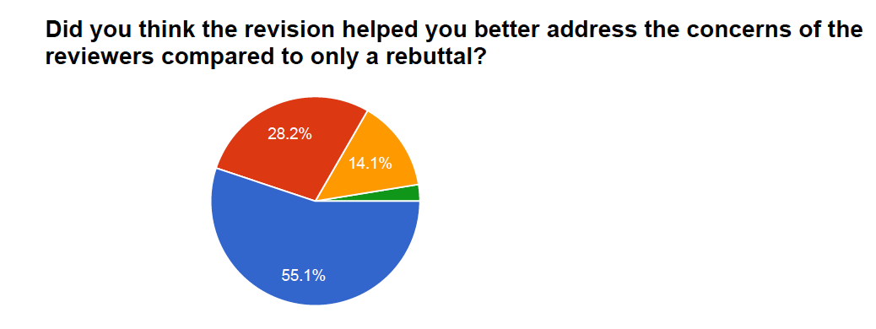
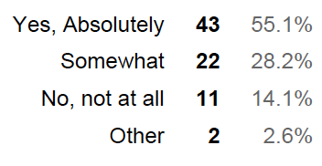
FEEDBACK FROM AUTHORS -- I
Authors of papers invited for revision surveyed before PC meeting
78 people responded

Slide 14
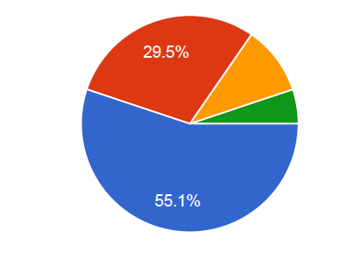
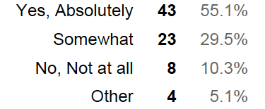
FEEDBACK FROM AUTHORS -- II
Authors of papers invited for revision surveyed before PC meeting
78 people responded

Slide 15
FEEDBACK FROM AUTHORS -- Comments

Slide 16
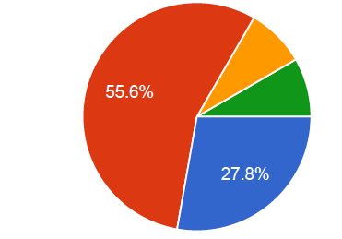
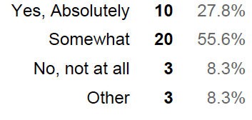
FEEDBACK FROM PC MEMBERS -- I
PC Members polled right after the PC meeting
36 PC members responded

Slide 17
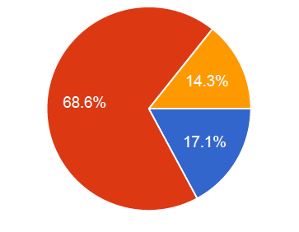
FEEDBACK FROM PC MEMBERS -- II

Slide 18
FEEDBACK FROM PC-- Comments
“The revision process is remarkably helpful for a paper which is solid but is being rejected for minor concerns that can be easily addressed by a revision. For instance if the reviewers require (i) results for an additional metric or (ii) are concerned about overheads or (iv) comparison to related work or (v) want clarification on methodology …” – Testimony from PC Member and Author (Emailed Last Night)

Slide 19
RECOMMENDATIONS
Revision more effective than rebuttal ➔ moves the needle
Enables authors to better address the concerns
Makes the final version stronger due to iterative nature
Helps reviewers in making a better decision
The extra time and effort in reviewing is not too bad
Can be made to fit in regular conference schedule
Revision: Rigor of Journals with Swiftness of Conference
Strongly recommended for our conferences (implementation is not perfect, can be improved)

Slide 20
OUTLINE
Revision-Based Model
Why?
How it was Implemented?
Is it Effective?
Survey from Authors, PC
Recommendations
Electronic Voting at PC Meeting
Other Innovations

Slide 21
PAPER DECISION process
Vote among the PC reviewers
If unanimous (and at least 3 votes), that is the final decision
If disagreement, we go to PC-wide vote
Decision by PC-wide vote
By majority
At least half the PC members in the room MUST vote
Author names NOT revealed at the PC meeting
Paper Number NOT revealed until conflicts leave the room

Slide 22
Electronic voting (within hotcrp)
Why? Manual voting is slow, prone to errors and biases
Vote influenced by who else is voting
Votes for “No” influenced by counts of “Yes”
We incorporated voting in HotCRP. Few ground rules:
For PC-wide voting only
Members had 10 seconds to enter vote after called “Lets Vote”
After 10 seconds, the count for YES and NO got displayed
We also displayed the list of members who voted YES or NO
Votes valid only during the call (entries after the decision will have no effect on the outcome of the vote)
This process worked very well, saved time, and loved by PC members

Slide 23
Electronic voting: IMPLEMENTATION
PC members wait until “saved” is displayed for vote to be counted

Slide 24
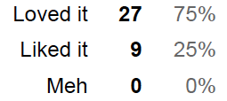
FEEDBACK FROM PC ON E-VOTING

Slide 25
OUTLINE
Revision-Based Model
Why?
How it was Implemented?
Is it Effective?
Survey from Authors, PC
Recommendations
Electronic Voting at PC Meeting
Other Innovations

Slide 26
OTHER INNOVATIONS
“Conflict Screen in Hallway” at the PC meeting
Avoids the manual call-in of conflicted PC members ➔ Faster, Accurate
Discussing “Online-Accept” at end of day, when PC is tired
“Voluntary Early Reject” during the author response period
49 papers opted for voluntary early reject
Converging submission format with camera ready format
Having a specified font-type (to ensure fairness on length)
Otherwise some submissions can get 10%-15% extra content *Should have used a popular font such as “Times” instead of default
Check all submission using word-count for gross violations Manually checked 35 submissions that had > 10K words. Returned 13.

