Slide 1
Unifying Primary Cache, Scratch, and Register File Memories in a Throughput Processor
Mark Gebhart^{1,2} Stephen W. Keckler^{1,2}
Brucek Khailany² Ronny Krashinsky²
William J. Dally^{2,3}
¹The University of Texas at Austin
²NVIDIA
³Stanford University

Slide 2
Motivation
GPUs have thousands of on-chip resident threads
  On-chip storage per thread is very limited
On-chip storage split between register file, scratchpad, and cache
Applications have diverse requirements between these three types of on-chip storage
Efficiently utilizing on-chip storage can improve both performance and energy

Slide 3
Overview
Traditional Design
Proposed Unified Design
Program A Program B
Register File
Register File
Register File
Shared Memory
Shared Memory
Cache
Cache
Shared Memory
Cache
Automated algorithm determines most efficient allocation
Overheads are mitigated by leveraging prior work on register file hierarchy

Slide 4
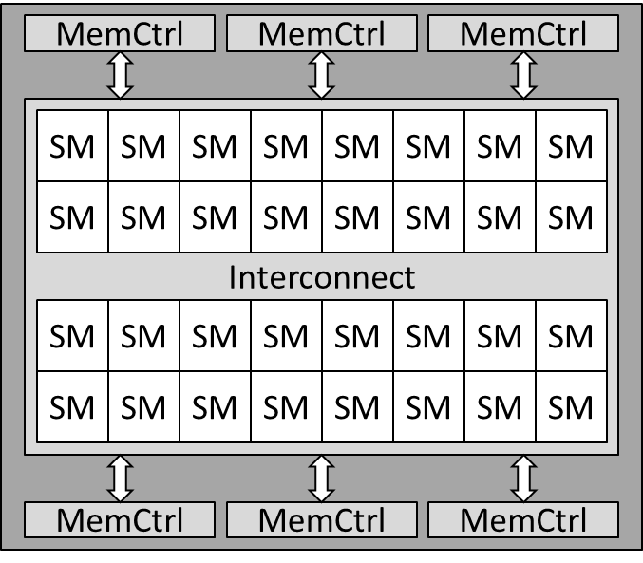
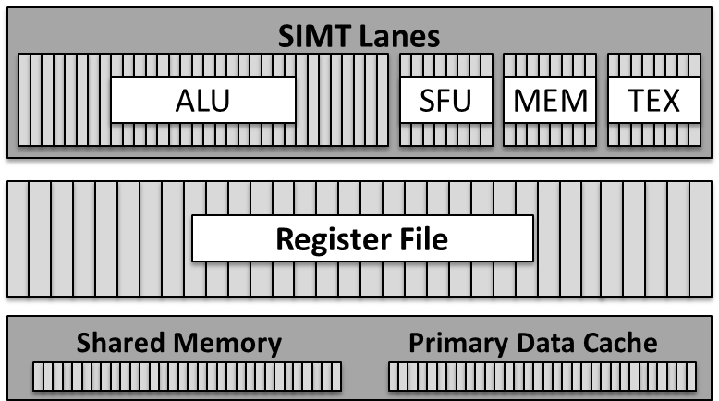
Contemporary GPUs
Large number of SMs per chip
High bandwidth memory system
Each SM contains:
  Parallel SIMT lanes
  High capacity register file
  Programmer controlled shared memory
  Primary data cache
  Coarse-grain configurability between shared memory and cache

Slide 5
Baseline Streaming Processor
Each SM contains:
  32 SIMT lanes
  256KB main register file
  64KB shared memory
  64KB primary data cache
  Register file hierarchy
Streaming Multiprocessor (SM)
SIMT Lanes
ALU
SFU
MEM
TEX
Register File Hierarchy
Main Register File
Shared Memory Cache
Register File Hierarchy
ALUs
L0 RF
L1 RF
Main
Register File
[Gebhart, MICRO 2011]

Slide 6
Outline
Motivation
GPU background
Unified GPU on-chip storage
  Sensitivity study
  Microarchitecture
  Results
Conclusions

Slide 7
Sensitivity Study
Evaluate the performance impact of memory capacity of three structures:
  Larger Register file
    Increase the number of registers per threads
    Increase the number of concurrent threads
  Larger Shared Memory
    Refactor code to use more shared memory per thread
    Increase the number of concurrent threads
  Larger Cache
    Better exploit locality

Slide 8
Register File Sensitivity Study
256, 512, 768, 1024 threads per SM

Slide 9
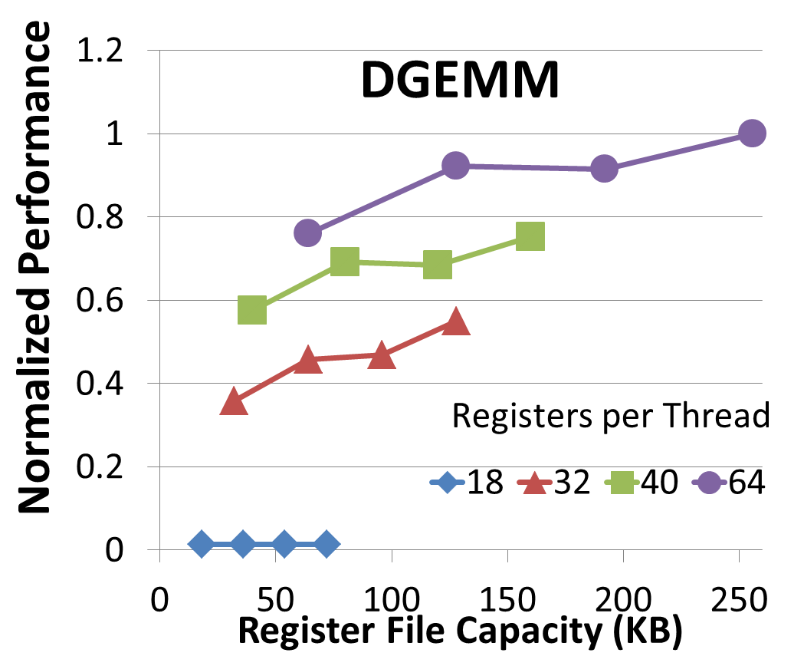
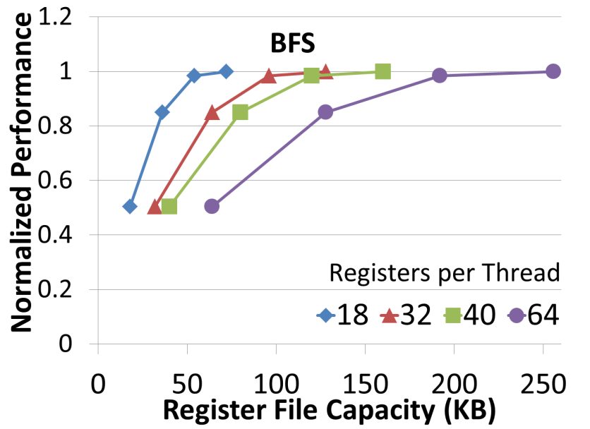
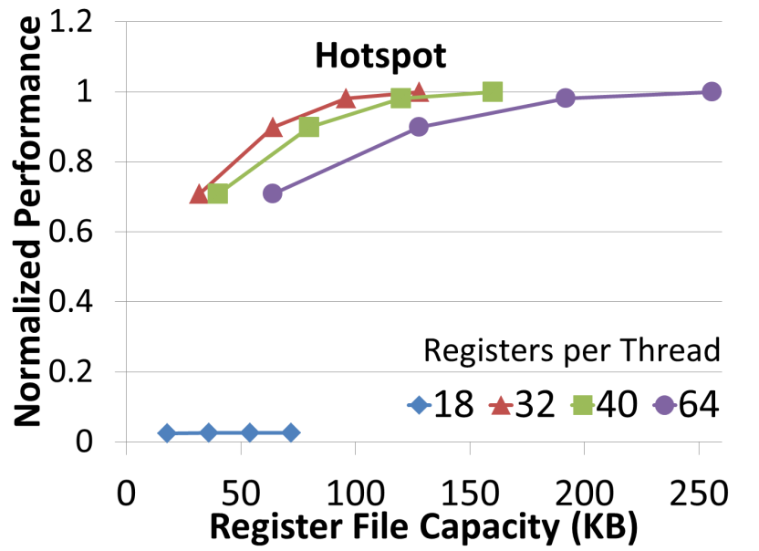
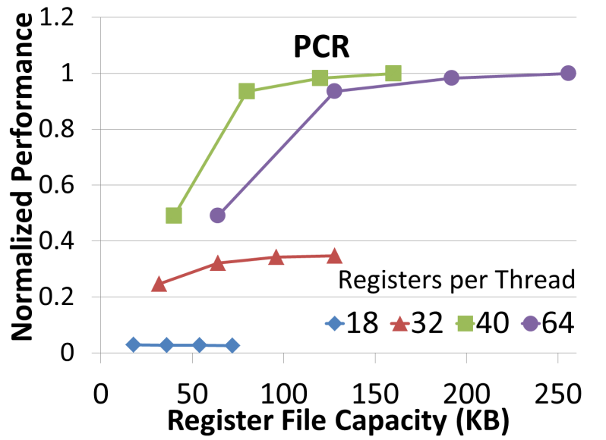
Register File Sensitivity Study

Slide 10
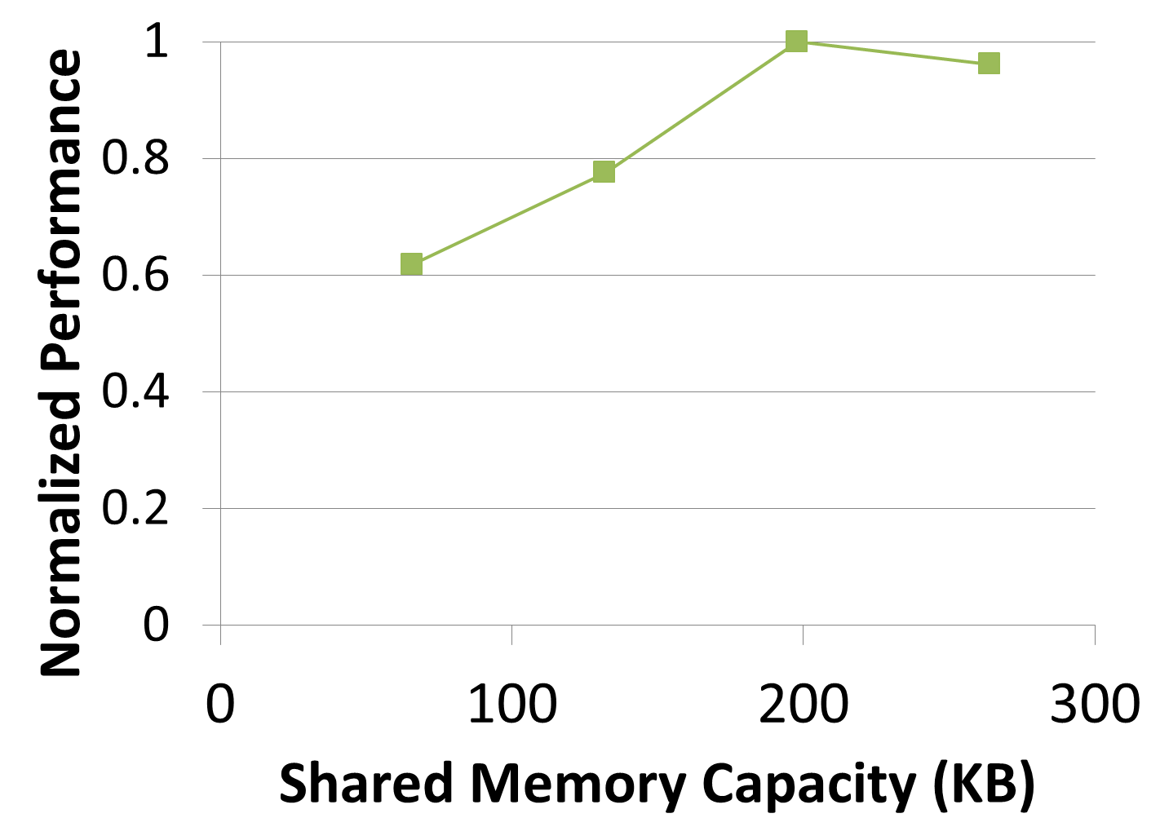
Shared Memory Sensitivity Study
Needle
256, 512, 768, 1024 threads per SM

Slide 11

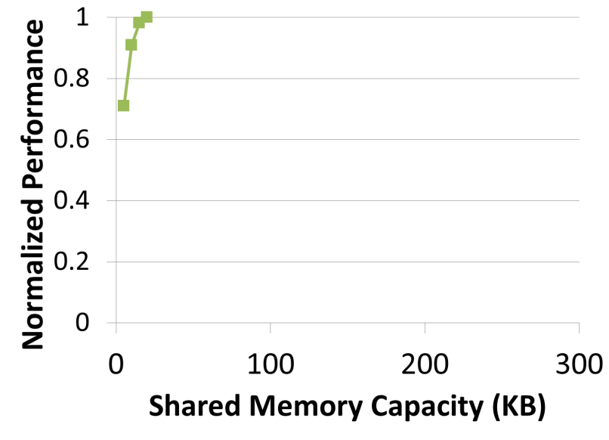
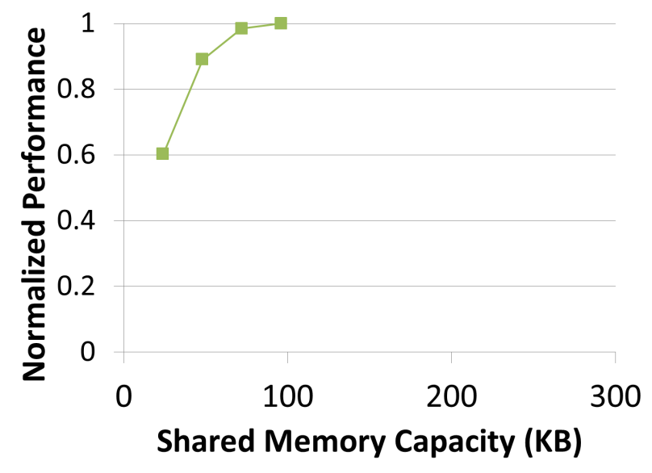
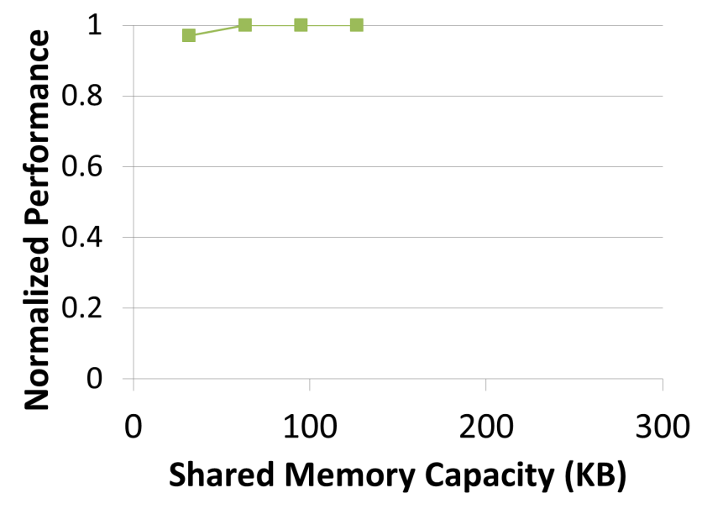
Shared Memory Sensitivity Study
Needle
PCR
LU
STO

Slide 12
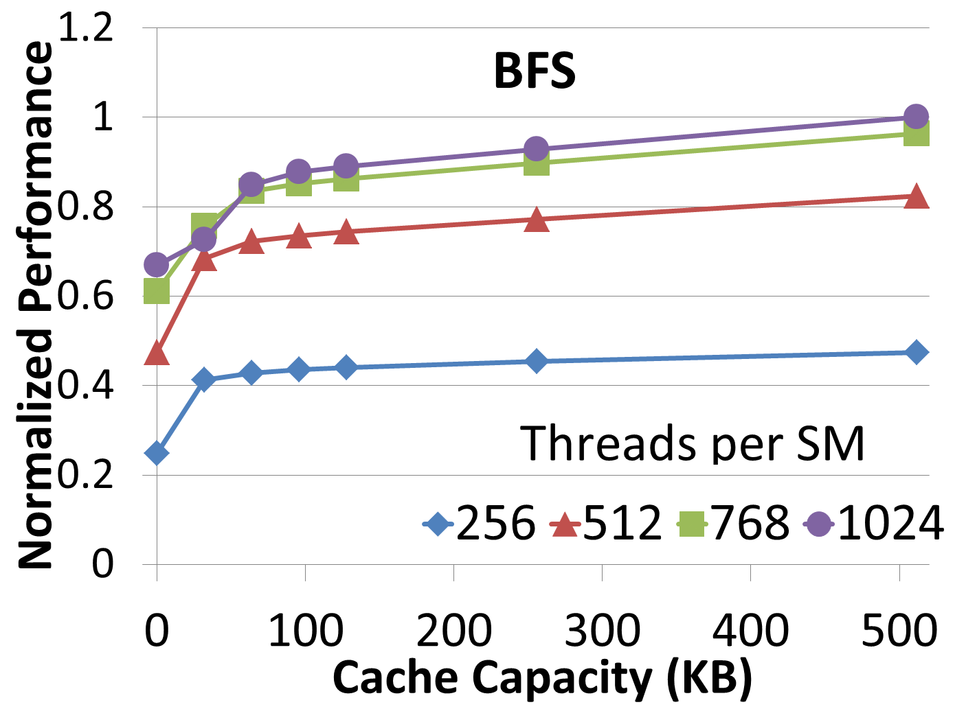
Cache Capacity Sensitivity Study

Slide 13

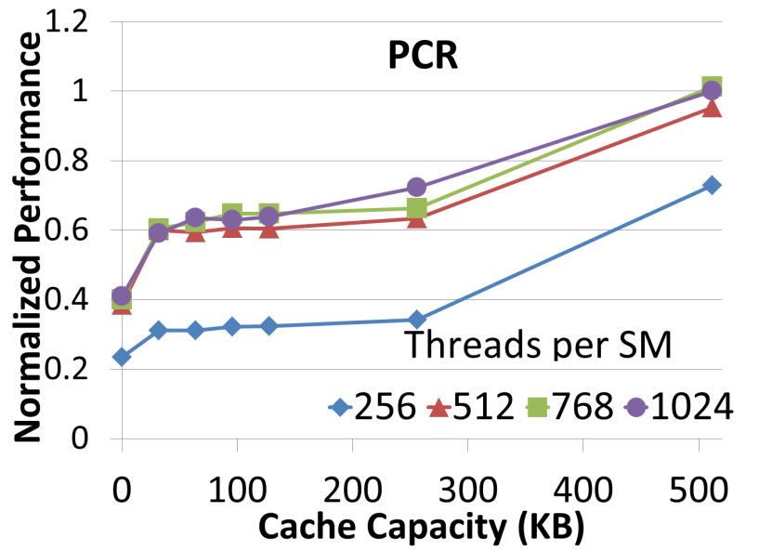
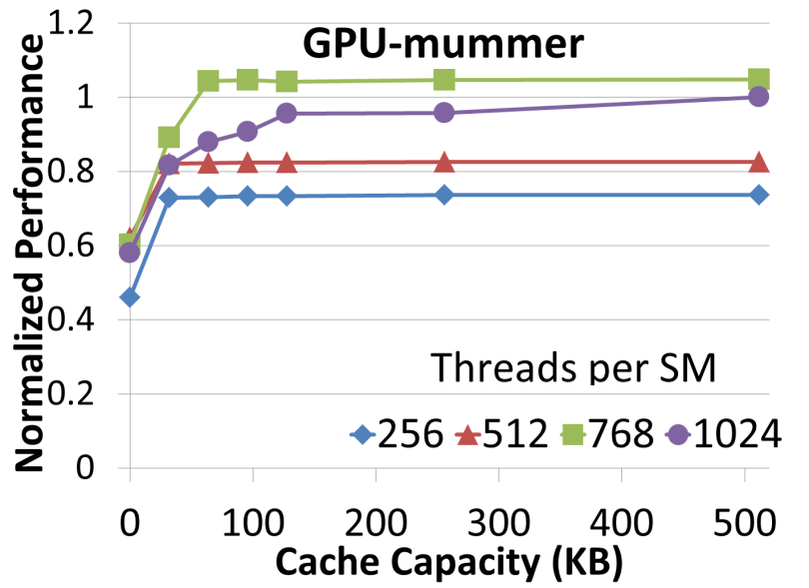
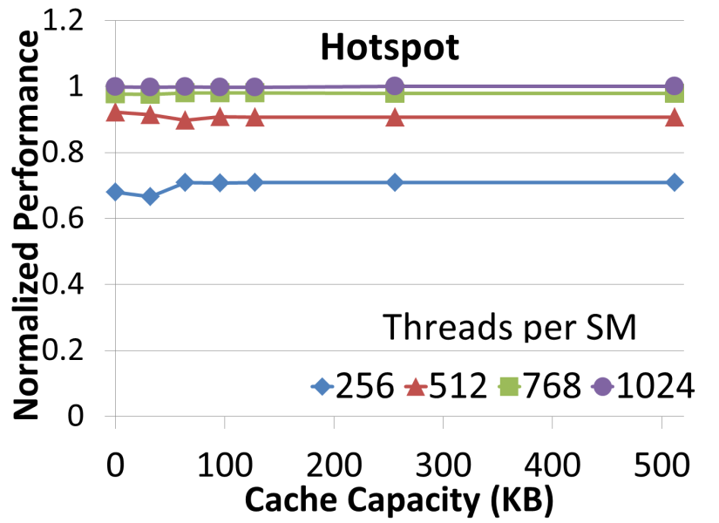
Cache Capacity Sensitivity Study

Slide 14
Workload Characterization Summary
Wide range of ideal capacities for each different type of memory
Performance is most sensitive to excessive register spills
Some applications see significant benefits from large caches
  Fewer DRAM accesses both improves performance and reduces energy

Slide 15
Proposed Design
Traditional Design
Proposed Unified Design
Program A Program B
Register File
Register File
Register File
Shared Memory
Shared Memory
Cache
Cache
Shared Memory
Cache
Challenges:
  Performance overhead of bank conflicts
  Energy overhead of bank access
  Allocation decisions

Slide 16
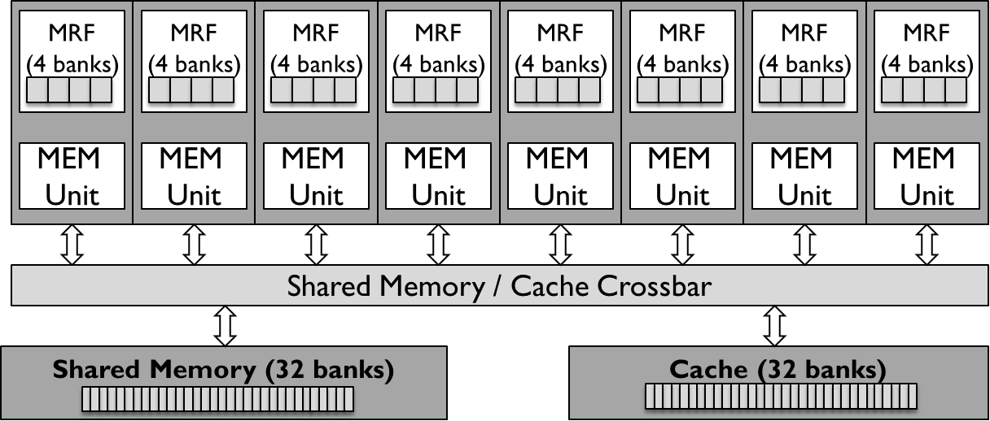
Baseline Microarchitecture
SM is composed of 8 clusters
Total of 96 banks
  32 register file banks
  32 L1 cache banks
  32 shared memory banks

Slide 17
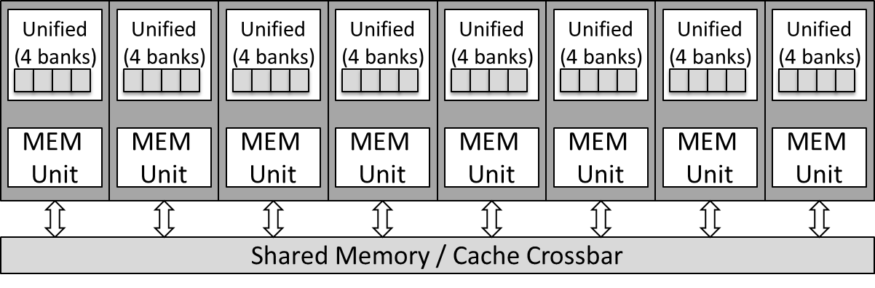
Unified Microarchitecture
Total of 32 unified storage banks
  Increase in bank conflicts
  Increase in bank access energy

Slide 18
Allocation Algorithm
Allocate enough registers to eliminate spills
Programmer dictates shared memory blocking
Maximize thread count subject to register and shared requirements
Devote remaining storage to cache
Compiler
Programmer
Registers per thread
Bytes of shared memory per thread
Runtime Scheduler
Number of threads to run
Cache capacity

Slide 19
Methodology
Generated execution and address traces with Ocelot
Performance and energy estimates come from custom SM trace-based simulator
30 CUDA benchmarks drawn from CUDA SDK, Parboil, Rodinia, GPGPU-sim
  22 with limited memory requirements that don’t benefit
  8 that see significant benefits

Slide 20
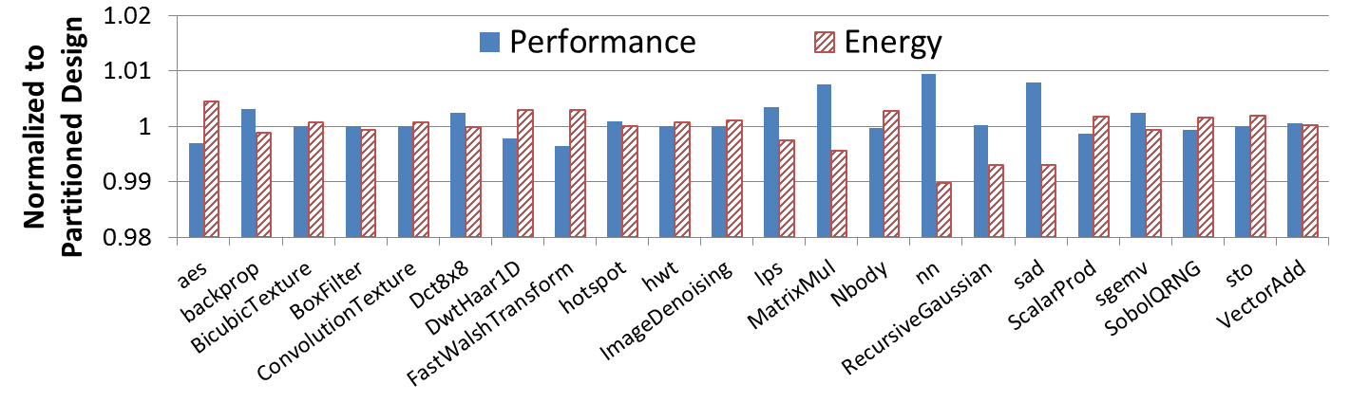
Overheads
For applications that don’t benefit
  <1% performance overhead
  <1% energy overhead

Slide 21
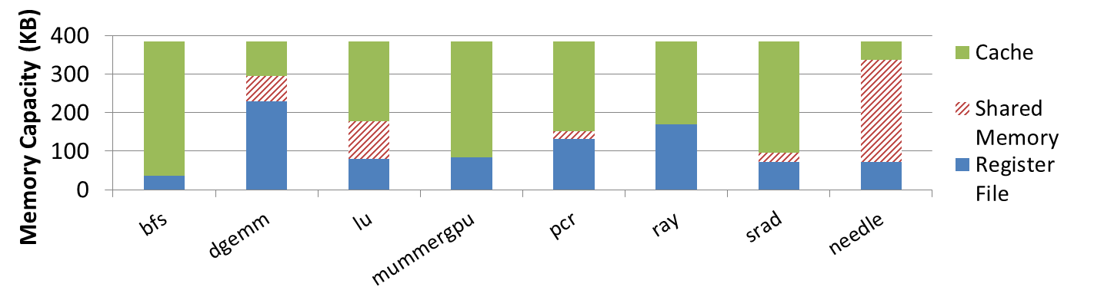
Allocation Decisions
Different allocation decisions are made across benchmarks
  Register file usage ranges from 50 to 250KB
  Cache usage ranges from 50 to 300KB
  Needle requires a large amount of shared memory

Slide 22
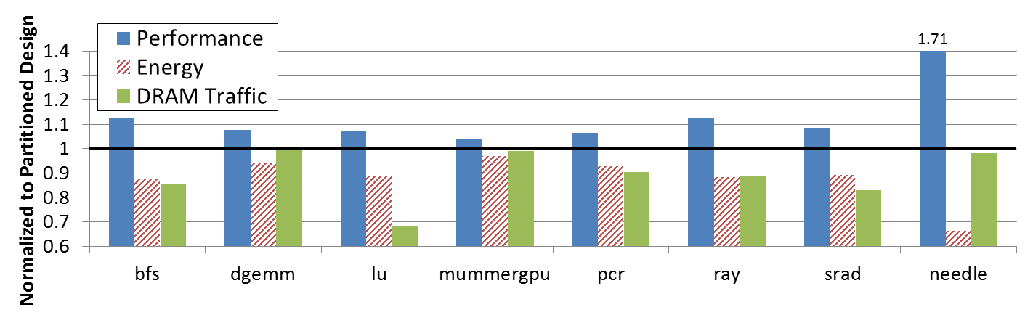
Results
Performance improvements range from 5—71%
Energy and DRAM reductions up to 33%
Leads to substantial efficiency improvements

Slide 23
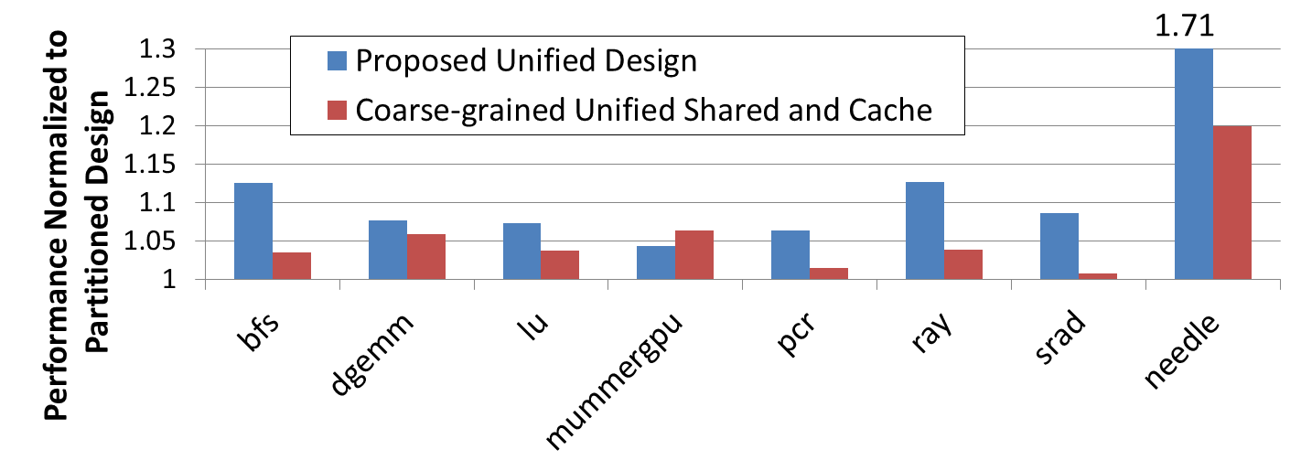
Comparison with Limited Flexibility
Unified design outperforms limited flexibility design that only unifies shared memory and cache
  mummergpu underperforms with unified design due to interactions with scheduler

Slide 24
Summary
Applications have diverse needs from on-chip storage
Unified memory presents minimal overheads
  Register file hierarchy mitigates bank conflicts
Moderate performance gains for large number of applications
Enables a more flexible system

