Slide 1



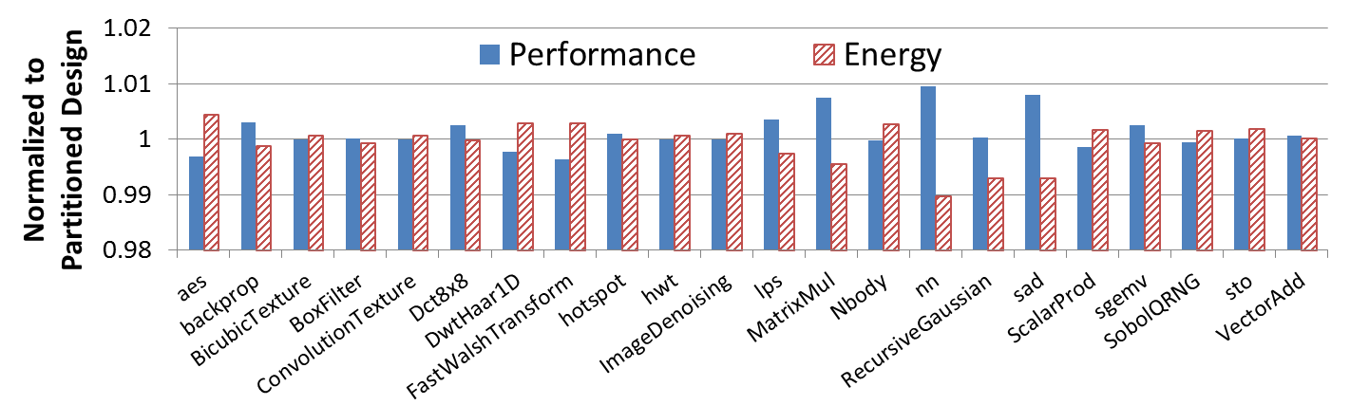
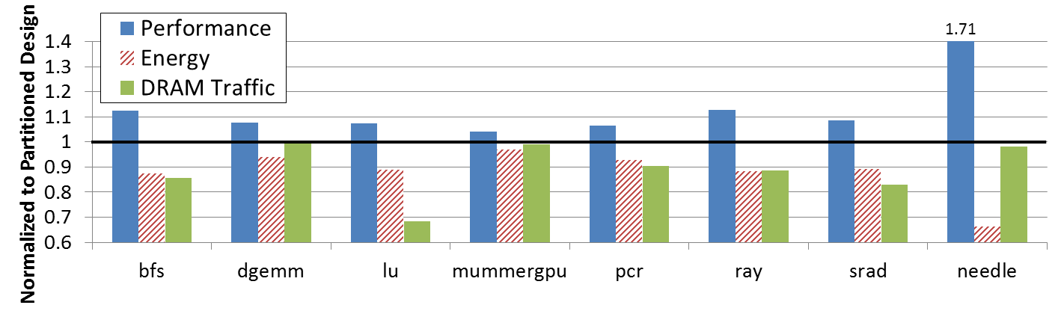
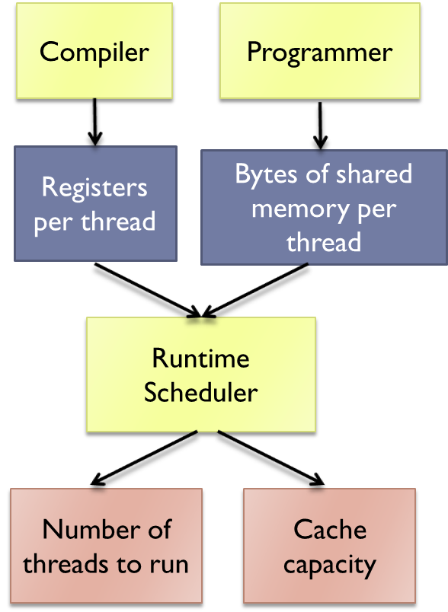
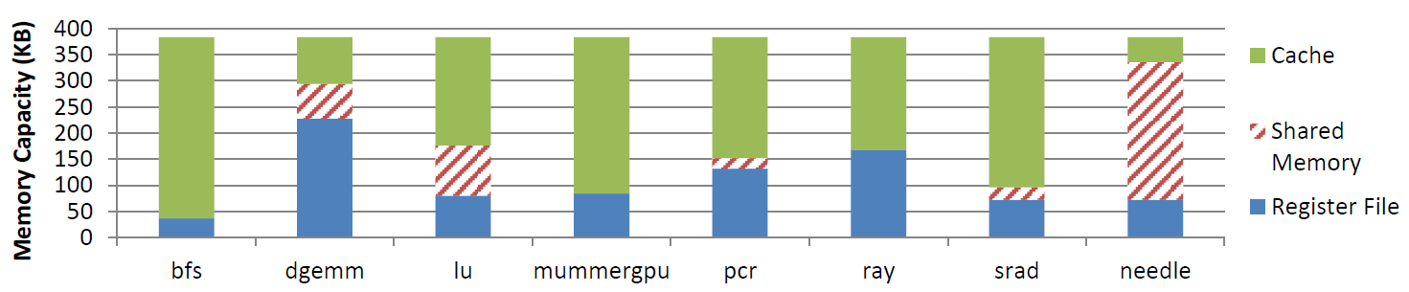
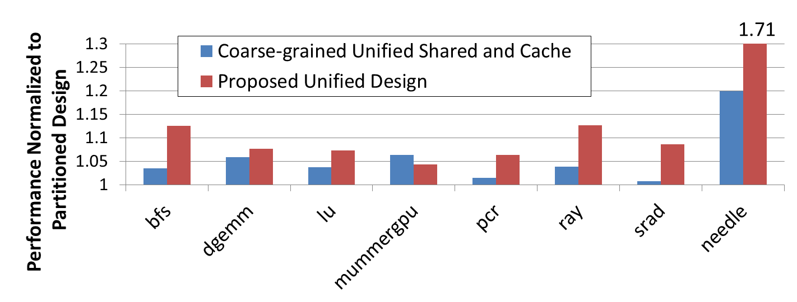
Unifying Primary Cache, Scratch, and Register File Memories in a Throughput Processor
Mark Gebhart^{1,2} Stephen W. Keckler^{1,2} Brucek Khailany² Ronny Krashinsky² William J. Dally^{2,3}
¹The University of Texas at Austin ²NVIDIA ³Stanford University
Motivation
Overview
GPUs have thousands of on-chip resident threads
  On-chip storage per thread is very limited
On-chip storage split between register file, scratchpad, and cache
Applications have diverse requirements between these three types of on-chip storage
Efficiently utilizing on-chip storage can improve both performance and energy
Results
Traditional Design
Proposed Unified Design
Register File
Program A Program B
Performance and energy overheads for benchmarks that do not benefit are less than 1%
Performance improvements up to 71% along with significant energy and DRAM reductions
Register File
Register File
Shared Memory
Cache
Shared Memory
Cache
Shared Memory
Cache
Automated algorithm determines most efficient allocation
Overheads are mitigated by leveraging prior work on register file hierarchy
Background
Microarchitecture
32 SMs per chip
Each SM contains:
  32 SIMT lanes
  Register file hierarchy
  256KB main register file
  64KB shared memory
  64KB primary data cache
Streaming Processor (SM)
MRF
(4 banks)
MRF
(4 banks)
MRF
(4 banks)
Total of 96 banks in baseline design
Unified design has only 32 banks
Challenges:
  Bank access energy
  Bank conflicts
SIMT Lanes
Baseline
MEM
Unit
MEM
Unit
MEM
Unit
ALU
SFU
MEM
TEX
Cache Tags
Register File Hierarchy
Shared Memory / Cache Crossbar
Main Register File
Shared Memory (32 banks)
Cache (32 banks)
Shared Memory Cache
Allocation Algorithm
Unified
(4 banks)
Unified
(4 banks)
Unified
(4 banks)
Allocate enough registers to eliminate spills
Programmer dictates shared memory blocking
Maximize thread count subject to register and shared requirements
Devote remaining storage to cache
Unified
MEM
Unit
MEM
Unit
MEM
Unit
Shared Memory / Cache Crossbar
Cache Tags
Methodology
Related Work
Generated execution and address traces with Ocelot
Performance and energy estimates come from custom SM trace-based simulator
30 CUDA benchmarks drawn from CUDA SDK, Parboil, Rodinia, GPGPU-sim
  22 with limited memory requirements that don’t benefit
  8 that see significant benefits
Fermi has a limited form of flexibility between shared memory and cache, programmer chooses either:
  16KB shared memory and 48KB cache
  48KB shared memory and 16KB cache

