Slide 1
Libra:Tailoring SIMD Execution using Heterogeneous Hardware and Dynamic Configurability
Yongjun Park¹, Jason Jong Kyu Park¹ , Hyunchul Park²,
and Scott Mahlke¹
December 3, 2012
¹University of Michigan, Ann Arbor
²Programming Systems Lab, Intel Labs, Santa Clara, CA

Slide 2


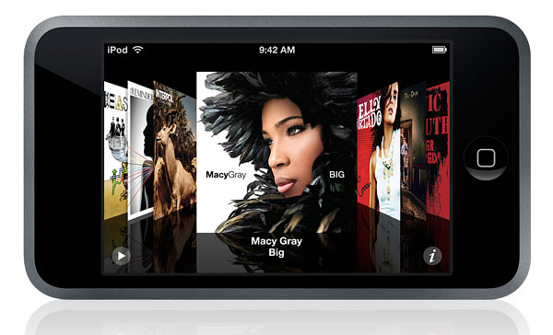
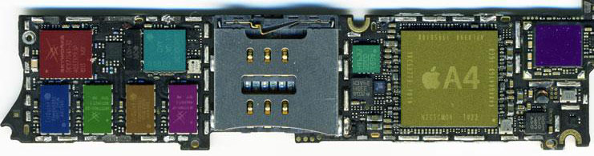
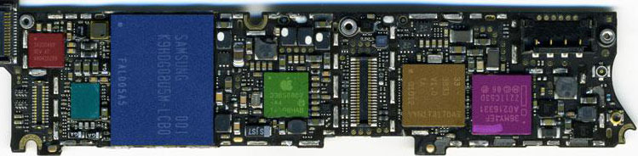
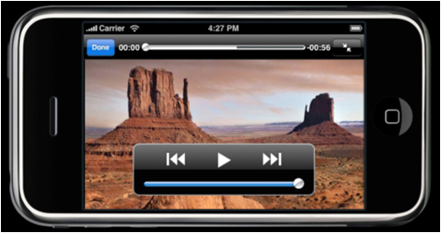
Convergence of Functionalities
Flexible
Accelerator!
4G Wireless
Audio
Video
3D
Navigation
Anatomy of an iPhone4
Convergence of functionalities demands a flexible solution due to the design cost and programmability

Slide 3



Current Mobile Solutions & Challenges
ILP-based
DLP-based
1.6 GHz ARM Cortex-A9
ULP GeForce
1.7 GHz Krait
Adreno 320
1.6 GHz ARM Cortex-A9
ARM Mali-400 MP4
Good for ILP
Good for DLP
legacy workloads
media processing
web browsing
Goal: Design of a unified accelerator with:
1. Scalability
2. Flexible execution support
3. Energy efficiency
scientific computing
wireless communication
Image processing
Mixture of ILP/DLP

Slide 4
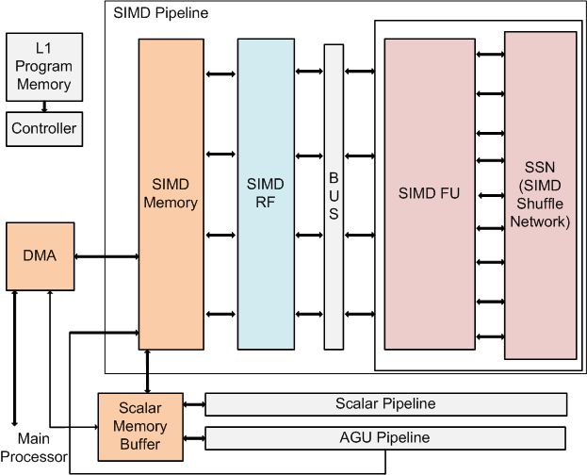
Traditional Homogeneous SIMD
Standard high performance machine for embedded systems
Industry: IBM Cell, ARM NEON, Intel MIC, etc.
Research: SODA, AnySp, etc.
Advantage
High throughput
Low fetch-decode overhead
Easy to scale
Disadvantage
Hard to realize high resource utilization
Example SIMD machine: 100 MOps /mW
Advanced goal: map broader range of applications into SIMD!
4

Slide 5
Exploration of Low Resource Utilization
AAC decoder
Input
Application
Huffman decoding
Acyclic
Loop
Inverse
Quantization
for ( …… ) {
}
Non-DLP
DLP
for ( …… ) {
IMDCT
}
Low-DLP
High-DLP
output
Execution Time Breakdown
@ 1-issue in-order core
High execution ratio on high data-parallel loops (~80%)
Traditional wide SIMD accelerator is frequently over-designed
The performance is limited by the non-high-DLP loops
Loop Execution Time Breakdown
@ 1-issue in-order core

Slide 6
Additional Flexibility on SIMD
Program flow
Non-DLP loop
DLP loop
Non-DLP loop
SIMD
Distributed VLIW
Control
Control
Control
RF
RF
RF
RF
FU
FU
FU
FU

Slide 7
Additional Flexibility on SIMD
Traditional SIMD
8
Libra
16
4
2
1
0
for ( …… ) {
0
1
}
1
2
2
3
3
4
4
5
5
6
6
7
7
DLP = 4
ILP = 1
Total: 4
DLP = 4
ILP = 4
Total = 16
DLP = 16
ILP = 1
Total = 16
DLP = 8
ILP = 2
Total = 16
DLP = 1
ILP = 16
Total = 16
DLP = 16
ILP = 1
Total: 16
DLP = 2
ILP = 8
Total = 16
DLP = 8
ILP = 1
Total: 8
DLP = 1
ILP = 1
Total: 1
8
DLP = 2
ILP = 1
Total: 2
8
9
9
10
10
11
11
12
12
13
13
Each logical lane has own ILP capability
The ILP capability is decided based on SIMD capability
Total degree of parallelism is consistent
All resources are utilized
14
14
15
15
Full DLP mode
Hybrid mode
Full ILP mode

Slide 8
Looks Good, but Too Expensive!
Control
Control
Control
Control
Control
Control
Control
Control
RF
RF
RF
RF
RF
RF
RF
RF
FU
FU
FU
FU
FU
FU
FU
FU
Notes:
However, the addition of whole interconnects and control units are too expensive!

Slide 9
Opportunity: Resource Utilization
Loop distribution over static ratio of multiply and memory instructions
for ( …… ) {
}
Small fraction of mul/mem instructions
Resource over-provision: Lane uniformity incurs inefficiency
Each SIMD lane provides the same functionalities
Only 32% (memory) and 16% (multiplication) of total dynamic instructions
More complex design, more static power consumption
High variation in the resource requirements of loops
Simple sharing leads to performance degradation

Slide 10
Adapting Heterogeneity (Homogeneous SIMD)
High DLP, 1 Multiplication
4-way SIMD w/ 4 multipliers
SIMD Lane
IPC = 4
M3
A0
A2
Lane 3
A1
ADD
0
1
ADD
M3
A0
A2
Lane 2
A1
ADD
2
M3
A0
A2
3
Lane 1
A1
Mul
M3
A0
A2
Lane 0
A1
Cycle
Notes:
The loop is divided by 4 and each lane can execute each of them

Slide 11
Adapting Heterogeneity (Heterogeneous SIMD)
High DLP, 1 Multiplication
4-way SIMD w/ 1 multiplier
SIMD Lane
IPC = 2.29
M3
M3
M3
M3
A0
A2
Lane 3
A1
Stall!!
M3
A0
A2
Lane 2
A1
M3
A0
A2
Lane 1
A1
M3
A0
A2
Lane 0
A1
Cycle
Notes:
However, when only lane 3 is supporting multiplication, severe performance overhead incurs b/c the remaining lanes are idle
When lane 3 executes multiplications of all lanes.

Slide 12
Adapting Heterogeneity (Heterogeneous SIMD + Flexibility)
High DLP, 1 Multiplication
4-way SIMD w/ 1 multiplier
SIMD Lane
IPC = 4
M3
M3
M3
Lane 3
M3
A2
A2
Lane 2
A2
A2
Logical lane 0
A1
A1
A1
Lane 1
A1
Lane 0
A0
A0
A0
A0
Cycle

Slide 13
Libra: Loop-adaptive SIMD Accelerator
Application
Heterogeneous SIMD
High-DLP loops
Traditional SIMD
0
Int
Expensive unit
0
1
Int
Expensive unit
0
Low/No-DLP loops
2
Int
Expensive unit
1
3
Int
Expensive unit
4
Int
Expensive unit
2
5
Int
Expensive unit
ExOp-intensive loops
1
6
Int
Expensive unit
3
7
Int
Expensive unit
Region-adaptive execution strategy customization
Key insights
Heterogeneous lane structure: less power/area
Dynamic configurability: change ILP/DLP capability
# of logical lanes: DLP, size of a logical lane: ILP

Slide 14
Libra Hardware Implementation
Each FU is only connected to the corresponding neighbors in adjacent PE groups
Intra-group Configurable Interconnect
Inter-group Configurable Interconnect
Dense 4x8 full crossbar
between FUs w/o writback
Integer ALUs in all 4 FUs
One multiplier and memory unit per PE group
Fully distributed nature including FUs, register files, and interconnections
No dynamic routing logic: all communications statically generated

Slide 15
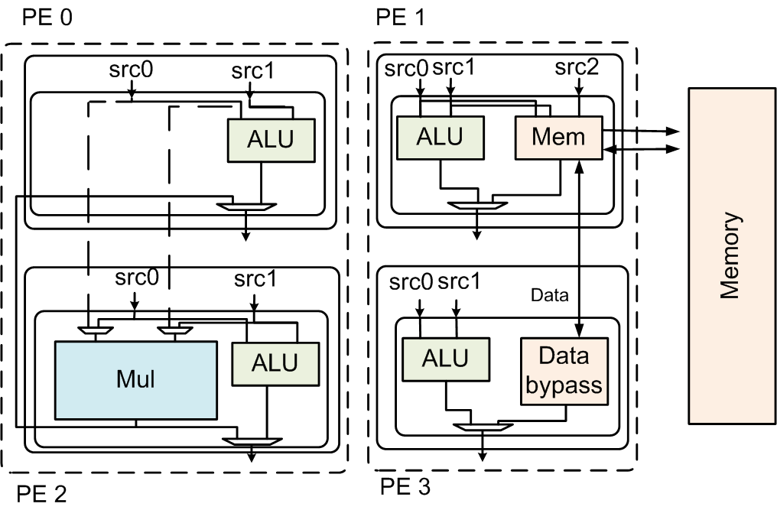
Resource Sharing @ Full DLP Mode
Logical Lane 0
A0
A1
B0
B1
C0
C1
D0
D1
Logical Lane 1
2-wide transfer
& data bypass
Simple hardware sharing
Execute 1 cycle difference for
avoiding resource contention

Slide 16
Compilation Overview
Generic C
program
Hardware
Information
Profile
Information
Compiler Front-end
Classifying the loop
Determine SIMDizability
Resource allocation
Set SIMD mode
Modulo
scheduling
List scheduling
w/ multi-threading
Set ILP mode
Code Generation
Executable

Slide 17
Experimental Setup
Target applications
Vision applications: SD-VBS [Venkata, IISWC '09]
Media benchmark: AAC decoder, H.264 decoder, and 3D rendering
Game physics benchmarks: line of sight, convolution, and conjugate
Target architecture: SIMD, clustered VLIW, and Libra
16 ~ 64 heterogeneous/homogeneous resources
IMPACT frontend compiler + cycle-accurate simulator
Power measurement
IBM SOI 45nm technology @ 500MHz/0.81V

Slide 18
Performance with Heterogeneous Hardware
Performance @ 32 heterogeneous datapath
Libra is 2.04x/1.38x faster than heterogeneous SIMD/VLIW
Notes:
Same resources.
Normalized execution time to 1issue cores, lower is better.
Yellow bar : execution time at non DLP loops
Blue bar: execution time at DLP loops
Libra beat SIMD the benchmarks with low DLP loops
Libra also beat the SIMD the benchmarks with high DLP loops for heterogeneity.
Libra is better than VLIW b/c the scheduling large unrolled loop in the wide resource has high difficulties
Libra is scalable

Slide 19
Scalability with Heterogeneous Hardware
Libra is scalable when having enough total ILP/DLP parallelism

Slide 20
Homogeneous SIMD vs. Heterogeneous Libra
Performance of Libra is better than SIMD
Energy consumption shows similar trend
Less expensive functional units can reduce the overall power overheads
Ex. Total 11% power overheads @ 32 PEs
Performance
Energy consumption
Power breakdown@32-PE
(+) Control power
overhead
(-) FU power saving

Slide 21
Mode Selection
Distribution of loop execution modes
Logical lane size
All available modes are used for considerable fraction
The mode is selected based on application characteristics

Slide 22
Conclusion
Mobile applications consist of loops with wide range of different level of ILP and DLP.
Heterogeneous SIMD lane structure can reduce the power overhead of over-provided resources.
Dynamic configurability enables broader applicability.
Libra outperforms traditional SIMD by 1.58x performance improvement with 29% less energy consumption on 32-PE architectures.

Slide 23

Questions?
For more information
http://cccp.eecs.umich.edu

