Slide 1


Supported by
Warped-DMR
Light-weight Error detection for GPGPU
Hyeran Jeon and Murali Annavaram
University of Southern California
Notes:
Hi everybody, I’m Hyeran Jeon and from university of southern california
My advisor is murali annavaram.
I’m going to introduce our work, Warped-DMR: the light weight error detection for GPGPU

Slide 2
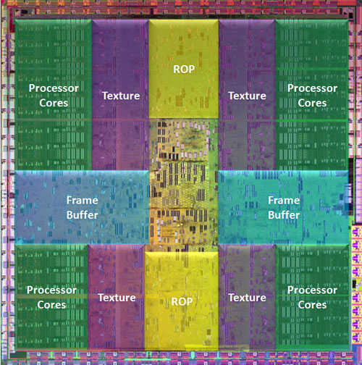
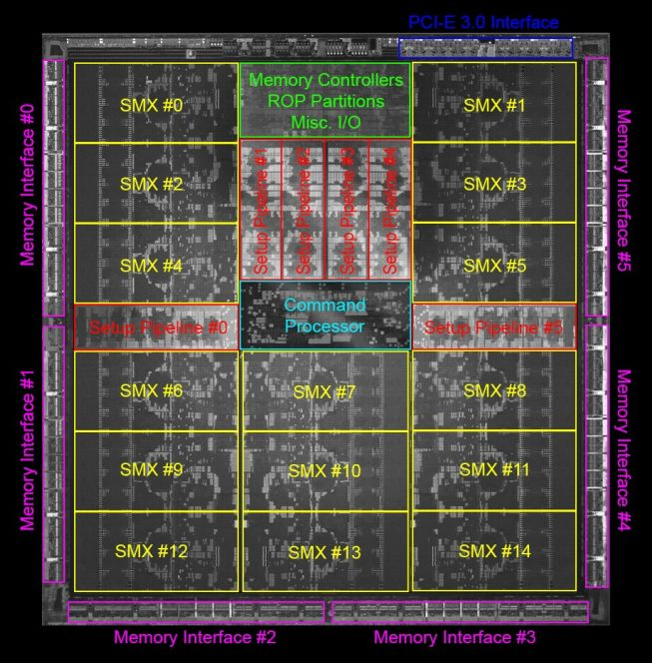
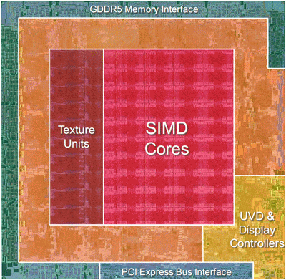
Reliability Concern in GPGPU
  Many of the top-ranked supercomputers are based on GPU
  The World #1 supercomputer, Titan(as of Nov. 12th) is powered by NVIDIA K20 GPU
Scientific computing is different to multimedia
  Correctness matters
  Some vendors began to add memory protection schemes to GPU
But what about the execution units?
  Large portion of die area is assigned to execution units in GPU
  Vast number of cores → Higher probability of computation errors
NVIDIA GT200
NVIDIA GK110
AMD RV770
Notes:
(click)
Recent few years, we could find many of the top ranked supercomputers in the world are powered by GPU.
Actually, as of November, the world number one supercomputer, Titan is powered by NVIDIA K20 GPU.
(click)
These supercomputers are using GPUs to run scientific computing by leveraging the general purpose computing ability of GPU.
Traditionally, GPU hasn’t had error protection feature because some pixel errors in the graphics applications are acceptable if it is not perceivable by human eye.
However, in the scientific or financial computings, even small calculation error is not forgivable.
Unsurprisingly, some GPU vendors started to add memory protection schemes like ECC to the latest GPU.
(click)
But, what about the execution units?
As you can see in the pictures of some GPU dies, the area of execution units is fairly large which has high possibility of errors.

Slide 3
GOAL : Design a light weight Error Detection Method for GPGPU processing cores (SPs, LD/STs*, SFUs)
  (Light-weight in both performance and resource addition)
  IDEA: Exploit under-utilized resources within a GPU for dual-modular redundant execution
  Warped-DMR = Inter-Warp DMR + Intra-Warp DMR
*: only address calculation is covered
Notes:
So, our goal is to design error detection method for GPGPU processing cores but in a light-weight way.
You know, GPU is mainly used in high performance computing so performance degradation due to reliability issue would not be acceptable.
(click)
Our baseline approach is to use dual modular redundancy but without adding extra processing cores unlikely to the traditional DMR.
We found that there are already hundreds of processing cores in the GPGPU and not all of them are always fully utilized.
By exploiting these underutilized resources, we could reduce the overhead in both area and performance perspective.
We explored the underutilization within warp as well as between warps and call each of them, Intra warp DMR and Inter warp DMR and together, Warped-DMR.

Slide 4
Underutilization of GPGPU Resources
  In NVIDIA GPU, a batch of 32 threads execute an instruction in SIMT fashion
  But, not all threads are active all the time
Can we use these idle resources?
< Execution time breakdown with respect to the number of active threads >
40% of execution time of BFS is run by 1 thread
Over 30% of execution time of BitonicSort is run by 16 threads
Notes:
As a motivation, we collected the number of active threads during the scientific application’s execution.
As you know, NVIDIA GPU executes instructions in a warp unit which has 32 threads.
But, not all the 32 threads are activated all the time.
(click)
40% of BFS’s execution is run by single thread, which means the rest 31 threads are inactive and the associative resources are wasted.
(click)
Also, in the BitonicSort, over 30% of execution time is spent by only 16 threads, which manes, during that time, half of the resources are not used.
(click)
We tried to find a way to leverage these idle resources

Slide 5
Observations
TWO REASONS OF UNDERUTILIZATION IN GPGPU
5/23
Notes:
We categorized the main reasons of underutilization in current GPGPU design into two.

Slide 6
GPU’s unique Architecture and Execution model
Instructions are executed in a batch of threads(warp or wavefront) unit
  Threads within a warp are running in lock-step manner by sharing a PC
Instructions are categorized into 3 types and executed on the corresponding execution units
  Arithmetic operations on SP, Memory operations on LD/ST, Transcendental instructions(i.e. sin, cosine) on SFU
Kernel
A Thread
Thread Block
...
Warp
SM
Scheduler/Dispatcher
Register File
SM
SP
LD/ST
SFU
Global Memory
GPU
Local Memory
Notes:
Before starting, let us briefly explore the unique architecture and execution model of current GPU
First of all, Instructions are executed in a batch of threads unit.
We call it either warp or wavefront.
Threads within a warp are executing in lock-stepping manner by sharing PC value
Second of all, for computation efficiency, instructions are categorized into 3 types and executed on the corresponding execution units
For example, arithmetic operations are assigned to SP, Memory operations are executed on LD/ST units, and some special functions are given to SFU
With this background knowledge, let us explore the two reasons of underutilization in GPGPU computing

Slide 7
Underutilization among homogeneous units
Since threads within a warp share a PC value, in a diverged control flow, some threads should execute one flow but the others not
active mask
warp execution
util
If(threadIdx.x % 2 == 0)
If(threadIdx.x % 2 == 0)
1111111111111111
100%
ret = funcA();
1010101010101010
ret = funcA;
ret = funcA;
Half of the processing cores are idle
50%
ret = funcB;
0101010101010101
ret = funcB();
ret = funcB;
50%
dst[threadIdx.x] = ret;
1111111111111111
dst[threadIdx.x] = ret;
dst[threadIdx.x] = ret;
100%
Notes:
First underutilization that we focused on was among homogeneous units.
As threads within a warp share a PC value, when a branch divergence is encountered, all the possible control flows should be explored sequentially.
Threads within the warp can be activated only when the current PC Is within the range of their own control flow.
Now, let’s see an example.
(click)
First, the if statement will be executed by all threads and the utilization is 100%.
(click)
But in the first diverged flow, only the even numbered threads are activated.
To control this, GPU uses active mask which contains as many bits as the number of threads within a warp.
When a thread has 1 in its position, the thread executes the instruction. Otherwise, the thread becomes inactive.
So, it has only 50% of utilization.
(click)
Likely, in the second diverged flow, only odd threads execute the instruction so again, the utilization is only 50%.
(click)
When the flows are merged, the utilization becomes 100% again.
As a result, in cycle 2 and 3, half of the processing cores are wasted

Slide 8
Underutilization among heterogeneous units
Dispatcher issues an instruction to one of three execution units at a time
  In worst case, two execution units among three become idle
Even with multiple schedulers or multi-issue dispatcher, there can be underutilized execution units due to dependencies among instructions
time
util
SP
SP
SP
SP
LD/ST
LD/ST
LD/ST
LD/ST
SFU
SFU
1:
SIN
SIN
1/3
2:
LD
LD
LD
2/3
More than half of the
processing cores are wasted
3:
FADD
FADD
FADD
2/3
4:
FFMA
2/3
FFMA
FFMA
5:
MOV
1/3
MOV
MOV
6:
ST
1/3
ST
ST
Notes:
The second reason of underutilization in current GPU designs we found is among heterogeneous units.
As mentioned earlier, GPU has 3 different type execution units.
As a dispatcher can issue an instruction to one of the three type execution units, in worst case, two of the three execution units should be idle.
Some lastest GPUs have multiple schedulers that can issue multiple instructions so the percentage of the underutilization among heterogeneous units might be reduced. However, in that case also, due to data dependencies among instructions, there still is a possibility of underutilization.
Let us see an example of a code execution.
We have 6 instructions to execute. As noted, Sin will be executed on SFU, LD and ST will be given to LD/ST unit, and the rest operations will be given to SP.
Since current GPUs have less number of SFUs than the other units, we assume that SFU has one forth as many cores as the number of the other two execution unit types. So, SFU will take 4x cycles to finish the execution compared to the other execution units.
(click)
When Sin is issued, SP and LD/ST units become idle and only SFUs are utilized.
(click)
In the next cycle, LD/ST units become active to execute LD instruction while SFU is still executing the sin instruction.
(click)
In the next cycle, SP becomes active to execute Floating point ADD instruction while LD/ST unit becomes idle as the LD instruction is finished.
(click)
Next cycle is the same. At cycle 5, SFU becomes also idle as it consumed all 4 cycles to finish sin instruction.
(click)
In the last cycle, to execute Store instruction, LD/ST units become active and the others become idle.
As a result, in this simple example, there is not a case that all the execution units are utilized.
And we can see that during the half of the cycles, more than half of the processing cores are idled.

Slide 9
WARPED-DMR
EXPLOITING THE TWO KINDS OF UNDERUTILIZATION FOR COMPUTATION ERROR DETECTION
9/23
Notes:
Based on the observations, we propose warped dmr which exploits the two kinds of underutilization for computation error detection.
Warped-DMR consists of two kinds of dmrs: intra-warp dmr and inter-warp dmr
Let me explain intra-warp dmr first.

Slide 10
Intra-Warp DMR: Exploiting underutilized resources among homogeneous units
For any underutilized warps, the inactive threads within the warp duplicate the active threads’ execution
  Active mask gives a hint for duplication selection
If the result of the inactive and active thread mismatches → ERROR detected!!
SP 1
SP 2
Intra-Warp DMR works well for underutilized warps.
BUT,
What if warps are full?
If(cond) {
b++;
} else {
b--;
}
a = b;
Cond?
time
Cond?
V
b++
b++
b++
DMR
same
OK
COMP
V
b--
b--
b--
DMR
different
a = b
COMP
ERROR!!
a = b
Flush & Error Handling
  Assume we have 2 threads in a warp, each runs on it’s own dedicated core
Notes:
Intra warp dmr is to reuse the resources idled due to underutilization among homogeneous units.
For any underutilized warps, the inactive threads within the warp duplicate the active threads execution.
And then, the computation results are compared at the end of the execution stage.
In the similar example as previous, let us see what is changed.
Assume we have two SPs and a warp has two threads. First if clause is executed on SP1 by thread 1 and
The second if clause will be executed on SP2 by thread 2.
The normal execution looks like this.
SP2 is idle in the second cycle and SP1 becomes idle in the third cycle.
But, with intra-warp dmr, SP2 is used to do DMR of SP1’s execution.
The results are compared at the end of the execution stage.
Likely, in the third cycle, SP1 is used to do DMR of SP2’s execution.
If the results are different, we can think that one of the two SPs have some fault and then the proper error handling can be done quickly.
Error handling is out of the scope of our work but one option will be flush the next instructions and redo the previous instruction again.
As Intra-Warp DMR reuses existing execution units, the area overhead is negligible.
Only the comparator and some data forwarding units will be added. These will be explained later.
(click)
Intra-warp dmr works well for underutilized warps but what if warps are full and we don’t have any idle resources within the warp?

Slide 11
Inter-Warp DMR: Exploiting underutilized resources among heterogeneous units
In any fully utilized warps, the unused execution units conduct DMR of an unverified previous warp’s instruction that has the corresponding instruction type
If the result of the stored original execution and the new result mismatches → ERROR detected!!
SPs
LD/STs
SFUs
warp4: sin.f32 %f3, %f1
sin
sin
sin
sin
warp1: ld.shared.f32 %f20,[%r99+824]
sin
warp1: ld.shared.f32 %f20,[%r99+824]
warp1: ld.shared.f32 %f20,[%r99+824]
ld
ld
warp2: add.f32 %f16, %f14, %f15
V
warp2: add.f32 %f16, %f14, %f15
warp2: add.f32 %f16, %f14, %f15
DMR
add
ld
V
warp1: ld.shared.f32 %f21, [%r99+956]
add
warp1: ld.shared.f32 %f21, [%r99+956]
warp1: ld.shared.f32 %f21, [%r99+956]
DMR
add
ld
ld
warp2: add.f32 %f18, %f12, %f17
V
warp2: add.f32 %f18, %f12, %f17
warp2: add.f32 %f18, %f12, %f17
V
add
sin
add
V
ld
warp3: ld.shared.f32 %f2, [%r70+4]
DMR
warp3: ld.shared.f32 %f2, [%r70+4]
warp3: ld.shared.f32 %f2, [%r70+4]
DMR
DMR
add
ld
V
ld
DMR
ld
time
  Assume 4x cycles are taken to execute instructions on SFU
Notes:
To verify the execution results of fully utilized warps, we propose inter-warp dmr.
Inter warp dmr is to reuse the resources idled due to underutilization among heterogeneous units.
For any fully utilized warps, the unused execute units among the three different type execution units conduct DMR of
One of the unverified previous warps’ execution.
And then, the computation result and the stored previous execution result are compared.
In the similar example as previous, let us see what is changed.
Assume all these six instructions are executed by all 32 threads within the warps.
(click)
The normal execution looks like this. At any point of time, maximum of two execution units are activated. We also assume that SFU takes 4x cycles to execute an instruction compared to the other two execution units.
(clickx3)
But, with inter-warp dmr, at the cycle three when add is issued to SP, LD/ST unit does the DMR of the previous ld instruction.
(click)
Likely, add instruction also can be DMRed at cycle 4 and the sin instruction is verified one cycle later than the original execution finishes.
(clickx)
In this example, luckly, all the instructions could be verified right after the original execution as different type instructions are interleavingly scheduled.
However, there is a possibility that the same type instructions are issued for several cycles in a row.
In that case, instead of stalling the pipeline to verify the instruction, we store the unverified instructions to a buffer so that they can be verified anytime later when the corresponding execution unit becomes idle.
Inter-Warp DMR reuses existing execution units like in Intra-warp dmr so the area overhead is small except the buffer to store the unverified instructions.
But, we will show later that only with small size buffer, the stall cycles can be reduced quite well.

Slide 12
Architectural support
12/23
Notes:
Now that we explored the idea of warped dmr, let us see the architectural supports needed to realize the idea.

Slide 13
Baseline Architecture
An SM has
  32x128-bit Banked register file
    each bank consists of 4 32bit registers of 4 SIMT lanes having the same name
  8 SIMT Clusters
    Each consists of 4 register banks and (3 types x 4 each)* execution units
* Simplified configuration : actual commercial GPGPUs have fewer SFUs
Register File
4x128-bit Banks
(1R1W)
th3.r0
th3.r1
.
.
th2.r0
th2.r1
.
.
th1.r0
th1.r1
.
.
th0.r0
th0.r1
.
.
8 SIMT Clusters
Operand buffering
A Register Bank
Shared Memory
A SM
SPs
SFUs
LD/STs
A SIMT Cluster
The baseline architecture is borrowed and simplified* from M.Gebhart et.al., ISCA’11
Notes:
We borrowed the baseline architecture model of Mark Gebhart’s paper of ISCA 2011.
A SM has 8 SIMT Clusters and each SIMT cluster consists of 4 128bit register banks and 4 SIMT lanes.
Each entry of a register bank has 4 32bit registers of the 4 SIMT lanes having the same name.
We tweaked the design a little bit for simplification that each SIMT cluster has four copies for all three different execution units.
Actual commercial GPGPUs have smaller number of SFU as showed in the previous simulation.

Slide 14
Intra-Warp DMR: 1) Register Forwarding Unit
To have the pair of active and inactive threads use the same operands, RFU forwards active thread’s register value to inactive thread according to active mask
  Overhead : 0.08ns and 390um² @ Synopsis Design Compiler
th3.r0
th3.r1
.
.
th2.r0
th2.r1
.
.
th1.r0
th1.r1
.
.
th0.r0
th0.r1
.
.
RF
Register Forwarding Unit
SP
SP
SP
SP
active mask
EXE
Comparator
ERROR!!
WB
Notes:
To do Intra-warp DMR, the operands of active threads should be forwarded to inactive threads.
As adding more ports and wires are quite expensive, it is believed that the execution units of a SIMT lane is wired only to the sub portion of the register bank.
Which means, SP in the SIMT lane 0 should have 32 bit channel only between the bit lines having thread 0’s registers.
To reduce the wiring cost, instead of wiring all the bit lines to all the SIMT lanes, we put register forwarding unit at the end of each register bank.

Slide 15
Intra-Warp DMR: 1) Register Forwarding Unit
To have the pair of active and inactive threads use the same operands, RFU forwards active thread’s register value to inactive thread according to active mask
  Overhead : 0.08ns and 390um² @ Synopsis Design Compiler
th3.r1
th2.r1
th1.r1
th0.r1
th3.r0
th3.r1
.
.
th2.r0
th2.r1
.
.
th1.r0
th1.r1
.
.
th0.r0
th0.r1
.
.
1100
RF
th3.r1
th2.r1
th3.r1
th2.r1
Register Forwarding Unit
SP
SP
SP
SP
active mask
EXE
Comparator
ERROR!!
WB
Notes:
Register forwarding unit has four 4 32bit input priority based MUXes.
Active mask is used as a selector.
(click)
When active mask is 1100 which means thread 3 and 2 is active and 1 and 0 is inactive for the given instruction,
(click)
The MUXes in the active SIMT lane propagate its own register value and
The MUXes in the inactive SIMT lane forwards one of the active lane’s value instead of its own.
So, the SIMT lane 0 and 1 can get the operands of SIMT lane 2 and 3.
With the same operand, the inactive SIMT lane can do DMR of the active lane and the results are fed to a comparator to be compared.

Slide 16
Intra-Warp DMR: 2) Thread-Core mapping
For the warps having unbalanced active thread distribution, the error coverage by Intra-Warp DMR might be limited(even impossible in some cases)
Slight modification on thread-core affinity in scheduler improves the error coverage
SIMT Cluster
Active mask
1
1
1
1
1
1
0
0
0
0
0
0
Core
1
1
1
1
1
0
1
0
1
1
1
1
0
0
0
0
0
1
0
1
0
0
0
0
Error Coverage : 0/4 2/2 0/0 → 2/6 = 25%
All Active All Inactive
Error Coverage : 2/2 2/2 2/2 → 6/6 = 100%
Notes:
From out experiments, we found that warps are likely to have unbalanced active thread distribution.
As Intra-warp DMR is done only within a SIMT Cluster, if active threads are consolidated to some of the SIMT clusters,
Some clusters might not be able to do Intra-warp DMR.
It is believed that in the current GPU designs the threads are mapped to cores in order: for example, thread 0 is always executed on core 0, thread 1 is mapped to core 1 and so on.
(click)
In this mapping method, as you can see, the first SIMT Cluster and the last SIMT Cluster will have 0 error coverage as they are packed with all active or all inactive threads even though the warp has equal number of active and inactive threads.
So, instead, we assigned threads in round robin fashion like the first thread is assigned to the first SIMT cluster and the second thread is assigned to the second SIMT cluster and so on.
(clickx)
This can be done in warp scheduler without adding extra logic to the architecture.
We’ll show you the effectiveness of this thread-core remapping later.

Slide 17
Inter-Warp DMR: 1) Replay Checker
To find availability of execution units for Inter-Warp DMR, Replay checker checks the instruction type in RF and Decode stage and commands replay if different
DEC
SP
different
CHECKER
RF
MEM
replay
V
DMR
MEM
CORE
CORE
CORE
MEM
MEM
EXE
SP
MEM
SFU
Notes:
To do inter warp dmr, the instruction type should be checked to find if the instruction can be dmred right after the original execution.
A replay checker is triggered when the warp in the register file stage is fully utilized.
(click)
Then, it checks the type of the instructions in the register file stage and the following instruction.
(click)
If the instructions have different type, it commands replay to the execution unit associated with the instruction that was in the register file stage instead of letting it become idle.
As the operands are still remained in the pipeline, the DMR can be done easily

Slide 18
Inter-Warp DMR: 2) ReplayQ
If the same type instructions are issued consecutively, the information needed for future replay is enqueued to ReplayQ
  Opcode, Operands, and Original execution result for 32 threads (around 500B for each entry)
A different type instruction from ReplayQ is dequeued to be co-executed with the instruction in Decode stage
DEC
SP2
same
CHECKER
SFU
SP1
V
RF
DMR
enqueue
& search
SFU
SP0
SP1
CORE
CORE
CORE
MEM
MEM
EXE
SP
MEM
SFU
ReplayQ
Notes:
If the same type instructions are issued consecutively, the instruction can not be verified in the following cycle so
We use replayQ to store the unverified instruction so that it can be verified anytime later when the corresponding execution unit becomes idle.
(click)
In this example, replay checker checks the instruction type and then finds the instruction types are the same.
(click)
So it searches the replayQ to find instruction that has different type.
If there’s any, it is dequeued from the replayQ and co-executed with the instruction SP2 and the unverified instruction,SP1 is enqueued to the replayQ

Slide 19
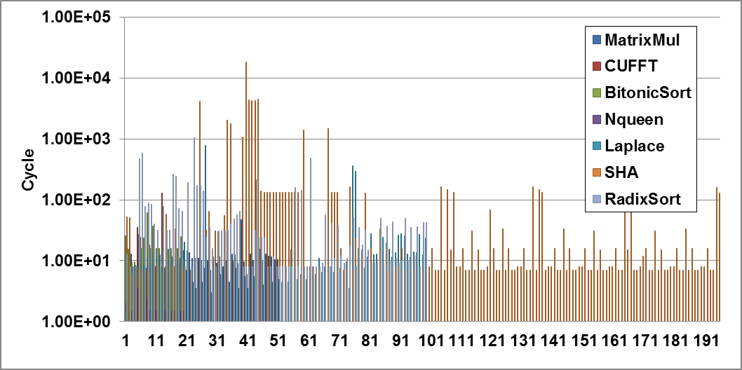
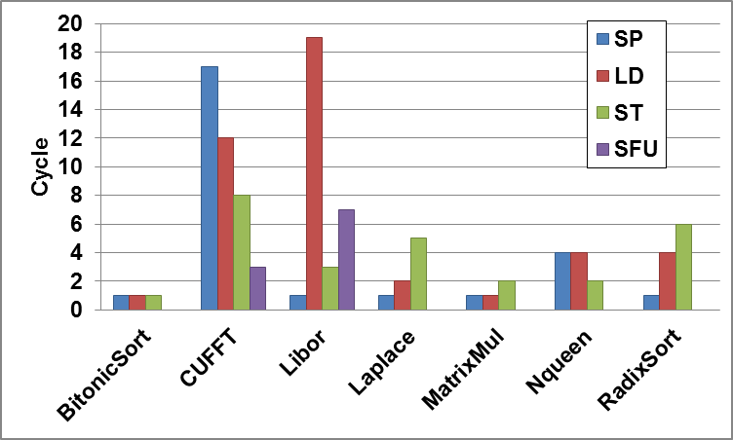
Key factors for effective ReplayQ size determination
RAW dependency distance among registers (RDD)
  Pipeline is stalled whenever there is RAW dependency on the unverified instructions
  ReplayQ that is bigger than RDD is waste of resource
Instruction type switching distance (ITSD)
  Instructions should be enqueued to ReplayQ until different type instruction is issued
  ReplayQ should afford at least the instructions within ITSD
ITSD < Effective ReplayQ size < RDD
8 ~ 100 cycles
~ 6 cycles
RDD of the registers of warp1 thread 32
Avg. ITSD within 1000 cycles
Notes:
To determine the effective replayQ size, we focused on two key factors: raw dependency distance among registers and instruction type switching distance.
The replayq only maintains the instructions until when it doesn’t cause any dependency issues.
Whenever there is a raw dependency between the instructions within the replayQ and the instruction that is to be issued, pipeline is stalled and the instruction in
the replayq is firstly verified.
Therefore, even though replayq can afford more instructions, we cannot store more instructions than the raw dependency distance.
And hence a replayq which is bigger than rdd is waste of resource.
Also, ReplayQ should be able to enqueue the instructions at least until different type instruction is issued.
So, replayq should be bigger than the instruction type switching distance.
(click)
So, the effective replayQ size should be inbetween these two distances.
From our experiments, the benchmarks that we used has average of 8 to 100 cycles of rdd and around 6 cycles of itsd.
The effective replayq should be inbetween these two values.
We used 10 entries in our expriments.

Slide 20
Evaluation
Simulator : GPGPU-SIM v3.0.2
Workloads : Non-Graphics Applications from CUDA SDK, Parboil, ERCBench
Category | Benchmark | Parameter
Scientific | Laplace Transform | gridDim = 25×4, blockDim = 32×4
 | Mummer | input f iles : NC_003997.20k. f na and NC_003997_q25bp.50k. f na
 | FFT | gridDim = 32, blockDim = 25
Linear Algebra/Primitives | BFS | input file : graph65536.txt, gridDim = 256, blockDim = 256
 | Matrix Multiply | gridDim = 8×5, blockDim = 16×16
 | Scan Array | gridDim = 10000, blockDim = 256
Financial | Libor | gridDim = 64, blockDim = 64
Compressin/Encryption | SHA | directmode, inputsize : 99614720, gridDim = 1539, blockDim = 64
Sorting | Radix Sort | –n = 4194304 –iterations = 1 –keysonly
 | Bitonic Sort | gridDim = 1, blockDim = 512
AI/Simulation | Nqueen | gridDim = 256, blockDim = 96
Notes:
As our focus is to enhance computing correctness in scientific computing, we collected workloads from three different benchmark suites that are categorized into 6 main scientific and finantial applications.
GPGPU sim is used.

Slide 21
Error Coverage
Percentage of instructions that are checked by Warped-DMR
The coverage of [4 core SIMT cluster + Cross mapping] is higher(96%) than 8 core SIMT cluster configuration by 5%
Error coverage with respect to SIMT cluster organization and Thread to Core mapping
Notes:
We firstly measured error coverage by varying SIMT cluster configuration and thread-core mapping.
We found that the proposed thread-to-core mapping enhances the error coverage by 5% even compared to 8 core SIMT cluster configuration.

Slide 22
Overhead
Normalized kernel simulation cycles when Warped-DMR is used
Small number of ReplayQ entries can reduce the performance overhead effectively
Normalized Kernel Simulation Cycles with respect to ReplayQ size
Notes:
We also measured the kernel simulation cycles by varying the replayq size.
In some applications like BFS which doesn’t have fully utilized warp at all, the timing overhead is almost zero as all the active thread’s execution can be verified
By the inactive thread while active thread’s are executing.
But, some applications like laplace and matrix multiply showed quite a large overhead up to 70% but we could find that the replayq effectively reduces the timing overhead.

Slide 23
Conclusion
Reliability is critical for GPGPUs due to their wide-usage in scientific computing
Explored two main reasons of resource underutilization in GPGPU computing: among homogeneous units and among heterogeneous units
Intra-Warp DMR exploits the idle resources of inactive threads within a warp to verify the active threads’ execution
Inter-Warp DMR exploits the idle execution units among three different execution units to verify fully utilized warps
Warped-DMR covers 96% of computations with 16% performance overhead without extra execution units
Notes:
As a conclusion, we claimed the reliability is critical for GPGPU due to their wide-usage in scientific computing
Firstly, we explored two main reasons of resource underutilization in GPGPU computing
And designed two different DMR schemes to leverage the idle resources due to the underutilizations.
For the underutilized warps, Intra-Warp DMR is designed to use the inactive threads to verify the active threads’ execution
For the fully utilized warps, Inter-Warp DMR is designed to use the idle execution units to verify unverified previous warps’ execution
As a result, Warped-DMR covers 96% of computations with 16% performance overhead without extra execution units

Slide 24
Thank you!

