Slide 1

Control-Flow Decoupling
Rami Sheikh, James Tuck, and Eric Rotenberg
Center for Efficient, Scalable, and Reliable Computing
Department of Electrical and Computer Engineering
North Carolina State University

Slide 2
Single-thread Performance is Important
14% - 33%
generation to
generation gains
Conroe
Nehalem
Haswell
Sandy Bridge
*Source: AnandTech website
OoO scheduling
window doubled
192
14-17 cycles (?)
*Source: Intel IDF presentations
168
128
14-17 cycles
Pipeline depth
remains high
17-cycle
96
*Source: AnandTech website
15-cycle
Notes:
Performance
Single-thread performance is important
Power
More cores on chip coupled with stalled supply voltage scaling
Processor designers aim for energy proportionality
Eliminating branch mispredictions is a dual win
Improves performance and saves energy

Slide 3
Energy is Important
More Cores
Constant Supply Voltage
Need to Reduce Per-core Energy

Slide 4
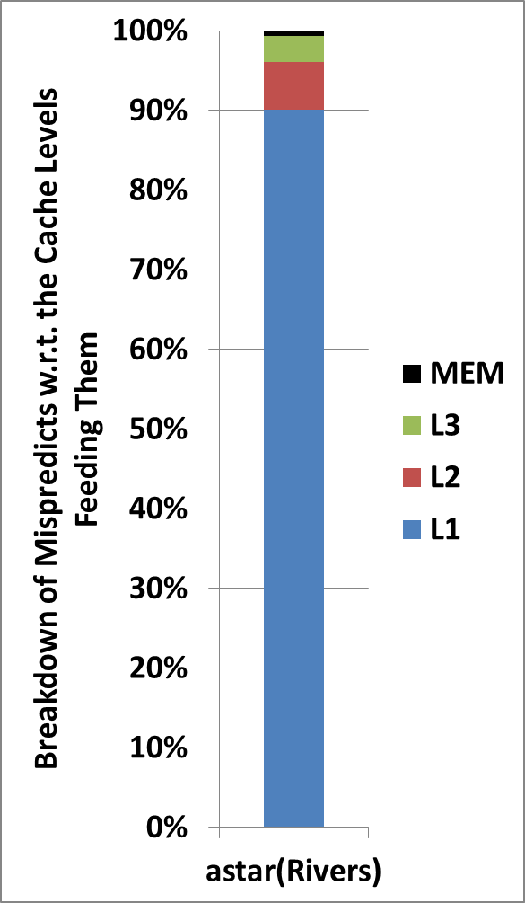
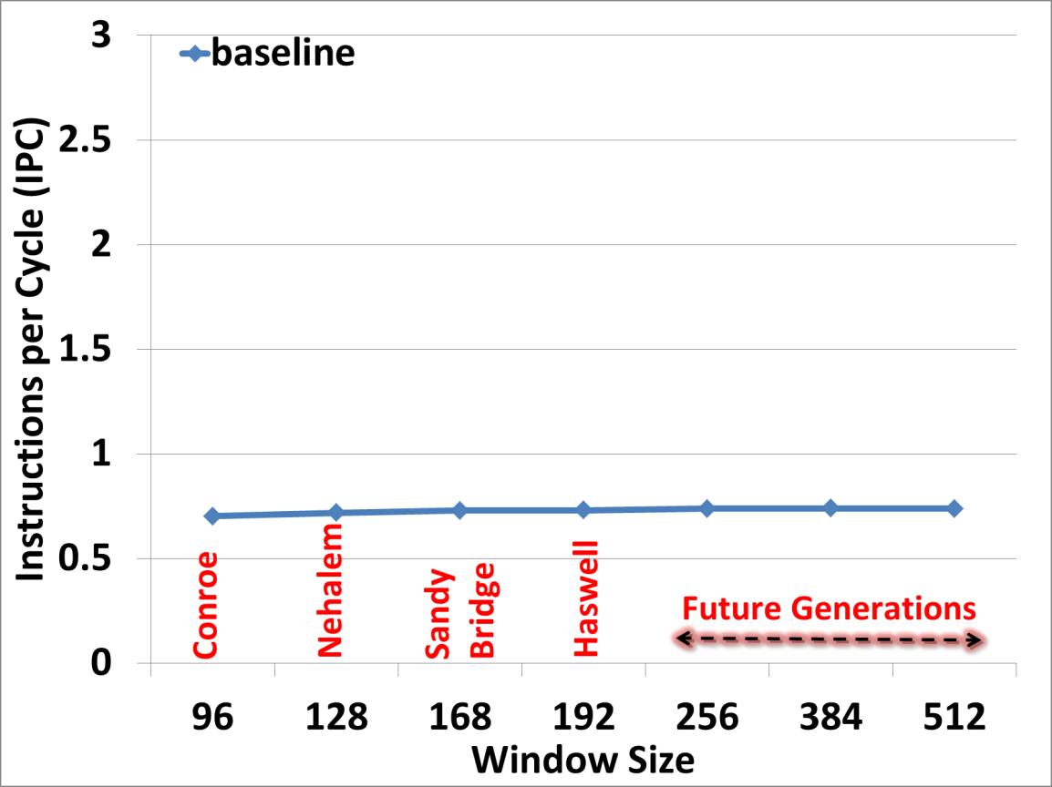
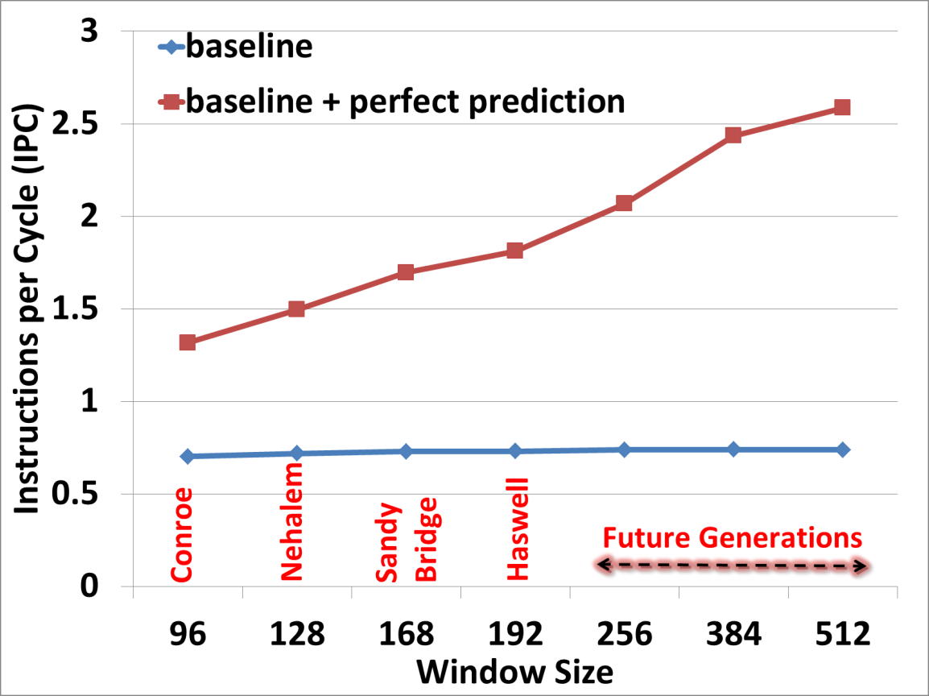
Memory Latency Tolerance
65%
69%
67%
67%
68%
65%
Energy Reduction
63%
ASTAR (Rivers)
Baseline uses ISL-TAGE predictor

Slide 5
Better Branch Handling is Important
Improves performance
Reduces energy consumption
  Wrong path
  Preparing for recovery
  Recovery
Necessary catalyst for memory latency tolerance
Notes:
Waste energy on wrong-path insts and recovery

Slide 6
Interesting Observation
branch-slice
branch
control-
dependent
region
Notes:
Define slice ….

Slide 7
Control-Flow Decoupling
branch-slice
branch-slice
branch
branch
control-
dependent
region
control-
dependent
region

Slide 8
Control-Flow Decoupling
CFD Loops
Original Loop
branch-slice
Push_BQ
branch-slice
branch-slice
Generate a vector of predicates
BQ
branch
BQ drives fetch
1 0 1 1 0 0 0 1 1 0 1 0
branch
Branch_on_BQ
control-
dependent
region
control-
dependent
region
control-
dependent
region
Notes:
Talk about vectorizing control-flow

Slide 9
Control-Flow Decoupling
Original Loop
Problem #1
No fetch separation: need branch prediction
IF
…….…
EX
Iteration-a
slice-a
branch-a
Iteration-b
slice-b
branch-b
Iteration-c
slice-c
branch-c
CD-a
CD-b
CD-c
IF
…….…
EX
Problem #2
No mechanism to comm. predicates to Fetch Unit
IF
…….…
EX
IF
…….…
EX
IF
…….…
EX
IF
…….…
EX
Notes:
Change as shown in poster

Slide 10

Control-Flow Decoupling
CFD Loops
First Loop
slice-a
slice-b
Second Loop
branch-a
slice-c
branch-c
branch-b
CD-a
CD-b
CD-c
…….…
IF
EX
IF
…….…
EX
IF
…….…
EX
BQ
1
0
1
IF
…….…
EX
CFD provides:
Fetch Separation
Mechanism to comm. predicates to Fetch Unit
IF
…….…
EX
IF
…….…
EX
Notes:
Change like poster

Slide 11

Control-Flow Decoupling: Example
SOPLEX
31% contrib.
1 0 1 1 0 0 0 1 1 0 1 0
Notes:
Processor designers aim for energy proportionality
Improving branch prediction improves performance and saves energy
State-of-art branch predictors have limitations
The collaboration between hardware and software seems imminent
In this work, we proposed a novel technique, CFD, which enables eliminating difficult branches with large, complex control-dependent regions

Slide 12
Agenda
Methodology
Control-flow classification
Control-flow decoupling (CFD)
Evaluation
Conclusion

Slide 13
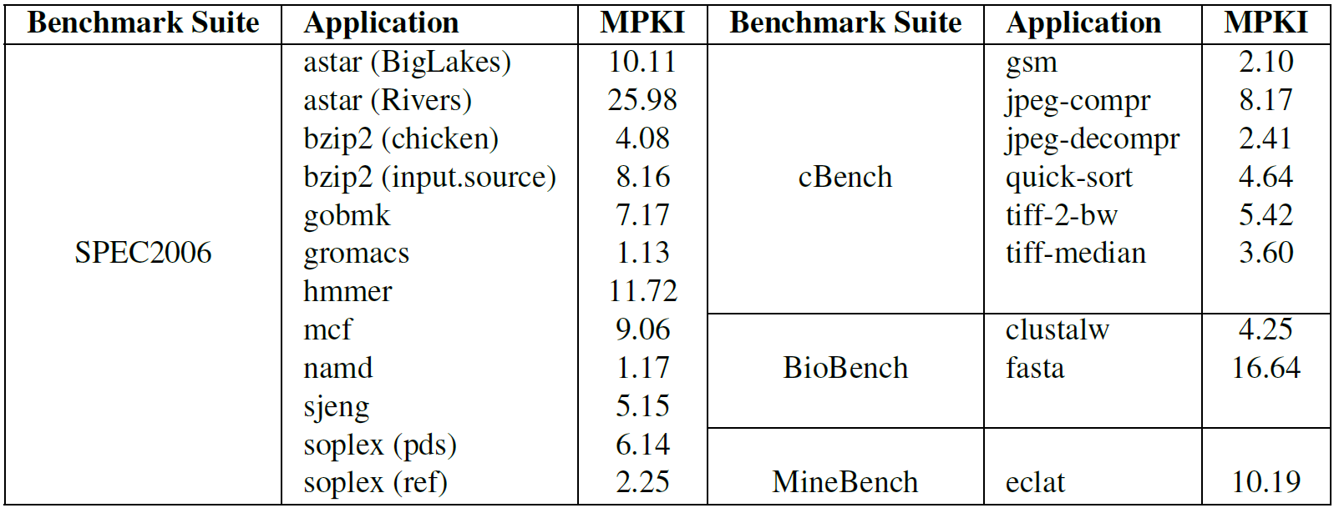
Methodology
Where do state-of-the-art branch predictors fall short?
  4 benchmark suites (80 apps)
    PIN with x86 binaries
  27 out of 80 have misprediction rate >= 2%
    6 of which had problems with cross-compiler
    Remaining 21 apps contribute 78% of total MPKI (in the 80 apps)
Notes:
Profile branches in four benchmark suites (80+ applications)
➔ Identify hard-to-predict branches at the source level
x86 binaries compiled using gcc with -O3 optimization
Use Pin to instrument binaries. Run instrumented binaries to completion on real machine (w/ ISL-TAGE pred.)

Slide 14
Control-Flow Classification
Classify targeted mispredictions into four classes
  Hammock
    If-conversion
  Separable branches
    Control-Flow Decoupling (CFD)
  Inseparable branches (very serial)
    Other solutions required
  Not analyzed
Notes:
Analyze top-ranked misprediction contributors
Properties of control-dependent (CD) regions
Influence the solutions that will be needed, both old and new
- Hammock: branches with small, simple CD regions
Separable: branches with large, complex CD regions
Inseparable: branches with large, complex CD regions (very serial)
Not Analyzed

Slide 15
Control-Flow Classification
Classify targeted mispredictions into four classes
  Hammock
  Separable
  Inseparable
  Not analyzed

Slide 16
Agenda
Methodology
Control-flow classification
Control-flow decoupling (CFD)
Evaluation
Conclusion

Slide 17
Control-Flow Decoupling
Targets separable branches with large, complex CD regions
  ISA support
  Software side
  Hardware side

Slide 18
ISA Support
BQ specification:
Size (N)
Content
Length
N elements
BQ
1-bit flag
<predicate>
Two purposes:
Needed to save/restore
BQ state
Flexible implementation
(e.g., circular vs. shifting buffer)
Length register
Notes:
The BQ has a specific size. BQ size has implications for software.
These are discussed in the next subsection.
2. Each BQ entry contains a single flag indicating taken/not-taken
(the predicate). Other microarchitectural state may be included
in each entry of the BQ’s physical counterpart, but this state is
transparent to software and not specified in the ISA.
3. A length register indicates the BQ occupancy. Architecting only
a length register has the advantage of leaving low-level management
concerns to the microarchitect. For example, the BQ
could be implemented as a circular or shifting buffer. Thus, at
the ISA level, the BQ head and tail are conceptual and are not
specified as architectural registers: their physical counterparts are
implementation-dependent.
4. The ISA provides mechanisms to save and restore the BQ state
(queue contents and length register) to memory. This is required
for context-switches. We recommend the approach used in some
commercial ISAs, which is to include the BQ among the specialpurpose
registers and leverage move-from and move-to specialpurpose-
register instructions to transfer the BQ state to and from
general-purpose registers (which can be saved and restored via
stores and loads, respectively). If this is not possible, then dedicated
Save_BQ and Restore_BQ instructions could be used.

Slide 19
ISA Support
New instructions:
  Push_BQ (push)
  Branch_on_BQ (pop)
Push-Pop Ordering Rules
time
push-1
push-2
….…
push-N
pop-1
pop-2
….…
pop-N
push-1
….
Align
predicates
with their
corresponding
branches
Rule #1: a push must precede its corresponding pop
Prevent
deadlock
Rule #3: N cannot exceed the BQ size
Rule #2: N consecutive pushes must be followed by
exactly N consecutive pops (same order)
Notes:
The first two rules are for properly aligning predicates to their corresponding branches (and you can indicate that with text). The third rule is for preventing deadlock ("overflow" is not an option because a pop needs its architectural predicate.. so a stall due to exceeding N causes a deadlock).
The Push_BQ instruction has a single source register specifier to
reference a general-purpose register. If the register contains zero (nonzero),
Push_BQ pushes a 0 (1). Branch_on_BQ is a new conditional
branch instruction. Branch_on_BQ specifies its taken-target like
other conditional branches, via a PC-relative offset. It does not have
any explicit source register specifiers, however. Instead, it pops its
predicate from the BQ and branches or doesn’t branch, accordingly.
The ISA specifies key ordering rules for pushes and pops, that
software must abide by. First, a push must precede its corresponding
pop. Second, N consecutive pushes must be followed by exactly N
consecutive pops in the same order as their corresponding pushes.
Third, N cannot exceed the BQ size.

Slide 20
Software Side
Working with finite-size BQ
CFD Loops
Strip-mined CFD Loops
for (large_trip_count) {body of first loop}
for (large_trip_count) {body of second loop}
for (large_trip_count/N) {
for (1 ... N) {body of first loop}
for (1 ... N) {body of second loop}
}
BQ
BQ
Notes:
Implementation constraint
BQ has finite size
CFD-class loops iterate thousands of times
Solution: loop strip mining

Slide 21
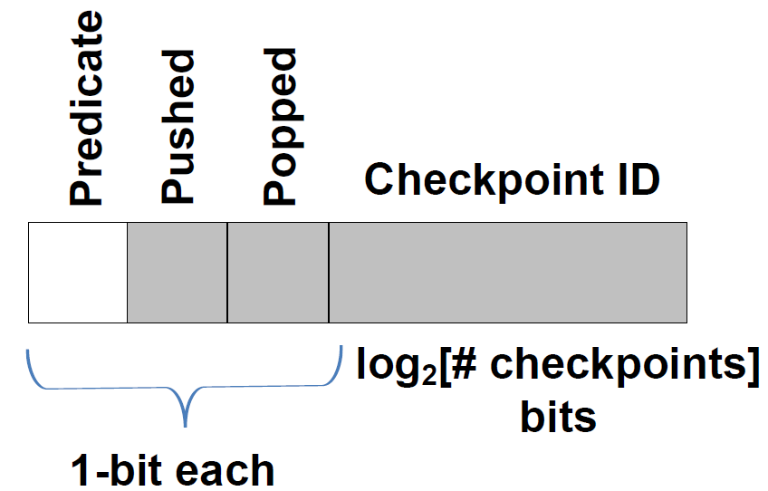
Hardware Side
BQ implementation
Notes:
state that the pushed/popped bits are for synchronizing the push/pop, i.e., detecting the hit/miss scenarios.
Branch Queue (BQ)
Resides in the Instruction Fetch Unit
Circular buffer with post-incremented head and tail pointers
Four fields per entry

Slide 22
Hardware Side
Execution scenarios
  BQ hit
  BQ miss
Common Case
Uncommon Case
BQ hit
BQ miss
slice
IF
…….
slice
…….…
EX
IF
EX
branch
IF
branch
IF
Speculate or Stall
Notes:
state that the pushed/popped bits are for synchronizing the push/pop, i.e., detecting the hit/miss scenarios.

Slide 23
Hardware Side
BQ length
BQ size is N
BQ Length
0
N
time
push-1
push-2
….…
push-N
pop-1
pop-2
….…
pop-N
push-1
….
Instruction Window
Notes:
Rami: Show 4 pushes …. (space) … push …. Then on a click show intervening pops
Explain that pipelining exposes this even when we follow ordering rules
Show a sliding inst window?!

Slide 24
Hardware Side
BQ length
BQ size is N
BQ Length
N
time
push-1
push-2
….…
push-N
pop-1
pop-2
….…
pop-N
push-1
….
Instruction Window
Stall push-1:
BQ is full
Notes:
Rami: Show 4 pushes …. (space) … push …. Then on a click show intervening pops
Explain that pipelining exposes this even when we follow ordering rules
Show a sliding inst window?!

Slide 25
Hardware Side
BQ length
BQ size is N
BQ Length
N -1
time
push-1
push-2
….…
push-N
pop-1
pop-2
….…
pop-N
push-1
….
Instruction Window
Unstall push-1
Notes:
Rami: Show 4 pushes …. (space) … push …. Then on a click show intervening pops
Explain that pipelining exposes this even when we follow ordering rules
Show a sliding inst window?!

Slide 26
Hardware Side
BQ length
BQ size is N
BQ Length
N
time
push-1
push-2
….…
push-N
pop-1
pop-2
….…
pop-N
push-1
….
Instruction Window
Notes:
Rami: Show 4 pushes …. (space) … push …. Then on a click show intervening pops
Explain that pipelining exposes this even when we follow ordering rules
Show a sliding inst window?!

Slide 27

Hardware Side
BQ recovery
Committed State:
AMT, … etc
Checkpoint:
RMT, … etc
Notes:
Show window, checkpionts through window. Expand one checkpoint to show its contents.
On a click, add BQ point snapshots inside checkpoints and at retire

Slide 28
Hardware Side
BQ recovery
Committed State:
AMT, … etc
Arch. BQ head ptr
Arch. BQ tail ptr
Checkpoint:
RMT, … etc
BQ head ptr
BQ tail ptr
Notes:
Show window, checkpionts through window. Expand one checkpoint to show its contents.
On a click, add BQ point snapshots inside checkpoints and at retire

Slide 29
Other Interesting Aspects of CFD
  Supports partially separable branches
branch-slice
branch-slice
branch
branch
branch
control-
dependent
region
control-
dependent
region
control-
dependent
region

Slide 30
Other Interesting Aspects of CFD
  Supports partially separable branches
branch-slice
Push_BQ
branch-slice
branch-slice
if-converted hammock
branch
branch
branch
control-
dependent
region
control-
dependent
region
control-
dependent
region
Branch_on_BQ
control-
dependent
region

Slide 31
Other Interesting Aspects of CFD
  Works with nested branches:
    Combine predicates (if safe)
    Multi-level decoupling
  CFD overheads can be reduced through value communication
  (see CFD+ in the paper)
Notes:
Show short animation for:
- partial separability, show subset of CD insts get hoisted and if-converted (important: profitable if only few insts are in the slice).
- multi-level decoupling.

Slide 32
Agenda
Methodology
Control-flow classification
Control-flow decoupling (CFD)
Evaluation
Conclusion

Slide 33
Evaluation Environment
Simulator
  In-house detailed execution-driven, execute-at-execute, cycle-level Alpha simulator
  CFD microarchitecture is faithfully modeled
  McPAT and CACTI are used to measure energy consumption
Benchmarks
  Compiled with gcc and -O3 level optimization
  Modified benchmarks are validated by compiling and running to completion on x86 host (emulate BQ with software queue)
  When simulating modified binaries, we simulate as many retired instructions as needed in order to perform the same amount of work as the unmodified binaries.
Notes:
Talk about comparing similar amount of WORK …. Very important
Highlight that CFD is applied manually, then automatically.

Slide 34
Evaluation Environment
Baseline
Branch Prediction | BP: 64KB ISL-TAGE predictor - 16 tables: 1 bimodal, 15 partially-tagged. In addition to, IUM, SC, LP. - History lengths: {0, 3, 8, 12, 17, 33, 35, 67, 97, 138, 195, 330, 517, 1193, 1741, 1930} BTB: 4K entries, 4-way set-associative RAS: 64 entries
Memory Hierarchy | Block size: 64B Victim caches: each cache has a 16-entry FA victim cache L1: split, 64KB each, 4-way set-associative, 1-cycle access latency L2: unified, private for each core, 512KB, 8-way set-associative, 20-cycle access latency - L2 stream prefetcher: 4 streams, each of depth 16 L3: unified, shared among cores, 8MB, 16-way set-associative, 40-cycle access latency Memory: 200-cycle access latency
Fetch/Issue/Retire Width | 4 instr./cycle
ROB/IQ/LDQ/STQ | 168/54/64/36 (modeled after Sandy Bridge)
Fetch-to-Execute Latency | 10-cycle
Physical RF | 236
Checkpoints | 8, OoO reclamation, confidence estimator (8K entries, 4-bit resetting counter, gshare index)
CFD | BQ: 96B (128 6-bit entries) VQ renamer: 128B (128 8-bit entries)

Slide 35
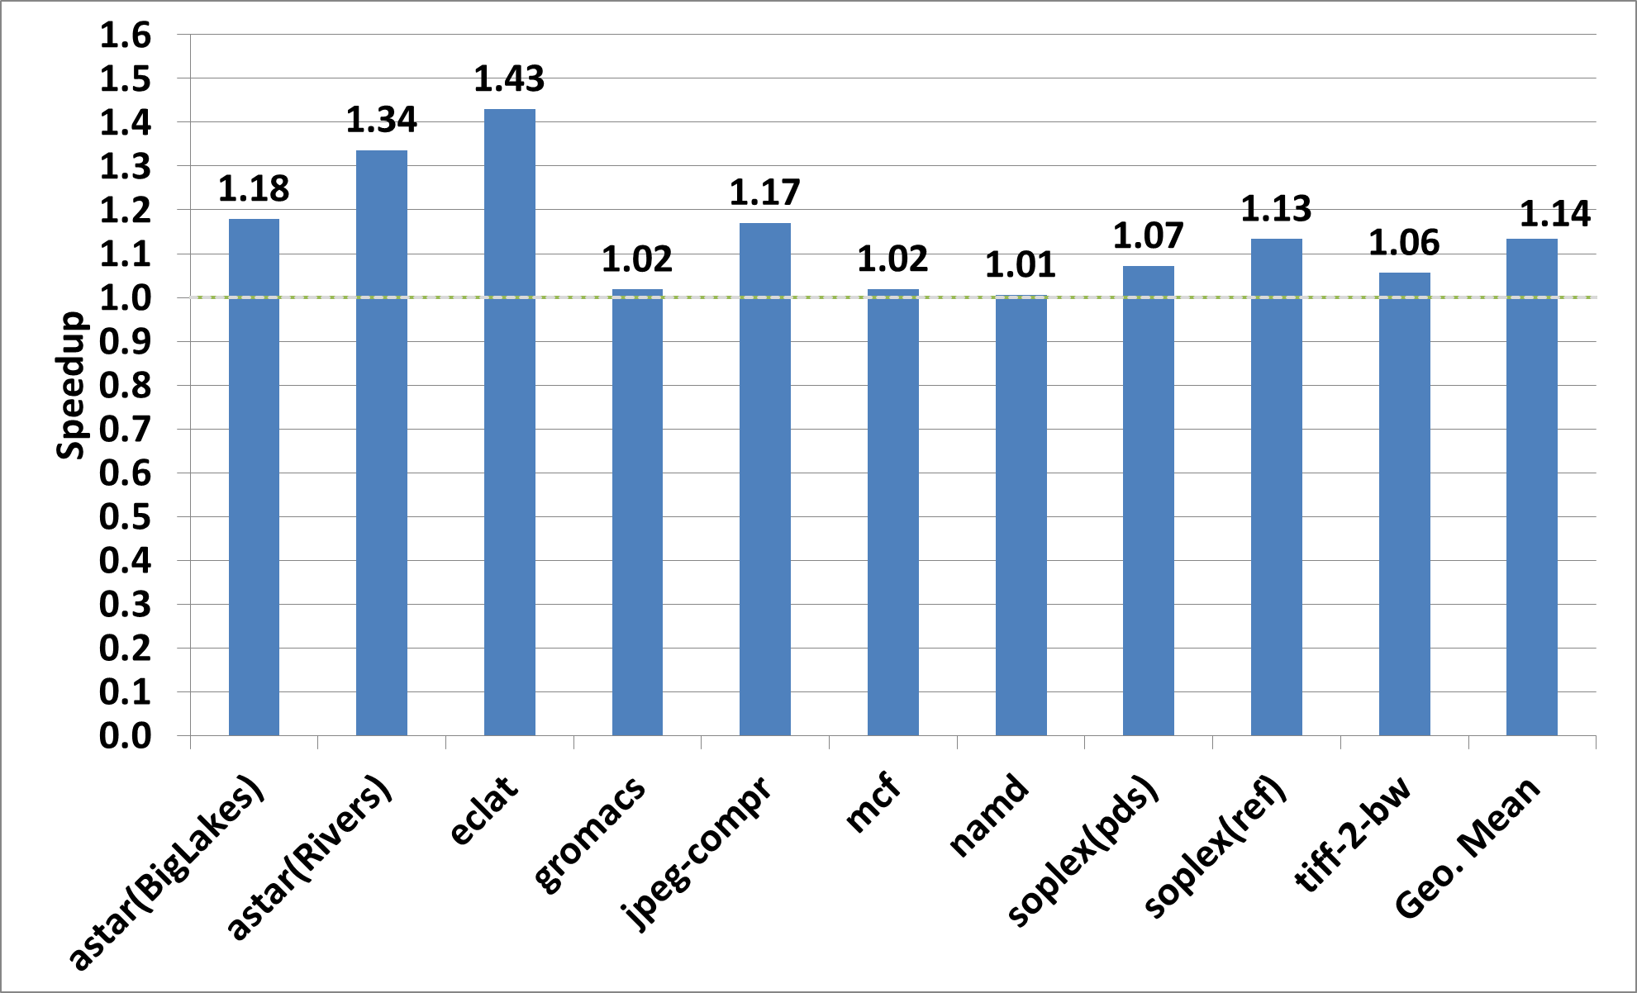
Results
Notes:
Simulated region selection
Modified binaries increase number of retired instructions

Slide 36
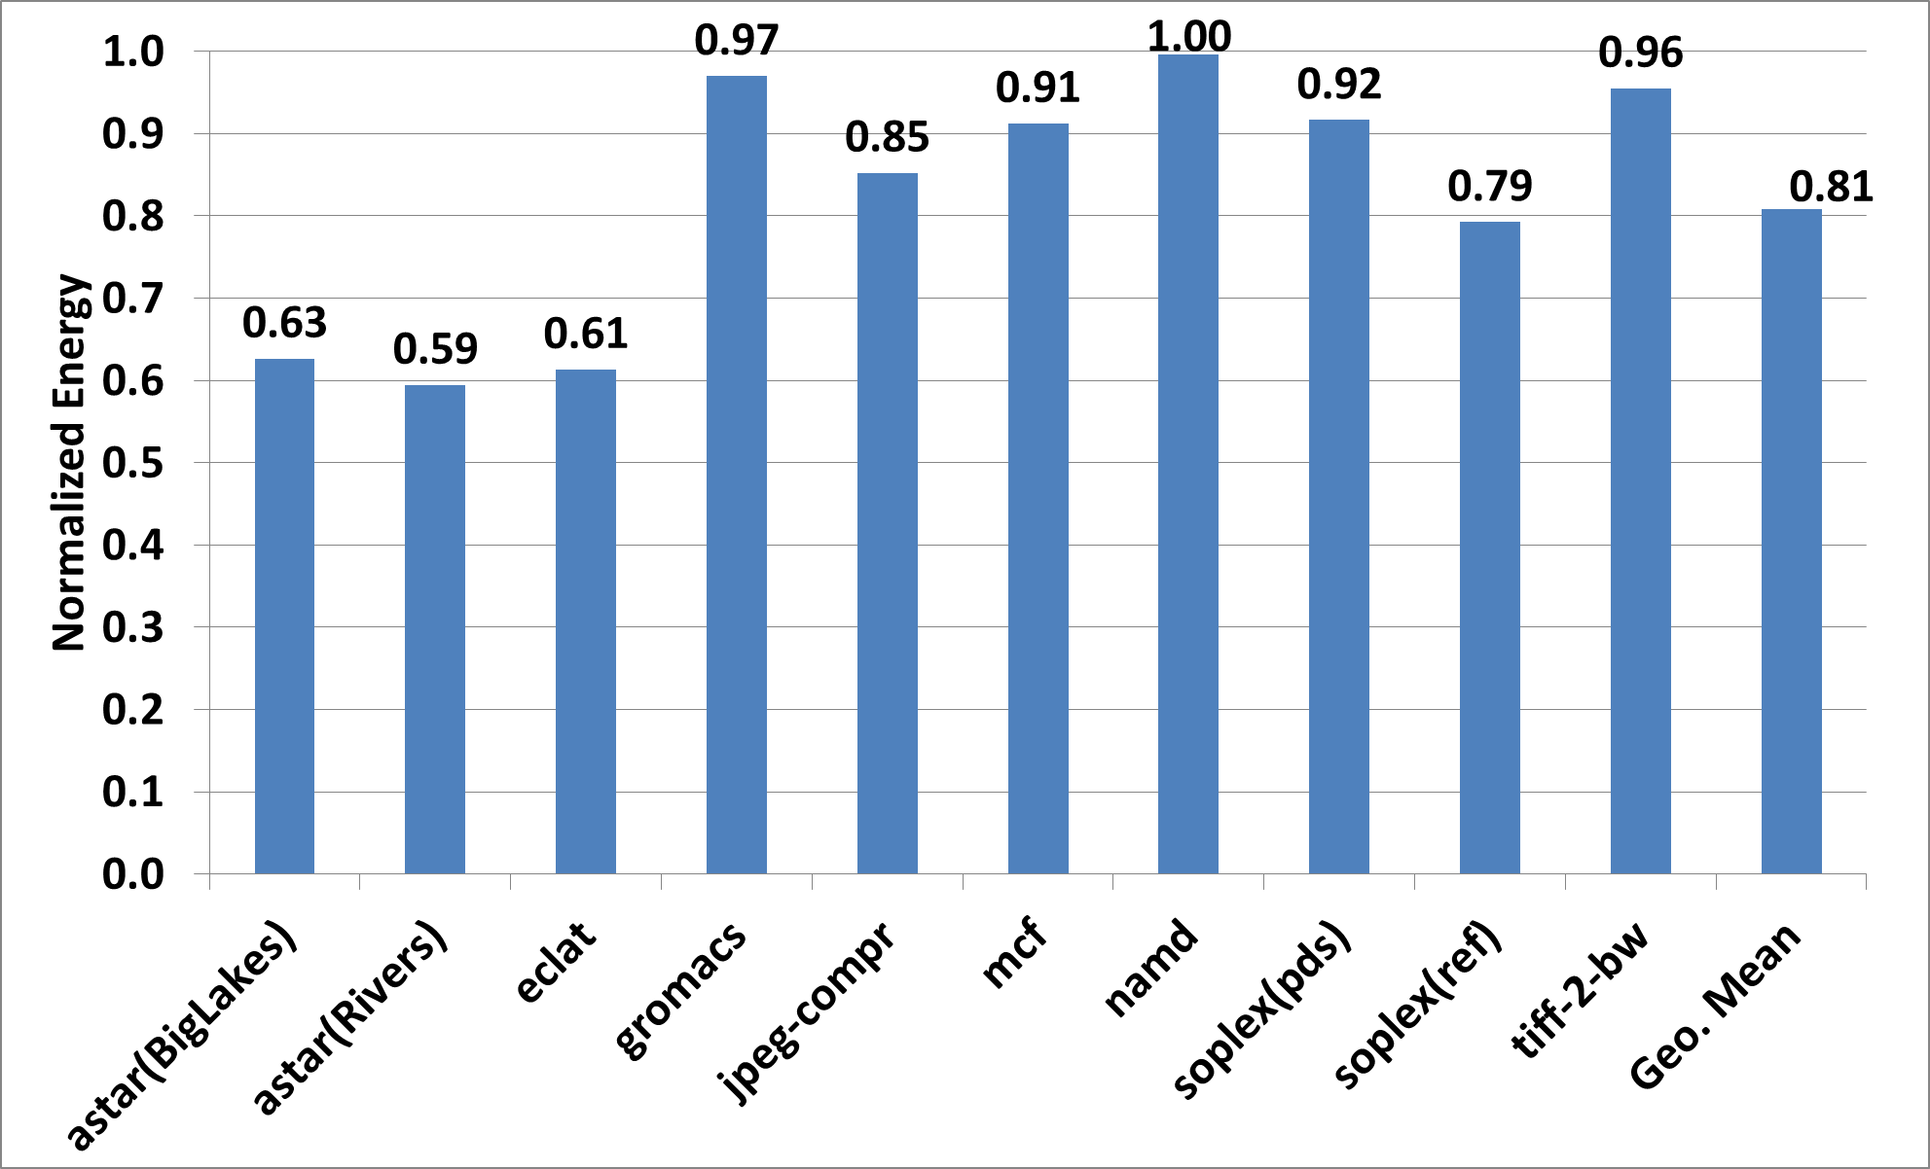
Results

Slide 37
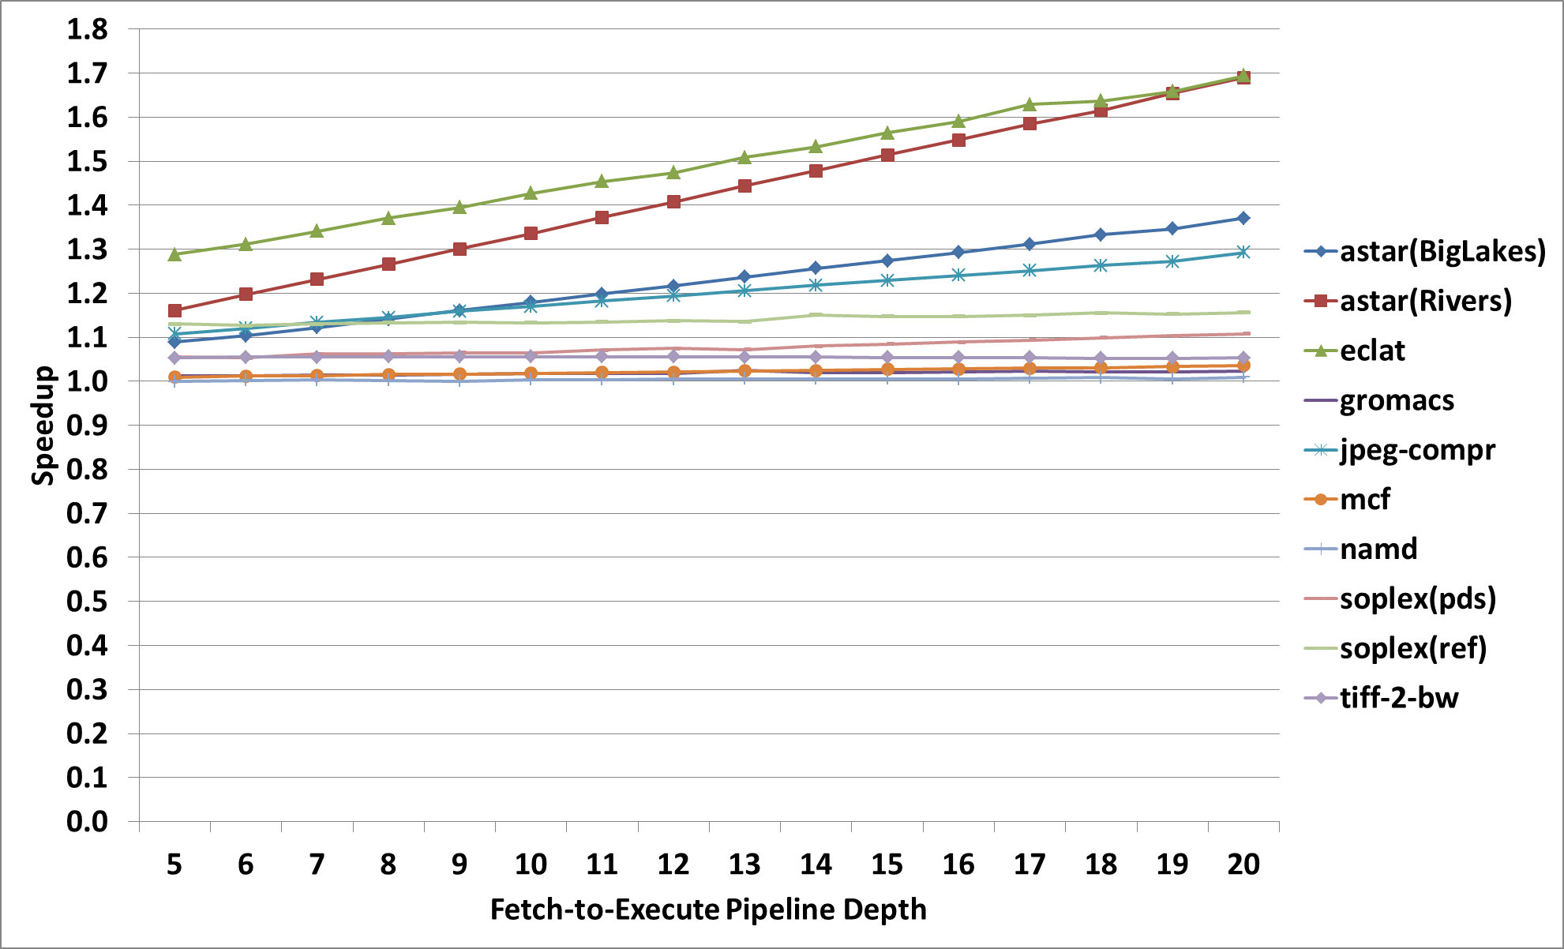
Results – Sensitivity Study
Fetch-to-execute depth
Cortex A15
GeoMean=1.18
Pentium 4
GeoMean=1.22
Bobcat/Power6
GeoMean=1.16

Slide 38
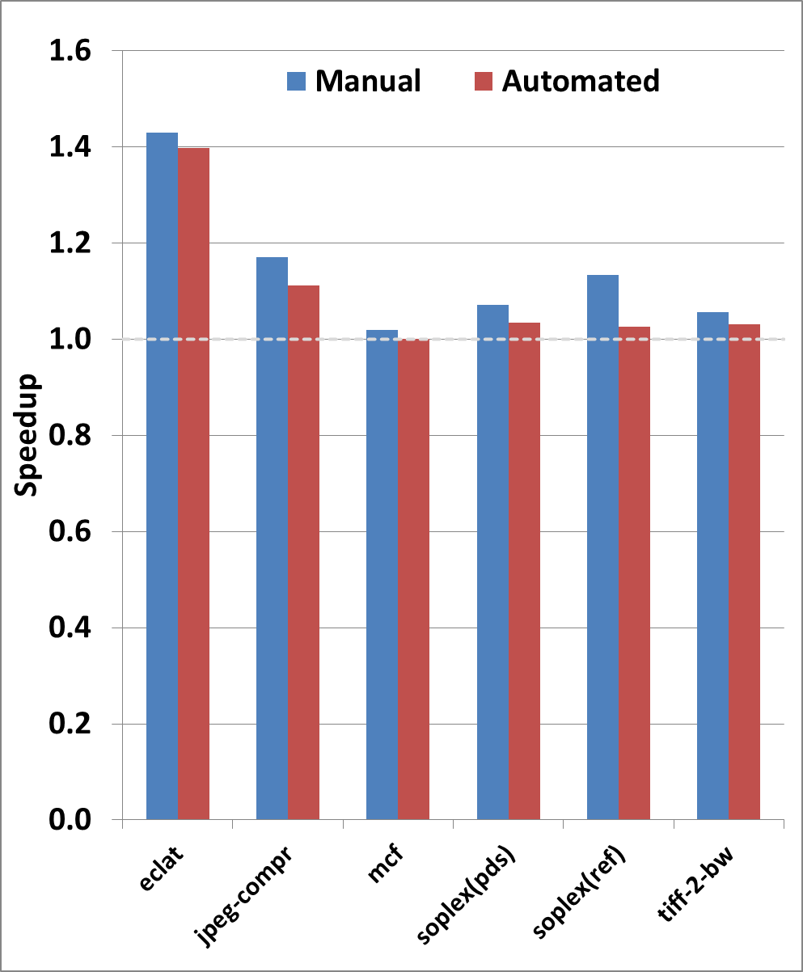
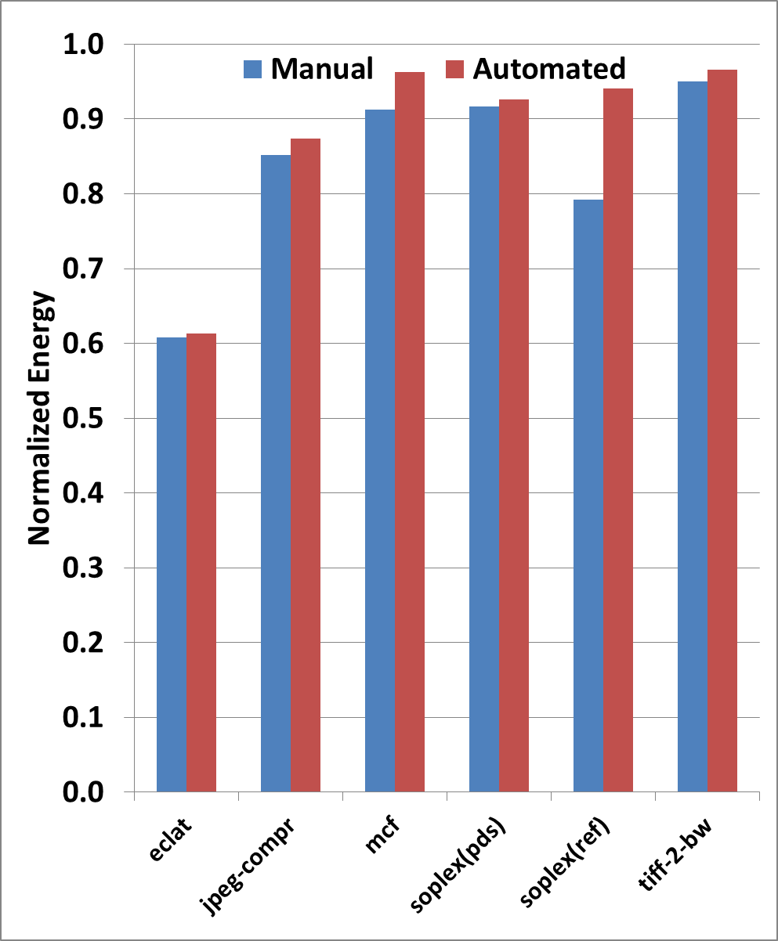
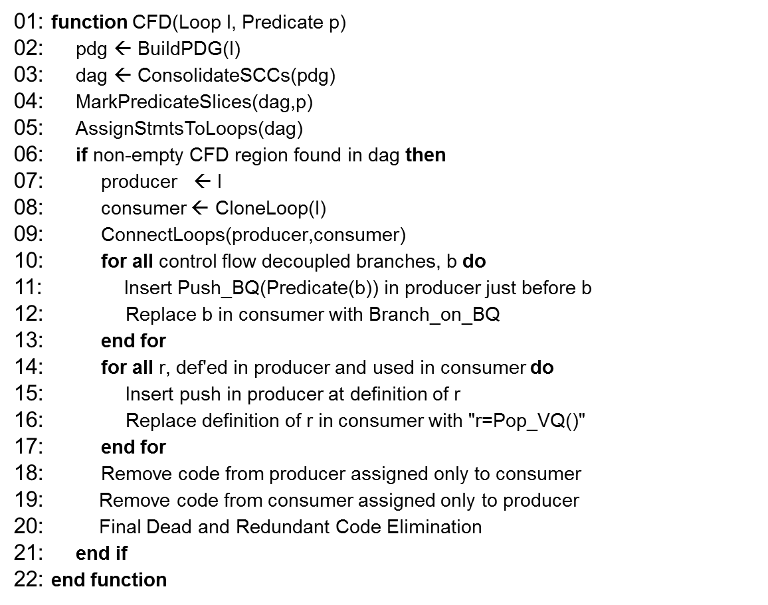
Results – Manual vs. Automated

Slide 39
Conclusion
  State-of-the-art branch predictors have limitations
  A third of mispredictions come from separable branches
  CFD is a software/hardware collaboration for exploiting separability with low complexity and high efficacy
  CFD is comparable to if-conversion in terms of number of static branches and MPKI contribution
Notes:
Flush text. See slide 30 for example

Slide 40
Thanks!
Questions?

