Slide 1


Addressing End-to-End Memory Access Latency in NoC Based Multicores
Akbar Sharifi, Emre Kultursay,
Mahmut Kandemir and Chita R. Das
Department of Computer Science and Engineering
The Pennsylvania State University
Notes:
(26 minute presentation)
Hello everyone. Thank you very much for showing your interest in our paper. My name is Emre Kültürsay and I am here to talk about what we did to improve the end-to-end memory access latencies in NoC based multicores. This work is from Penn State University and my couthors are Akbar Sharifi, Mahmut Kandemir, and Chita Das.

Slide 2
Outline
Introduction and Motivation
Details of the Proposed Schemes
Implementation
Experimental Setup and Results
Notes:
I will begin by giving an introduction to the problem we are tackling here and provide the data that was the driving force for us to pursue this work.
Then I will explain the two schemes that we propose in our paper.
I will provide some insights on the implementation of these schemes.
And finally, I will give details on how we evaluated our proposals and what results we obtained.

Slide 3
Target System
Tiled multicore architecture
  Mesh NoC
  Shared, banked L2 cache (S-NUCA)
  MCs
MC
MC
Router
Core
L1
L2 bank
Node
MC
Communication Link
MC
Notes:
First of all. What is our target system? We assume a tiled large-scale multicore architecture connected with a mesh network. We have shared, banked L2 cache, distributed across the tiles using S-NUCA, which means lines are striped across the L2 cache banks and each cache line is statically mapped to a single home L2 cache bank. We have memory controllers that control the off-chip DRAM, cache lines are also striped across memory controllers in a similar manner.
One question here is that, are we restricted to only this architecture? For instance, do we have to have mesh network for our schemes to work? Not necessarily. The schemes I will present are generic. You are welcome to apply these ideas to, say other interconnects such as a ring network. Similarly, they are applicable to other data layout schemes as well.

Slide 4
Components of Memory Latency
MC0
MC1
4
3
5
L2
Response
Message
2
Request
Message
L1
1
MC2
MC3
Many components add to end-to-end memory access latency
Notes:
Now, let us look at the “journey” of cache misses in this architecture. We know that when a core has an L1 cache miss, a request is sent to the target L2 cache bank. If there is an L2 hit, then a response message is sent back from the L2 cache to the L1 cache. This is represented by the paths (1 and 5) in this figure. On an L2 cache miss, the request is forwarded to the target memory controller, and the response message that contains the data goes back to L2 cache and then to L1 cache. These communications are represented by all the red and blue paths in the figure. The delays of these paths on the network all add up to the total “end-to-end memory access latency”.

Slide 5
End-to-end Memory Latency Distribution
Significant contribution from network
Higher contribution for longer latencies
Motivation
  Reduce the contribution from the network
  Make delays more uniform
Notes:
But, quantitatively, what exactly is the contribution of the NoC to the overall end-to-end memory access latency?
What you see in this figure is the distribution of the end-to-end memory latency into its components. Here we grouped the accesses based on their total latency. The first stacked-column shows the distribution of messages that suffer 150-200 cycles, the last one is for messages in the same experiment, for the same application on the same core, that suffer 650-700 cycles. What does this figure tell us? First, look at the sum of the bottom two and the top two bars, they represent the contributions coming from the NoC. That ratio is pretty significant. Then, look across the groups. As we go from left to right, NoC latency becomes even more significant.
But, “how many messages are there in each group?”: The distribution looks like this.
So, we have some messages that suffer much larger delays than average, and NoC is actually a significant source of this latency for these messages. We consider this as a motivation and ask: “Can we reduce the contribution from the network for these messages and make delays more uniform?”
But, hold on, why do we want that? What is the problem with “long latency messages”, what is it there that really bothers us?

Slide 6

Out-of-Order Execution and MLP
OoO execution: Many memory requests in flight
Instruction Window
  Oldest instruction commits $→$ instruction window advances
  A memory access with a long delay
    Block instruction window
    Performance degradation
begin
Instruction Window
end
commit
Load-A
Load-B
Load-C
Load-D
miss
L2-hit
L1-hit
miss
Network
Network
Network
Notes:
The answer lies with OoO execution and its limited ability to hide long-latency memory requests.
In OoO execution, we have many memory requests simultaneously in flight.
We have the instruction window, where as the oldest instruction in the window commits, the window advances. By overlapping other, independent instructions with in-flight memory requests, OoO execution hides the latency of memory accesses. But, when we design our processors for the common case, hitting these “extra long latency” memory requests can make our instruction window block. A blocked instruction window means reduced instruction throughput, and in turn, performance degradation. So we have a reason for expediting these “long latency” requests.

Slide 7
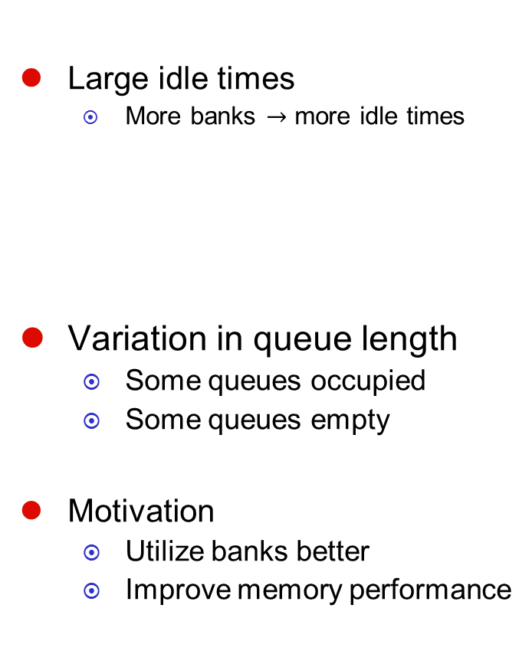
Memory Bank Utilization
Large idle times
  More banks $→$ more idle times
Variation in queue length
  Some queues occupied
  Some queues empty
Motivation
  Utilize banks better
  Improve memory performance
MC
R-1
MC
Bank 0
Bank 1
Bank 2
R-0
MC
R-2
MC
Notes:
What happens when the memory requests reach the MC? They get into the bank queues and when they reach the head of these queues, they access the memory banks. We also looked at the utilization of the memory resources in our target system and discovered that:
first, the banks themselves are mostly idle,
second, there are lots of dynamic variations in the bank queue lengths, which means at any time instant, while some queues are occupied, others can be empty.
We considered this as another motivation and asked: “What can we do at the network to better utilize banks?”.
Because if we can improve utilization, we can also improve memory performance.

Slide 8
Proposed Schemes
Scheme 1
  Identify and expedite “late” memory response messages
    Reduce NoC latency component
    Provide more uniform end-to-end memory latency
Scheme 2
  Identify and expedite memory request messages targeting idle memory banks
    Improve memory bank utilization
    Improve memory performance
Notes:
We have come up with the following two network prioritization based schemes:
*In our scheme 1, we identify and expedite “late” memory response messages to reduce the NoC latency component in them.
Here, our goal is to provide a more uniform end-to-end memory latency.
*In our scheme 2, we expedite memory request messages that target idle memory banks to improve bank utilization.
Here, our goal is to provide a better memory performance.

Slide 9
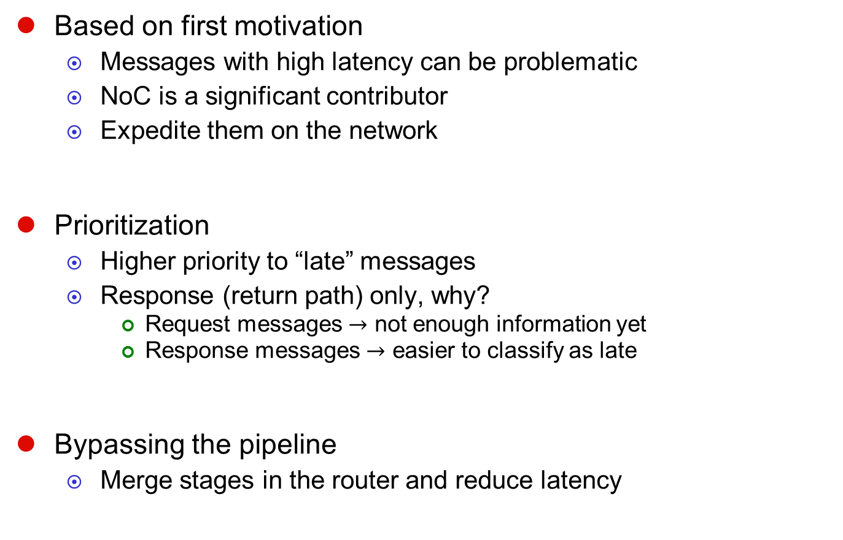
Scheme 1
Based on first motivation
  Messages with high latency can be problematic
  NoC is a significant contributor
  Expedite them on the network
Prioritization
  Higher priority to “late” messages
  Response (return path) only, why?
    Request messages $→$ not enough information yet
    Response messages $→$ easier to classify as late
Bypassing the pipeline
  Merge stages in the router and reduce latency
Notes:
Let us look more into our first scheme. This scheme is based on our first motivation that says messages with high latency can be problematic in terms of their higher potential to block the instruction windows on the cores. We also saw that a big part of the latency in those messages was coming from the NoC.
Our approach to this problem is to expedite these messages on the network. We first use “network prioritization” and assign a higher priority to these messages on their “return” path. Why return only? This is because it is very difficult to classify a request message as “late” as it has not suffered most of its end-to-end latency yet. We simply don’t have the information yet on the request path to classify it as “late”. But, once we reach the MC and do the off-chip memory access, then we have a pretty good idea of whether we are late or not. As a result, we can decide if a response message is late or not before injecting them to the network from the MC.
We also use pipeline bypassing at the routers which enables us to further reduce the latency of the routers on the path for these late messages.

Slide 10
Scheme 1: Calculating Age
Age = “so-far” delay of a message
  12 bits
    Part of 128-bit header flit
    No extra flit needed (assuming 12-bits available)
Updated at each router and MC locally
  No global clock needed
Frequency taken into account
  DVFS at routers/nodes supported
$$age=age+ \frac{\left({cycles}_{current}−{cycles}_{message_entry}\right)×FREQ_MULT}{local_frequency}$$
Notes:
Clearly, we need a mechanism to identify which messages are “late”. For this, we use an age field on the network messages. This age field represents the “so-far delay”, which means “the delay this memory request suffered since it was generated by the L1 cache”. We reserve 12 bits from the header flit for this purpose.
At each router and at the MC, we update the age field. Spesifically, we:
calculate the “absolute time” the message spends inside the router or the MC
add this to the age field of the message.
In this calculation, we use the local clock cycles at the routers and MCs, so we don’t assume the existence of a global clock.
And since we also use local frequency at each node, this scheme also supports DVFS at the nodes.

Slide 11
Scheme 1: Example
MC1 receives request from core-1
R0 is the response message
MC1 updates age field
  Adds memory queuing/service
Use age to decide if “late”
  Mark as “high-priority”
Inject into network as “high-priority”
Age
R0
MC0
Late
MC1
L2
L1
MC2
MC3
core-1
Notes:
Let us look at an example to see how our scheme works.
In this example, MC1 receives a request from core-1.
R0 is the corresponding response message.
When we are about to inject this memory response message back to the NoC, the MC updates the age field of the message, and uses this updated value to decide if the message is late or not.
If it is late, then message is marked as “high priority” throughout its entire return path.
But, to determine if a message is “late” or not, we need to compare the age field with some “threshold”

Slide 12
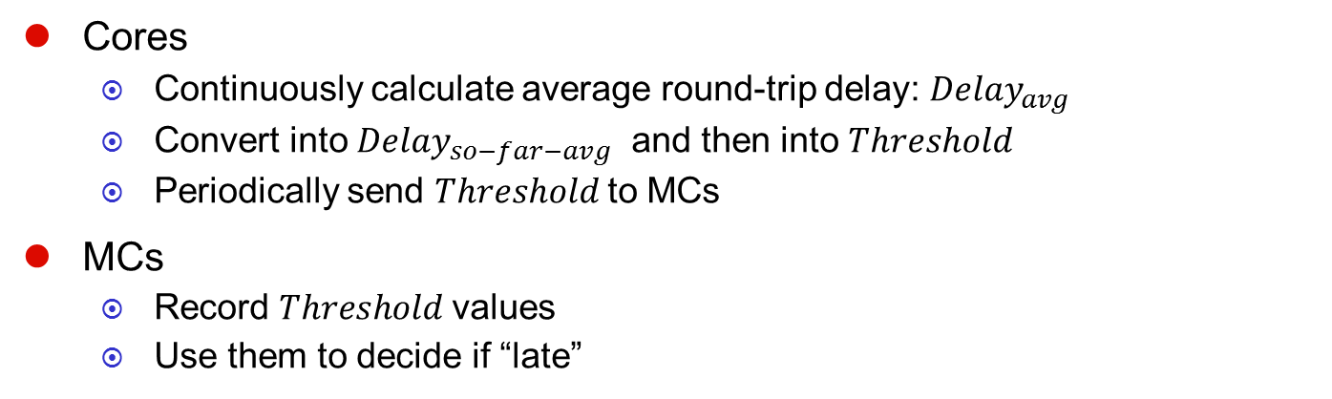
Scheme 1: Late Threshold Calculation
Cores
  Continuously calculate average round-trip delay: ${Delay}_{avg}$
  Convert into ${Delay}_{so−far−avg}$ and then into $Threshold$
  Periodically send $Threshold$to MCs
MCs
  Record $Threshold$values
  Use them to decide if “late”
Each application is treated independently
  Not uniform latency across whole-system
  Uniform latency for each core/app
Delay_avg
Delay_avg
Threshold
Threshold
Delay_so-far-avg
Notes:
How do we calculate this threshold?
First, on the core side, each core continuously monitors the latency of the memory requests it injected into the network and calculates their average: Delay_avg.
Note that this is a “round-trip-delay”, which means it includes Req+MC+Res latency.
So the core first translates this into a “so-far” average delay that is Req+MC, and then into a Threshold.
These threshold values are periodically (1ms interval default) sent to MCs.
Then, the MCs receive these Thresholds. These are per-core values. Hence, in our scheme, each application is treated independently.
What this means is that we do not try to generate a single “uniform” latency across the entire system. Instead, this scheme tries to make the latency of individual cores/applications more uniform.

Slide 13
Scheme 2: Improving Bank Utilization
Based on second motivation
  High idleness at memory banks
  Uneven utilization
Improving bank utilization using network prioritization
  Problem: No global information available
  Approach: Prioritize at the routers using router-local information
Bank History Table per-router
  Number of requests sent to each bank in last T cycles
  If a message targets an idle bank, then prioritize
    Route a diverse set of requests to all banks
    Keep all banks busy
Notes:
Going into our second scheme, please recall that our second motivation was about large idleness at memory banks and their uneven utilization.
To improve bank utilization, we thought of again using network prioritization. But there was a problem with that:
The problem is, the routers in the NoC are unaware of the DRAM state. There is no global information available. If you try to send that information from the MC to the routers, it takes so much time that the data becomes useless by the time it reaches the routers.
Instead, we decided to prioritize messages at the routers using only “router-local” information.
For this, we employ a Bank History Table per router.
This table records the number of request sent to each bank in last T cycles from this router. Then, for each message, we check this table and if there has not been any messages to its target bank recently, then we prioritize that message.
Once again, this method uses purely router-local information.

Slide 14
Network Prioritization Implementation
Routing
  5 stage router pipeline
  Flit-buffering, virtual channel (VC) credit-based flow control
  Messages split into several flits
  Wormhole routing
Our Method
  Message to expedite gets higher priority in VC and SW arbitrations
  Employ pipeline bypassing [Kumar07]
    Fewer number of stages
    Pack 4 cycles into 1 cycle
Baseline
Pipeline Bypassing
BW
RC
VA
SA
ST
setup
ST
Notes:
Here are some more details on how we actually expedite particular messages on the NoC.
In our NoC, we use 5-stage router pipelines, Flit-buffering, VC credit-based flow control. We split messages into flits, and use wormhole routing.
Now, when we decide to expedite a message, we assign those messages a higher priority in Virtual Channel and Switch arbitration stages.
For those prioritized messages, we also employ pipeline bypassing, which lets us use fewer number of stages by packing four cycles of work in the routers into one cycle.

Slide 15
Experimental Setup
Simulator: GEMS (Simics+Opal+Ruby)
DDR-800
Memory Bus Multiplier = 5
Bank Busy Time = 22 cycles
Rank Delay = 2 cycles
Read-Write Delay = 3 cycles
Memory CTL Latency = 20 cycles
16 banks per MC, 4 MCs
5 stage
128-bit flit size
6-flit buffer size
4 VC per port
X-Y Routing
32KB
64B/line
3 cycle latency
MC
MC
Router
4x8 Mesh NoC
Core
L1
512KB
64B/line
10 cycle latency
1 bank/node
(32 banks total)
L2 bank
32 OoO cores
128 entry instruction window
64 entry LSQ
MC
MC
Notes:
Going into our evaluations, we used the GEMS simulator, which combines simics as the functional simulator, opal as the OoO core simulator, and uses Ruby to simulate NoC and Memory.
We simulated a 4x8 mesh network. Our 32 OoO cores had 128 entry instruction window and 64 entry LSQ.
Private L1 caches had a capacity of 32KB, with 64B/line and 3 cycle access latency.
Each L2 cache bank had a 512 KB capacity at a 10 cycle latency.
I already provided the details on the network.
And, here are the latencies for the memory system. We used 16 banks per memory controller. With 4MCs.

Slide 16
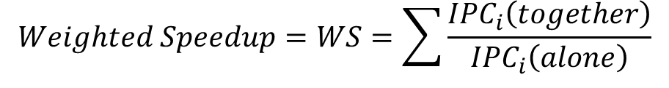
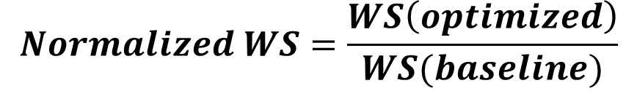
Experimental Setup
Benchmarks from SPEC CPU2006
  Applications categorized based on memory intensity (L2 MPKI)
  High memory intensity vs. low memory intensity [Henning06]
18 multiprogrammed workloads: 32-applications each
  Workload Categories
    WL 1-6: Mixed (50% high intensity -50% low intensity)
    WL 7-12: Memory intensive (100% high intensity)
    WL 13-18: Memory non-intensive (100% low intensity)
  1-1 application-to-core mapping
Metric
$$Weighted Speedup=WS=\sum{\frac{{IPC}_{i}\left(together\right)}{{IPC}_{i}\left(alone\right)}}$$
$$Normalized WS=\frac{WS\left(optimized\right)}{WS(baseline)}$$
Notes:
In our tests, we used SPEC CPU2006 benchmarks. We used the existing “high intensity-low intensity” categorization of these benchmarks and used this information to create 18 multiprogrammed workloads, each containing 32 applications.
First 6 of our workloads contain a fifty fifty mix of high and low intensity workloads, we call these as mixed workloads.
The second and third groups of workloads have all high intensity and all low intensity workloads respectively.
We mapped applications to cores one to one and used normalized weighted speedup as our performance metric,
which is the ratio of the WS “with our optimizations” to the WS “without our optimizations”.

Slide 17
Experimental Results
10%
Higher intensity benchmarks benefit more from Scheme 1
  More traffic
  More “late” messages
w-2 and w-9 degrade
  Prioritizing some messages hurts some other messages
13%
11%
15%
6%
10%
Notes:
So, here are our results. At the top, we have mixed workloads, the ones on the left have high memory intensity and the ones on the right have low memory intensity.
Looking at the averages, we see that our scheme-1 (which prioritizes “late” response messages) brings 10, 11, and 6% performance improvement, respectively.
When we add in our second scheme, our improvements go up to 13, 15, and 10%, respectively.
We see that higher intensity benchmarks benefit more from our Scheme-1, simply because there is more traffic on the network and more late messages. We also see that the benefits of adding Scheme-2 is pretty consistent, at around 3-4%.
We have some exceptions in results, specifically, workloads 2 and 9 had some slight performance degradation with Scheme 1, the reason being that in these workloads, prioritizing some late messages did actually hurt other messages.

Slide 18
Experimental Results
Before Scheme-1
Cumulative Distribution of latencies
  8 threads of WL-1
  90% point delay reduced
  from ~700 cycles to ~600 cycles
Probability Density
  Moved from region 1 to region 2
  Not all can be moved
After Scheme-1
Region 2
Region 1
New distribution
Fewer accesses
with high delays
Notes:
To get some more insight on how these schemes improved performance, let us look at these Cumulative Distribution Functions. These are the distributions for 8 threads in one of our workloads. On the top, we have the figure for “before applying Scheme-1” and on the bottom we have the figure for “after applying scheme 1”. The 90% points for the average are marked on these figures, which clearly shows that it reduced from around 700 cycles down to less than 600 cycles.
Looking at the probability density function tells us what happened underneath. We see that scheme-1 moved many of the “long latency” accesses from Region 1 into region 2. The new distribution has fewer accesses with high delays.

Slide 19
Experimental Results
Reduction in idleness of banks
Dynamic behavior
  Scheme-2 reduces the idleness consistently over time
Notes:
What about Scheme-2? Here, we see that Scheme-2 successfully reduces the idleness of the banks.
When we analyze the dynamic behavior over time, we see that we have consistently better bank utilization throughout the course of execution with Scheme 2.

Slide 20
Sensitivity Analysis
System Parameters
  Lateness threshold
  Bank History Table history length
  Number of memory controllers
  Number of cores
  Number of router stages
Analyze sensitivity of results to system parameters
  Experimented with different values
Notes:
17 minutes up to here.
Clearly, we have various parameters in the system we experimented with.
First, there are the parameters we introduced, such as “lateness threshold” and “bank history table history length”.
Then there are architectural parameters, such as the number of memory controllers, cores, router stages.
Clearly, one questions what happens to our results when we change the values of these, and how robust our proposed schemes to these changes.

Slide 21
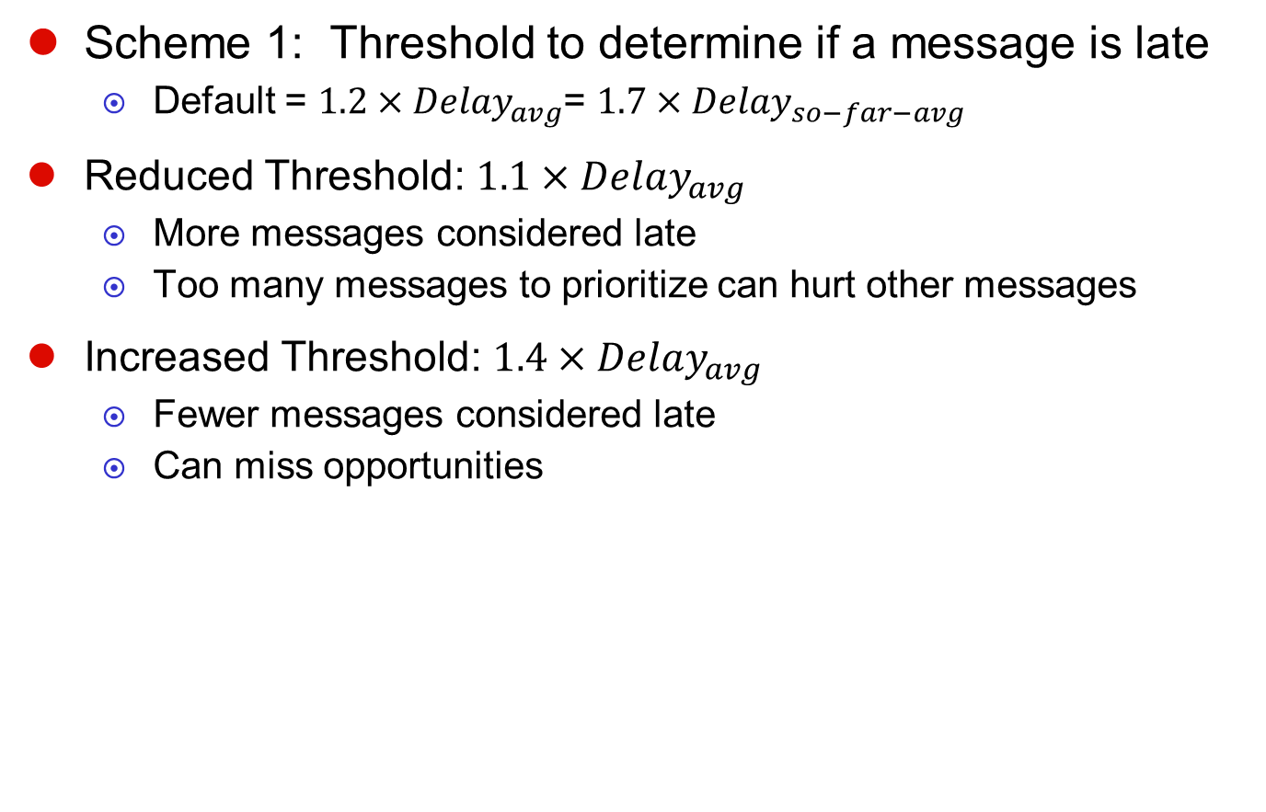
Sensitivity Analysis – “Late” Threshold
Scheme 1: Threshold to determine if a message is late
  Default = $1.2×{Delay}_{avg}$= $1.7×{Delay}_{so−far−avg}$
Reduced Threshold: $1.1×{Delay}_{avg}$
  More messages considered late
  Too many messages to prioritize can hurt other messages
Increased Threshold: $1.4×{Delay}_{avg}$
  Fewer messages considered late
  Can miss opportunities
Notes:
The first parameter we have is associated with Scheme 1. It is the threshold we use at the memory controller to determine if a response message is late or not, before injecting it to the NoC.
The default value we use is 1.2 times the average delay, which translates into roughly 1.7 times the “so-far” average delay.
When we reduce this threshold, more messages are considered late, which means we have more messages to prioritize.
This can actually hurt the performance of other messages.
When we increase this threshold, we consider fewer messages as late, which can lead to missed opportunities.
But, overall, experimenting with two other threshold values, 1.1 and 1.4 times the average delay, we saw that reducing the delay still gives good results, but increasing the delay makes our scheme less sensitive and makes us lose some of our benefits.

Slide 22
Sensitivity Analysis – History Length
Scheme 2: History length
  History kept at the routers for past T cycles
  Default value T=200 cycles
Shorter history: T=100 cycles
  Cannot find idle banks precisely
Longer history: T=400 cycles
  Less number requests prioritized
Notes:
Our second parameter is associated with Scheme 2. In Scheme 2, we keep bank history tables at the routers. How long a history we keep is T the default value for which we took 200 cycles. While using a shorter can lead to imprecisions in finding idle banks, using longer histories can lead to less number of requests being prioritized as more banks will appear to be busy.
We tested two other values for the history length T, 100 and 400 cycles. We saw that our scheme performance improvement drops slightly as you see in the figure, but overall, it still performs quite well for all the three cases.

Slide 23
Sensitivity Analysis – Number of MCs
Less MCs means
  More pressure on each MC
  Higher queuing latency
More late requests
  More room for Scheme 1
Less idleness at banks
  Less room for Scheme 2
Slightly higher
improvements with 2 MC
Notes:
There are also some system parameters that can play an important role for us. One of them is the number of MCs.
Having less MCs means more pressure on each MC, and thus, higher queuing latency.
While having more requests can give more room for Scheme 1 to improve latency, less idleness at banks can give less room for scheme 2.
Experimental evaluation shows that we achieve slightly better improvements with 2MCs, the increase being due to Scheme 1.

Slide 24
Sensitivity Analysis – 16 Cores
Scheme-1 + Scheme-2
  8%, 10%, 5% speedup
  About 5% less than 32-cores
Proportional with the # of cores
  Higher network latency
  More room for our optimizations
Notes:
We also wanted to see how our scheme performs with different number of cores. We tried using 16 cores to see if we achieve similar results with it.
Using the applications in the first halves of the same workloads, we observed 8, 10, and 5% speedup with our schemes.
Compared to the results with 32 cores, this tells us that when there is cores and hence higher network latency, there is more room for our optimizations.

Slide 25
Sensitivity Analysis – Router Stages
NoC Latency depends on number of stages in the routers
  5 stage vs. 2 stage routers
  Scheme 1+2 speedup ~7% on average (for mixed workloads)
Notes:
And finally, we looked at the case where we have 2-stage router pipelines instead of our default 5-stage pipelines.
Using 2-stages at the routers can potentially reduce the time spent on the network.
So, do we still benefit from these network prioritization schemes? The answer is yes. Even with these 2 stage routers, we see a good 7% performance improvement in our mixed workloads.

Slide 26
Summary
Identified
  Some memory accesses suffer long network delays and block the cores
  Banks utilization low and uneven
Proposed two schemes
  Network prioritization and pipeline bypassing on “late” memory response messages to expedite them
  Network prioritization of memory request messages to improve bank utilization
Demonstrated
  Scheme 1 achieves 6%, 10%, 11% speedup
  Scheme 1+2 achieves 10%, 13%, 15% speedup
Notes:
So, as a summary:
In step 1, we identified that some memory accesses suffer long network delays and block the cores, and we also shoed that we have low and uneven memory bank utilization.
Based on these, we proposed two schemes:
The first one usd network prioritization and pipeline bypassing on “late” memory response messages to expedite them
Second one uses network prioritization of request messages to improve bank utilization.
As our third step, we demonstrated the impact of our schemes. We showed that Scheme 1 achieves 6 –to- 11% performance improvement and the two schemes combined bring 10-15% speedup.

Slide 27
Questions?
Thank you for attending this presentation.
Addressing End-to-End Memory Access Latency in NoC Based Multicores
Akbar Sharifi, Emre Kultursay,
Mahmut Kandemir and Chita R. Das
Department of Computer Science and Engineering
The Pennsylvania State University
Notes:
26 minutes up to here. Variation +-1 minute over 10+ samples.

Slide 28
References
[1] A. Kumar, L. Shiuan Peh, P. Kundu, and N.K. Jha, “Express Virtual Channels: Towards the Ideal Interconnection Fabric”, in ISCA, 2007
[2] J. L. Henning, “SPEC CPU2006 Benchmark Descriptions”, SIGARCH Comput. Archit. News, 2006

