Slide 1

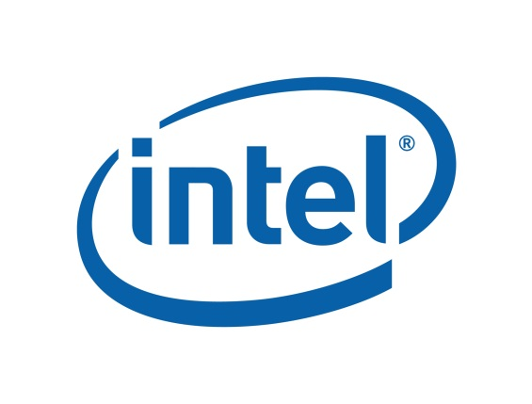
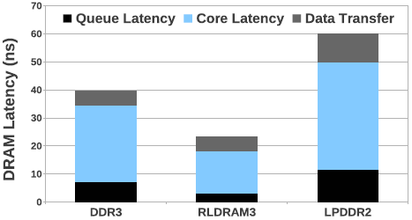
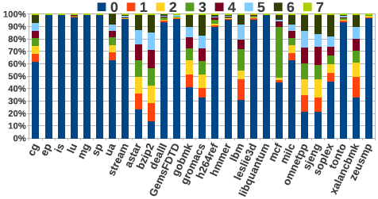
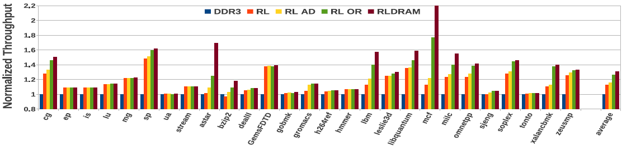
Leveraging Heterogeneity in DRAM Main Memories to Accelerate Critical Word Access
N. Chatterjee, M. Shevgoor, R. Balasubramonian, A. Davis, Z. Fang*‡, R. Illikkal†, and R. Iyer†
University of Utah, Intel Labs† and Nvidia*(work done while at Intel) ‡
DRAM Variants
RLDRAM/LPDDR Heterogeneous Memory
RLDRAM
RLDRAM 0.25GB Data
4 such Data and Add/Cmd Channels
4 Sub-Ranked Channels of RLDRAM, each 0.25GB Data
DDR
DDR2
DDR3
DDR4
8-bit Data + 1-bit Parity
26-bit Addr/Cmd
Ch0
Ch1
Ch2
Ch3
MRC0
RLMC
38-bit Addr/Cmd
Processor
Processor
Processor
8-bit Data + 1-bit parity RLDRAM Channel
LPDDR
23-bit Addr/Cmd
MC0
72-bit Data
+ECC
MC0
MC0
4 such DDR3
channels
64-bit Data +ECC
23-bit Addr/Cmd
4 such LPDDR channels
64-bit Data + ECC
23-bit Addr/Cmd
2GB DDR3 DRAM DIMM
4 such LPDRAM
channels
LPDRAM DIMM 1.75GB Data+ ECC (4 such channels)
LPDRAM DIMM 1.75GB Data+ ECC
Heterogeneous Memory
(a) Baseline DDR3 System
(b) Heterogeneous System with Critical Word Access
(c) Proposed System
Critical Word Regularity
Word-0 is the critical word 67% of the time
Fetch Critical-Word from RLDRAM
Fetch Non-Critical words from LPDDR
Average gap between first and second access > LPDDR latency 82% of the time
Heterogeneous memory system includes low-latency RLDRAM and low-energy LPDRAM
Average main memory access time of RLDRAM3 is 43% lower than that of DDR3
Results
Average performance improvement of 12.9%
22% reduction in average Latency
Memory energy reduction of 15%
System energy reduction of 6%

