Slide 1



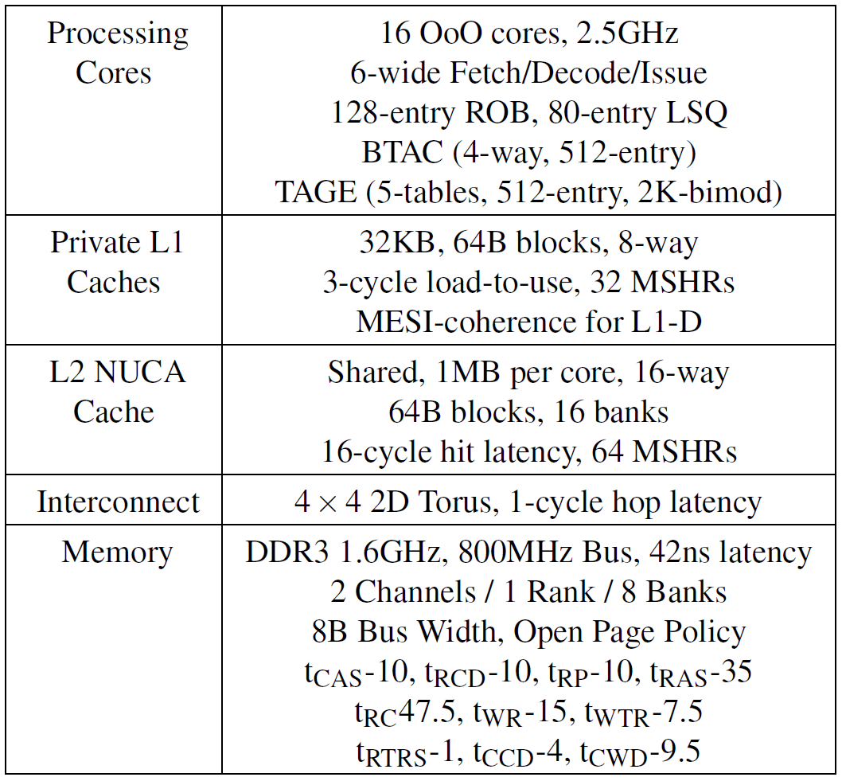
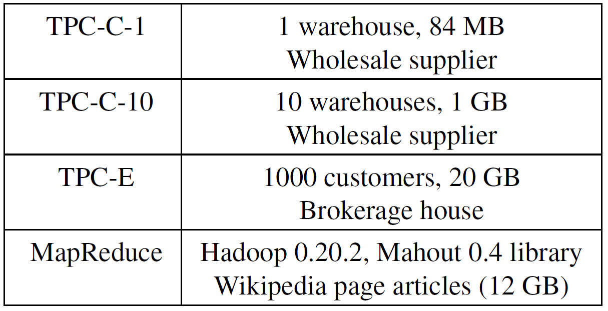

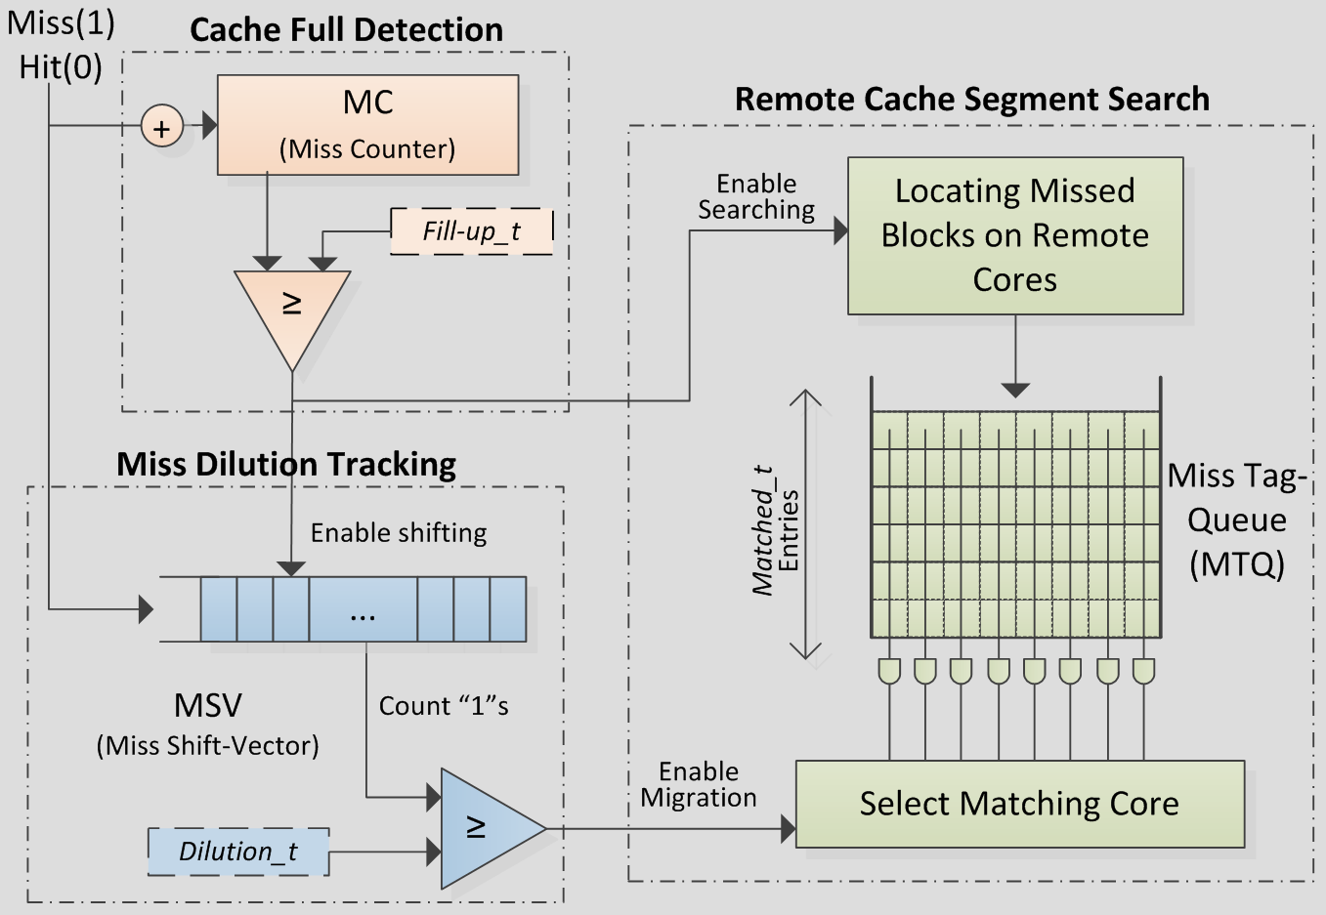
SLICC: Self-Assembly of Instruction Cache Collectives
for OLTP Workloads
Islam Atta¹, Pınar Tözün², Anastasia Ailamaki², Andreas Moshovos¹
¹University of Toronto, ²École Polytechnique Fédérale de Lausanne
Email: iatta@eecg.toronto.edu
Phone: 416-805-8790
Website: http://islamatta.com
Target:
Improve Performance for OLTP workloads
How?
Reduce Instruction Misses / Stalls
Why we care?
Online Transaction Processing (OLTP)
  $100 billion/year, +10% annually
    Drives innovation for HW and DB vendors
SLICC Concept
Example
Methodology
Zesto: x86 CMP simulator
Shore-MT: storage manager
QEMU Extension
T1
T2
T3
Execution Flow
Transactions
Conventional
SLICC
0
CORES
CORES
T1
1
2
3
L1-I
0
1
2
3
T1
T1
T1
T1
T2
T2
T1
Key Results
Effect on Misses
OLTP:
Instruction misses: 58%
Data misses: 7%
Robust:
MapReduce, a non-OLTP
workload with a small instruction
footprint, is not affected.
Performance
Baseline: no effort to reduce instruction misses
  TPC-C: +60% TPC-E: +79%
Next-line: always prefetch the next-line
  TPC-C: +35% TPC-E: +52%
Upper bound for Proactive Instruction Fetch [Ferdman, MICRO’11]
  TPC-C: ±2%, TPC-E: +21%
  SLICC requires <1KB of storage, while PIF requires ~40KB.
  PIF is a general technique, while SLICC is tailored to workloads with behavior similar to OLTP.
Instruction Stalls in OLTP?
Many concurrent Transactions
Instruction Caches are Thrashed
T1
T2
T3
T3
T1
Time
T1
T2
T2
T1
T1
T2
T3
T3
T2
T1
T2
T3
T1
T2
T3
T3
T3
Each
L1-I size
Cache Filled 10 times
Cache Filled 4 times
Footprint
Divided we Fail
United we Succeed
Better
Ingredients & Implementation
When to migrate?
Detect – Cache Full
Counting the number of misses incurred by the cache.
Detect – New Segment
Track miss dilution by counting the number of misses within a window of N cache accesses.
Where to go?
Predict where is the next code segment?
Find which other core holds all N cache blocks missed recently.
1
Exploit CMP Integration and OLTP Behavior
CMP Integration
OLTP Behavior
Lots of code reuse
Higher overlap across
same-type transactions
2
A transaction's
Instruction footprint
fits in
aggregate L1-I capacity
of a CMP
3
Footprint
L1-I size
Better

