Slide 1

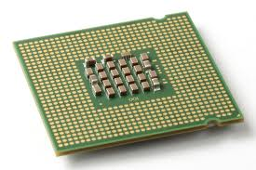



CoScale: Coordinating CPU and Memory System DVFS in Server Systems
Qingyuan Deng, David Meisner⁺, Abhishek Bhattacharjee, Thomas F. Wenisch*, and Ricardo Bianchini
Rutgers University +Facebook Inc. *University of Michigan

Slide 2
Server power challenges
CPU and memory power represent the vast majority of server power
Notes:
2

Slide 3
Need to conserve both CPU and memory energy
Related work
  Lots of previous CPU DVFS works
  MemScale: Active low-power modes for memory [ASPLOS11]
Uncoordinated DVFS causes poor behavior
  Conflicts, oscillations, unstable behavior
  May not generate the best energy savings
  Difficult to bound the performance degradation
Need coordinated CPU and memory DVFS to achieve best results
  Challenge: Constrain the search space to good frequency combinations

Slide 4
CoScale: Coordinating CPU and memory DVFS
Key goal
  Conserve significant energy while meeting performance constraints
Hardware mechanisms
  New performance counters
  Frequency scaling (DFS) of the channels, DIMMs, DRAM devices
  Voltage & frequency scaling (DVFS) of memory controller, CPU cores
Approach
  Online profiling to estimate performance and power consumption
  Epoch-based modeling and control to meet performance constraints
Main result
  Energy savings of up to 24% (16% on average) within 10% perf. target;
  4% on average within 1% perf. target

Slide 5
Outline
Motivation and overview
CoScale
Results
Conclusions

Slide 6
CoScale design
Goal: Minimize energy under user-specified performance bound
Approach: epoch-based OS-managed CPU / mem freq. tuning
Each epoch (e.g., an OS quantum):
  Profile performance & CPU/memory boundness
    Performance counters track mem-CPI & CPU-CPI, cache performance
  Efficiently search for best frequency combination
    Models estimate CPU/memory performance and power
  Re-lock to best frequencies; continue tracking performance
    Slack: delta between estimated & observed performance
  Carry slack forward to performance target for next epoch
6
Notes:
6

Slide 7
Frequency and slack management
Actual
Profiling
Pos. Slack
Neg. Slack
Pos. Slack
Target
Calculate slack vs. target
Performance
Estimate performance/energy via models
High Core Freq.
Core
Low Core Freq.
MC, Bus + DRAM
High Mem Freq.
Low Mem Freq.
Epoch 1
Epoch 2
Epoch 3
Epoch 4
Time
7
7
Notes:
7

Slide 8
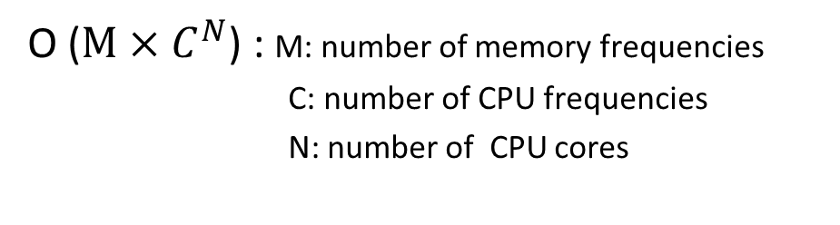
Frequency search algorithm
Offline
Memory Frequency
Core 0 Frequency
Core 1 Frequency
Impractical!
O ($M×C^{N}$) : M: number of memory frequencies
C: number of CPU frequencies
N: number of CPU cores

Slide 9
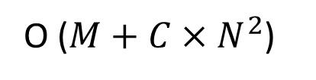
Frequency search algorithm
CoScale
Metric: △Power/△Performance
Mem
Core 0
Core 1
Action
0.73
0.65
0.81
Core 1
0.73
0.65
0.52
Mem
0.61
0.65
0.52
Core 0
Mem
Memory Frequency
Core 0
Mem
Mem
Core 0 Frequency
Core 1
Core 1 Frequency
Core grouping: Balance impact of memory and cores
O ($M+C×N^{2}$)

Slide 10
Outline
Motivation and overview
CoScale
Results
Conclusions
10

Slide 11
Methodology
Detailed simulation
  16 cores, 16MB LLC, 4 DDR3 channels, 8 DIMMs
  Multi-programmed workloads from SPEC suites
Power modes
  Memory: 10 frequencies between 200 and 800 MHz
  CPU: 10 frequencies between 2.2GHz and 4GHz
Power model
  Micron’s DRAM power model
  McPAT CPU power model

Slide 12
Results – energy savings and performance
Average energy savings
Performance overhead
Higher CPU energy savings on MEM; higher memory savings on ILP
System energy savings of 16% (up to 24%); always within perf. bound

Slide 13
Alternative approaches
Memory system DVFS only: MemScale
CPU DVFS only
  Select the best combination of core frequencies
Uncoordinated
  CPU & memory DVFS controllers make independent decisions
Semi-coordinated
    CPU & memory DVFS controllers coordinate by sharing slack
Offline
  Select the best combination of memory and core frequencies
  Unrealistic: the search space is exponential on the number of cores

Slide 14
Results – dynamic behavior
Timeline of milc application in MIX2

Slide 15
Results – comparison to alternative approaches
Full-system energy savings
Performance overhead
CPI increase (%)
Energy Savings (%)
CoScale achieves comparable energy savings to Offline
Uncoordinated fails to bound the performance loss

Slide 16
Results – Sensitivity Analysis
Impact of performance bound
Results for MID workloads

Slide 17
Conclusions
CoScale contributions:
  First coordinated DVFS strategy for CPU and memory
  New perf. counters to capture energy and performance
  Smart OS policy to choose best power modes dynamically
Avg 16% (up to 24%) full-system energy savings
Framework for coordination of techniques across components
In the paper
  Details of search algorithm, performance counters, models
  Sensitivity analyses (e.g., rest-of-system power, prefetching)
  CoScale on in-order vs out-of-order CPUs

Slide 18


THANKS!
SPONSORS:

