Slide 1

Kernel Weaver: Automatically Fusing Database Primitives for Efficient GPU Computation
Haicheng Wu¹, Gregory Diamos², Srihari Cadambi³,
Sudhakar Yalamanchili¹
¹Georgia Institute of Technology
²NVIDIA Research
³NEC Laboratories America
Sponsors: National Science Foundation, LogicBlox Inc. , and NVIDIA
Notes:
1

Slide 2




Data Warehousing Applications on GPUs
The Opportunity
  Significant potential data parallelism
  If data fits in GPU memory, 2x—27x speedup has been shown ¹
The Challenge
  Need to process 1-50 TBs of data²
  15–90% of the total time* spent in moving data between CPU and GPU *
  Fine grained computation
1 B. He, M. Lu, K. Yang, R. Fang, N. K. Govindaraju, Q. Luo, and P. V. Sander. Relational query co-processing on graphics processors. In TODS, 2009.
2 Independent Oracle Users Group. A New Dimension to Data Warehousing: 2011 IOUG Data Warehousing Survey.

Slide 3
Relational Algebra (RA) Operators
RA operators are the building blocks of DB applications
Set Intersection
Set Union
Set Difference
Cross Product
Join
Select
Project
Example: Select [Key == 3]
Key | Value
3 | True, a
3 | False, b
4 | True, a
Key | Value
3 | True, a
3 | False, b
4 | True, a

Slide 4
Relational Algebra (RA) Operators
RA are building blocks of DB applications
Set Intersection
Set Union
Set Difference
Cross Product
Join
Select
Project
Example: Join
New Key = Key(A) ∩ Key(B)
New Vallue = Value(A) U Value(B)
Key | Value
3 | a
3 | b
4 | a
Key | Value
3 | c
4 | d
5 | e
Key | Value
3 | a,c
3 | b,c
4 | a,d
A
B
JOIN (A, B)

Slide 5
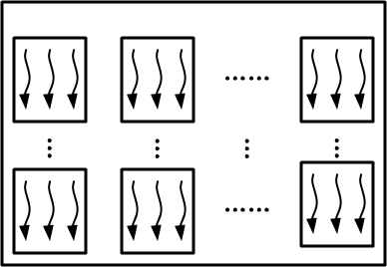
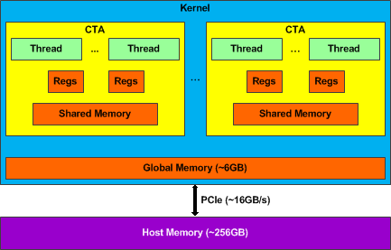
Data Movement in Kernel Execution
M
T
N
② Execute
~250GB/s
① Input
③ Result

Slide 6
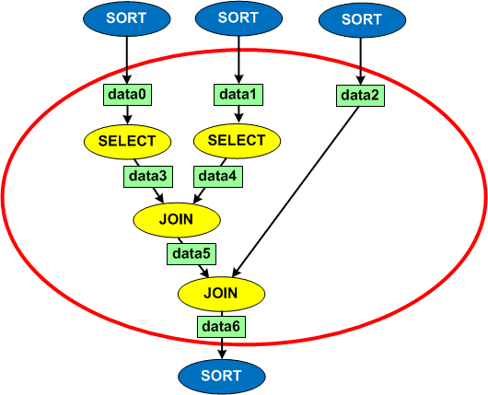
Kernel Fusion- A Data Movement Optimization
Increase the granularity of kernel computation
Reduce data movement throughout the hierarchy
Inspired by loop fusion
Compile-time automation
  Input is an optimized query plan

Slide 7
Kernel Fusion
A1
A2
A1
A2
A3
Before Fusion
Kernel A
A3
After Fusion
Fused Kernel A , B
Temp
Kernel B
Result
Result
GPU MEM
GPU Core
GPU MEM
GPU Core
A1
A1
A1
A1
Temp
Temp
Temp
A2
A2
A2
A2
A3
A3
A3
A3
Result
Result
Result
Result
Kernel A
Kernel B
Fused Kernel A&B

Slide 8
Major Benefits
Reduce Data Footprint
  Reduction in accesses to global memory
  Access to common data across kernels improves temporal locality
  Reduction in PCIe transfers
Expand optimization scope of the compiler
  Data re-use
  Increase textual scope of optimizers
A1
A2
A1
A2
A3
Kernel A
A3
Fused Kernel A , B
Temp
Kernel B
Result
Result

Slide 9
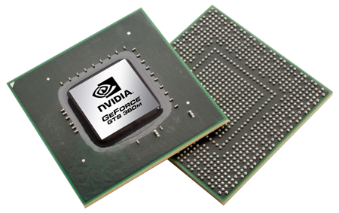
Red Fox Compilation Flow
Kernel Weaver – CUDA source to source transformation to apply kernel fusion
Datalog Queries
RA Primitives Library
LogicBlox
Front-End
RA-to-PTX
(nvcc + RA-Lib)
Runtime
Kernel Weaver
Language Front-End
Translation Layer
Back-End
Query Plan
PTX/Binary Kernel
PTX – Parallel Thread Execution

Slide 10
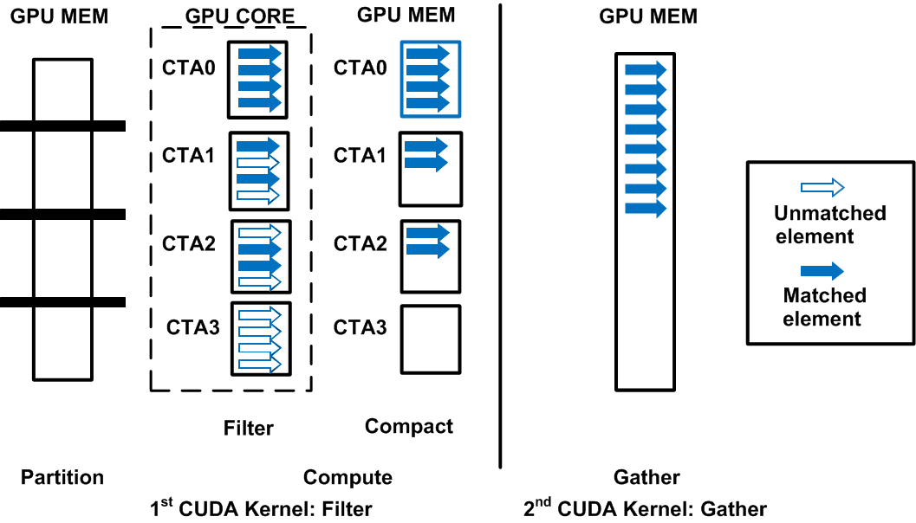
RA Implementation-Multi-Stage Algorithms
All primitives have the same three stages *
Each stage normally maps to 1 CUDA kernel
Example of SELECT
* G. Diamos, H. Wu, J. Wang, A. Lele, and S. Yalamanchili. Relational Algorithms for Multi-Bulk-Synchronous Processors. In PPoPP, 2013.

Slide 11
Kernel Fusion – Three Steps
Opportunity: Find candidates meeting fusion criteria.
Feasibility: Choose kernels to fuse according to available resources.
Fusion: Kernel fusion.

Slide 12
Kernel Fusion Criteria (1)
Compatible kernel configurations (CTA & thread dimensions)
  Implementations of RA primitives are parametric
  Empirically choose configurations after fusion
M1
T1
M
Kernel A
T
N1
M2
N
T2
Kernel B
N2
Fused Kernel A & B
12

Slide 13
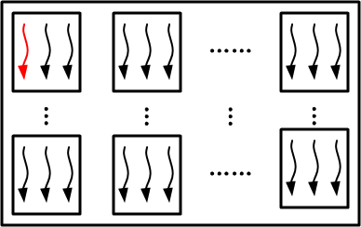
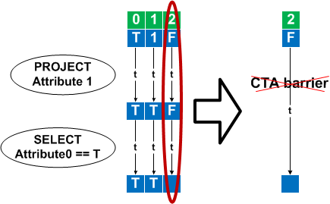
Kernel Fusion Criteria (2)
Dependence Restriction
  Thread dependence
Input data have 2 attributes
Kernel A
Kernel A
Kernel B
Kernel B
Operations of each thread are independent
Use registers to communicate

Slide 14
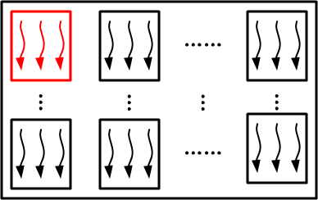
Kernel Fusion Criteria (2)
Dependence Restriction
  Thread dependence
  CTA (Thread Block) dependence
Kernel A
Kernel B
14

Slide 15
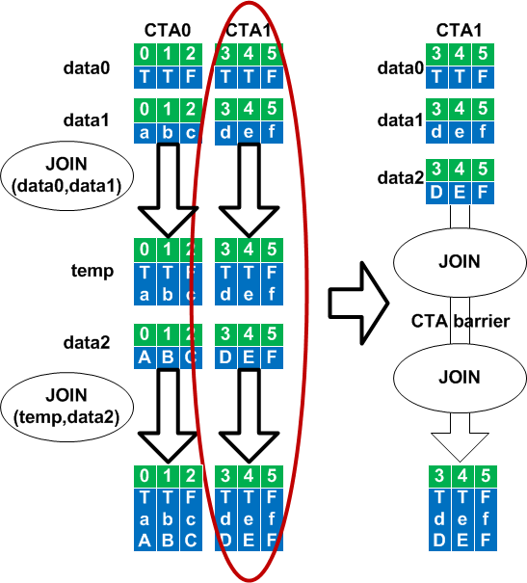
Kernel Fusion Criteria-CTA Dependence
Example of 2 back-to-back JOINs
Threads in the same CTA have dependence
No dependence between CTAs
Can be fused
After fusion
  Use Shared MEM to communicate
  Synchronization is needed

Slide 16
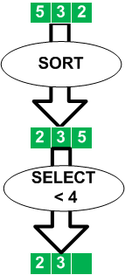
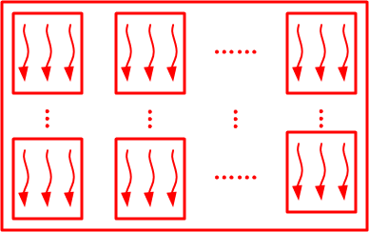
Kernel Fusion Criteria (2)
Dependence Restriction
  Thread dependence
  CTA (Thread Block) dependence
  Kernel dependence
Can be fused
Kernel A
Kernel B
16

Slide 17
Kernel Fusion Criteria - Candidates for Fusion
Only exhibit thread or CTA dependence
Bounded by operators with kernel dependence

Slide 18
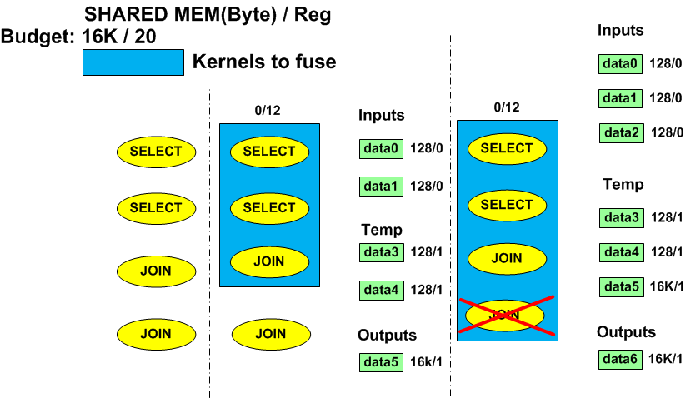
Choosing Operators to Fuse
Kernel fusion will increase resource usage, e.g., registers
Greedy heuristic to choose
Dependence Graph
1. Topo Sort
2. Incrementally add operators
3. Stop When the Estimated Usage is Larger than Budget

Slide 19
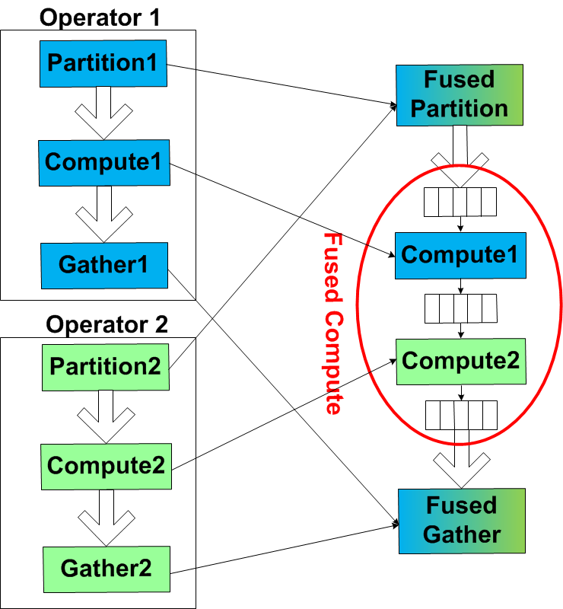
Kernel Weaving and Fusion
Interweaving and Fusing
individual stages (CUDA kernels)
Use registers or shared memory to store temporary result

Slide 20
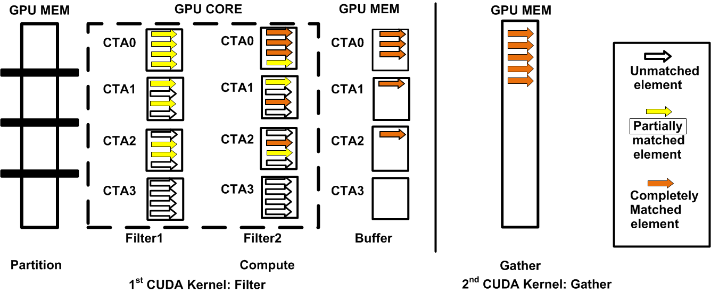
Fusing Thread Dependent Only Operators
Unary operators only
No Synchronization required
Register-based communication
Select
Select
Example of fusing 2 SELECTs

Slide 21
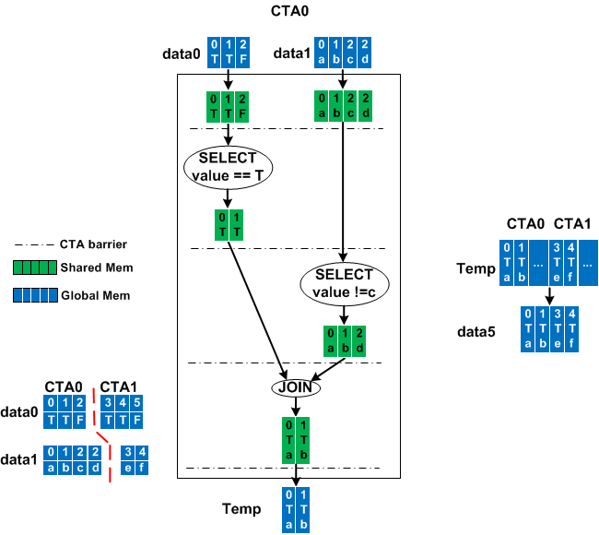
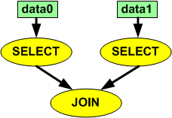
Fusing CTA and Thread Dependent Operators
Partition multiple inputs
Synchronization necessary
Communication via shared memory
Example Pattern
Gather
Partition
Compute

Slide 22
Experimental Environment
CPU | 2 quad-core Xeon E5520 @ 2.27GHz
Memory | 48 GB
GPU | 1 Tesla C2070 (6GB GDDR5 memory)
OS | Ubuntu 10.04 Server
GCC | 4.4.3
NVCC | 4.0
Use micro-benchmarks derived from TPC-H
  Measure memory allocation, memory access demand, effect of optimization scope, and PCIe traffic
Full queries from TPC-H

Slide 23
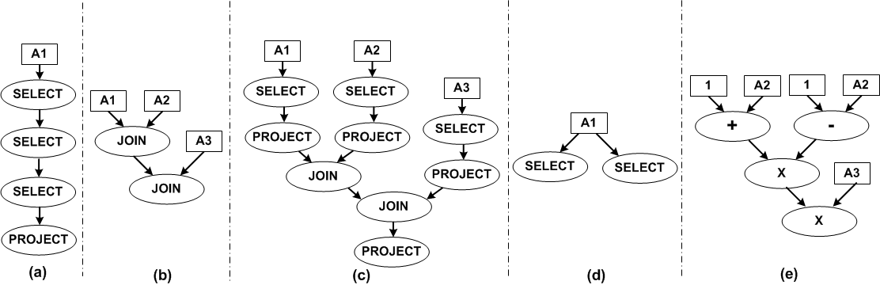
TPC-H Benchmark Suites
A popular decision making benchmark suite
Micro-benchmarks are common patterns from TPC-H
Baseline: directly using primitive implementation without fusion
Optimized: fusing all primitives of each pattern

Slide 24
Small Inputs-PCIe excluded
Small inputs (64MB-1GB) fitting the GPU memory
Fused vs. Not Fused
Average 2.89x speedup

Slide 25
Small Inputs-Analysis
Compiler Optimization
(Speedup of O3)
Memory Allocation
Memory Access Reduction

Slide 26
Large Inputs-PCIe included
Large inputs (1GB-1.6GB) fitting the GPU memory
Average 2.22x speedup overall
and 2.35x speedup in PCIe

Slide 27
Resource Usage & Occupancy
Individual primitive
After kernel fusion
 | PTX Reg # | Shared MEM (Byte) | Occupancy (%)
PROJECT | 11 | 0 | 100
SELECT | 22 | 3848 | 88
JOIN | 47 | 13580 | 38
+/- | 10 | 0 | 100
Multiply | 13 | 0 | 100
 | PTX Reg # | Shared MEM (Byte) | Occupancy (%)
(a) | 22 | 2308 | 88
(b) | 55 | 23560 | 33
(c) | 62 | 23048 | 17
(d) | 30 | 4612 | 67
(e) | 27 | 0 | 75
Kernel fusion may increase resource usage and thus decrease occupancy
These two do not negate the other benefits

Slide 28
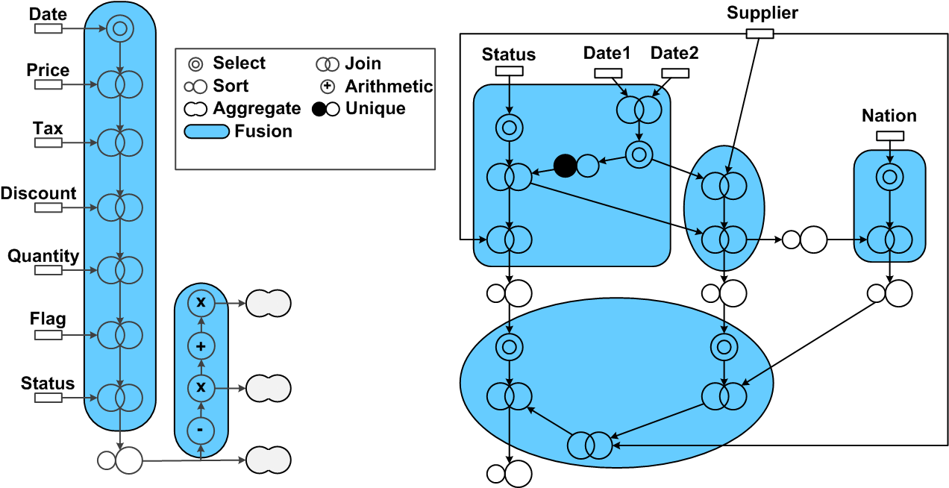
Real Queries (scale factor = 1)
TPC-H Q1
TPC-H Q21
1.25x speedup
1.22x speedup

Slide 29
Extensions
Different Domains
  Require multi-stage algorithm
  Dependence classification still applies
Different Representation
  PTX, OpenCL, LLVM
Different Platform
  CPU, GPU/CPU hybrid

Slide 30
Conclusions
Kernel Fusion can reduce data transfer and speeds up the computation for Data Warehousing Apps.
  Definition of basic dependences and general criteria for kernel fusion applicable across multiple application domains
  Quantification of the impact of kernel fusion on different levels of the CPU-GPU memory hierarchy for a range of RA operators.
  Proposes and demonstrates the utility of compile-time data movement optimizations based on kernel fusion

Slide 31
Thank You
Questions?
31

