Slide 1


Fine-grained Power Budgeting to Improve Write Throughput
of MLC PCM
¹Lei Jiang, ²Youtao Zhang,
²Bruce R. Childers and ¹Jun Yang
¹Electrical and Computer Engineering Department
²Computer Science Department
University of Pittsburgh, Pittsburgh

Slide 2
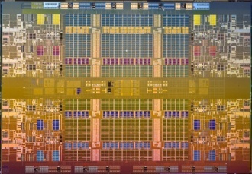


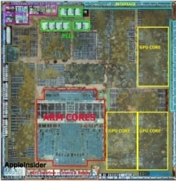

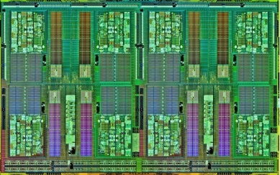
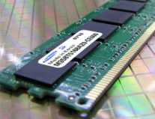
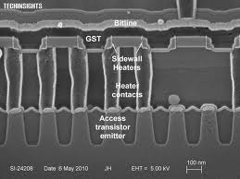
Phase Change Memory (PCM)
Intel
Xeon
8 cores
ARM
CortexA15
4 cores
AMD
Bulldozer
16 cores
MemCached
Working Set of
Single Thread (WSST)↑
# of Cores (C#)↑
Memory Capacity ↑ = C# x WSST
small
large
?
DRAM
PCM
Figures are from ARM, Intel, AMD, VoltDB, Memcached, MySQL and Samsung website

Slide 3
Multi-Level Cell and PCM write
00
01
11
10
Large Resistance Difference
Capacity ↑ Cost-per-bit ↓
Vreset
Vset,2
Higher than
V_{dd} write voltage
Vset,1
Voltage
Vset,0
Vverify
Vverify
Vverify
…
Time
Nondeterministic write

Slide 4
Multi-Level Cell and PCM write
00
01
11
10
More write power and energy
Large Resistance Difference
Capacity ↑ Cost-per-bit ↓
Vreset
Write is non-deterministic
Vset,2
Higher than
V_{dd} write voltage
Vset,1
Voltage
Vset,0
Vverify
Vverify
Vverify
…
Time
Nondeterministic write

Slide 5
PCM DIMM and Chip Architecture
1
Bridge Chip[FANG_PACT2011]: handles non-deterministic write
Iteration Manager (IM): iterative programming algorithm
2
Local Charge Pump (LCP): boosts voltage and current for writes

Slide 6
Power Constraint and Solution for SLC
DIMM level power constraint (DLPC) [HAY_MICRO’11]
  One DIMM only supports 560 concurrent RESETs (power token)
  ~one 512-bit (64B) write – poor write throughput
SLC power management (SPM) [HAY_MICRO’11]
  Approximately estimate # of written cells in cache by MC
  Allocate power tokens based on estimated number
  Reclaim after a fixed write latency
  Can write ~ 8 64B lines (assuming 15% cell changing rate)
Ideal
SPM
~Full write throughput

Slide 7
A Different Story on MLC
Higher power demand, but DLPC does not increase
  MLC has larger write power
  MLC needs larger memory line size and LLC
  More cell changes, lower write throughput
Nondeterministic write on MLC
  Reclaim power tokens after a fixed latency?
  Worst case write latency must be used → Power tokens wasted
67%
Ideal
SPM
MLC
SPM does NOT work on MLC!

Slide 8
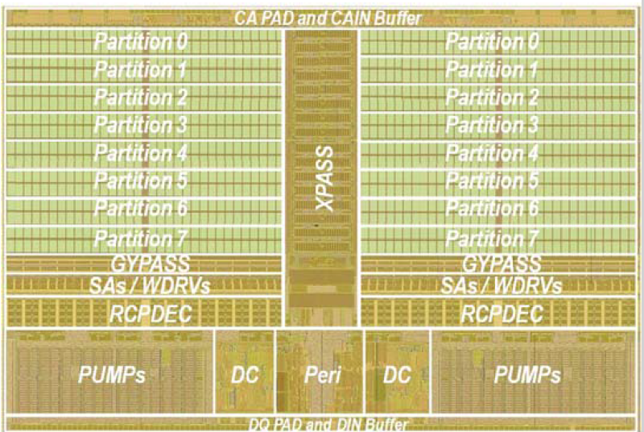
In Addition: Chip Level Power Constraint
Total # of cells written per chip is limited too
  Introduced by local charge pump (LCP) [LEE_JSSCC’09]
  LCP power supply ability ∝ LCP area
[CHOI_ISSCC’12]
15%-20%
area overhead

Slide 9
DIMM and Chip Power Constraints Example
DIMM
12
Chip 0 budget
Chip 1 budget
Chip 2 budget
DIMM
8
4
4
0
4
Bank 0
00 00 00 00
11 11 11 11
00 00 00 00
00 00 00 00
Bank 1
00 00 00 00
00 00 00 00
00 00 00 00
Hot chip
WR-A (bank 0)
00 00 00 00
11 11 11 11
00 00 00 00
WR-B (bank 1)
00 00 00 00
11
11
00 00
00 00 00 00
Chip power constraint is violated!
1
Write-A obeys both DIMM and chip power constraints
It can go to bank 0.
2
Write-B violates chip power constraint. It has to be stopped.
Notes:
Chip level power constraint could further limit write concurrency, as illustrated
in this simply example.
…
There are two banks and 3 chips on one DIMM. Each chip has 4 power tokens,
totally 12 power tokens on the DIMM. Write A goes to Bank 0. It changes 4 cells in
chip1. It obeys both chip and DIMM level power constraints, it can go. So no power
token is in chip 1. 4 Pts in chip0 and 4 in 2. Write B goes to bank 1, It changes 2
cells in chip 1. Although we have 8 pts on the DIMM, no power token is in chip 1.
chip level power budget is violated. Write B has to be stopped. So, chip 1 is frequently
written hot chip, it blocks following writes.

Slide 10
Performance with Both Power Constraints
49%
Ideal
SPM
DIMM
Chip
DIMM and chip power constraints hurt write throughput / performance a lot !

Slide 11
Simple Solutions?
Intra-line wear leveling [ZHOU_ISCA’09]
  Periodically shift N bytes for one line
Scheduling for power constraints
  Reorder writes
Shift bytes
WR-D
WR-D
WR-C
Conflict
WR-C
WR-B
WR-B
WR-A
WR-A
No Conflict
………..
………..
4x throughput
reordering
B and C
No Conflict
WR-D
WR-D
WR-C
WR-B
WR-B
WR-C
WR-A
Conflict
WR-A
Conflict
No Conflict
………..
………..
1.5x throughput

Slide 12
But They do NOT Help
DIMM only
DIMM+chip
1.5xLocal
2xLocal
PWL
Scheduling
PWL | intra-level wear leveling without overhead
Scheduling | Scheduling writes under both power constraints
N x local | Enlarging local charge pump
--- No effect
--- No effect
--- 1.5xlocal No effect
2 x local ≈ DIMM only case, but 100% overhead!

Slide 13
How to tackle
chip level power constraint?

Slide 14
Global Charge Pump
GCP
Bridge Chip
LCP
LCP
LCP
LCP
IM
DIMM
1
GCP balances power supply among chips
2
Power of GCP + LCPs ≤ DIMM level power constraint
3
Each sub-array is powered by either GCP or LCP, not both
4
Long wire → large resistance on wire[OH_JSSC’06] → low efficiency
5
Tradeoff between power utilization and efficiency

Slide 15
Global Charge Pump
GCP+100% eff. can relieve chip level P constraint!
GCP+50% eff. cancels the benefit of GCP!
Notes:
To see the impact of GCP power efficiency, we compare the GCP
performance with different power efficiencies. The efficiency
is defined w.r.t. local charge pumps. High power efficiency
means GCP is as efficient as LCP.
Ideal, with DIMM power constraint only, and DIMM plus chip
power constraint.
With high power efficiency, using a GCP is comparable to the
DIMM only scheme, meaning that it can completely balance the
chip level power constraint across the entire DIMM. However,
when the efficiency decreases, which is a more realistic case,
this benefit drastically drops. As we can see, a 50% power efficiency
results a comparable performance as DIMM+chip, completely offsetting the
benefit of having a GCP.
To overcome low power efficiency on GCP, we propose simple cell mappings
to mitigate the imbalanced write traffic among different chips.

Slide 16
Cell Mapping
Naïve Mapping (NE)
64B line = 256 cells
255
31 …. 0
7
6
5
4
3
2
1
0
Chip
7
6
5
4
3
2
1
0
Vertical Interleaving (VIM)
Chip# = Cell# mod 8
7
3
2
1
0
7
6
6
5
5
4
Chip
4
3
2
1
0

Slide 17
Can We Do Even Better?
Braided Interleaving (BIM)
255
Chip# = (Cell# – Cell# / 16) mod 8
31 30 29 … 23 22 …. 16 15 14 … 8 7 6 5 4 3 2 1 0
6
5
4
3
2
1
0
7
7
6
5
4
3
2
1
0
7
6
5
4
3
2
1
0
Chip
7
6
5
4
3
2
1
0
7
6
5
4
3
2
1
0

Slide 18
Effectiveness of Cell Mapping
?
GCP + V/BIM + 70% eff. ≈ GCP + 100% eff. !
GCP + V/BIM + 50% eff. > GCP + 70% eff.

Slide 19
Can we utilize DIMM level power budget much better?

Slide 20


Iteration Power Management
 | power | latency
R_{eset} | 2 | 1
S_{et} | 1 | 2
A: 50 cell changes
B: 60 cell changes
Total : 80
R_{eset}
S_{et}
S_{et}
S_{et}
S_{et}
50
40
26
12
ideally
60
36
20
12
2
Complete in 9 units of time
SPM
on
MLC
50
50
50
50
50
40
26
12
60
60
60
60
60
wait
60
36
20
12
2
Complete in 16 units of time

Slide 21
Iteration Power Management
 | power | latency
R_{eset} | 2 | 1
S_{et} | 1 | 2
A: 50 cell changes
B: 60 cell changes
Total : 80
Proposed
IPM
50
25
20
13
50
40
26
12
60
30
18
10
6
60
36
20
12
2
Complete in 12 units of time
Multi
RESET
(MR)
50
25
20
13
50
40
26
12
30
30
60
30
18
10
6
30
60
36
20
12
2
30
Complete in 10 units of time
Notes:
We propose our iteration based power management which allocates power tokens
iteration by iteration. The allocation budget for next iteration is based on
the cell changes in current iteration. And the reset of power tokens are reclaimed
immediately. As shown in this example, the 1st iteration still starts with 50 tokens.
In the 2nd iteration of, only 25 power tokens are allocated. This is because
the 1st iteration has only 50 cell changes Which is the upper bound of the cell
changes in the 2nd SET iteration, and a SET costs only half token. In the 2nd iteration,
there are only 40 cell changes, so the 3rd iteration allocates only 20 tokens. So on
and so forth. Since many power tokens have been reclaimed back in time, B can start
as soon as there are 60 free power tokens on DIMM, much earlier than before. This
schedule saves 4 time units in the end.
Finally, we notice that the power consumption peak is actually in the first reset
iteration. If we break the number of RESET cells into two groups, one group might be
able to go since it requires fewer power tokens. In this example, B can start at the
same time with A if we break the RESET cells into two groups. Such schedule
Saves 2 more time units in completing both writes.
As we can see, we can effectively increase the write concurrency through more
economical power token management.

Slide 22
Experimental Methodology
In-order 8-core 4GHz CMP processor
  L1: private i-32KB/d-32KB
  L2: private 2MB, 64B line
  L3: DRAM off-chip, private 32MB, 256B line
4GB 2-bit MLC PCM main memory
  One DIMM, single-rank, 8 banks
  R/W queue 24 entries [HAY_MICRO’11]
  Read first; schedule writes when NO read
  Queue is full → write burst issuing all write until queue is empty
  RESET: 500 cycles, 300μA, 480μW
  SET: 1000 cycles, 150μA, 90μW
  MLC non-deterministic write model [QURESHI_HPCA’10]
Benchmarks
  SPEC2006, BioBench, MiBench and STREAM
Notes:
Configuration

Slide 23
Effectiveness of IPM
86%
76%
x2.4

Slide 24
Conclusions
Increasing # of cores & Enlarging working set
  Large & scalable main memory: MLC PCM
Two power restrictions on MLC PCM
  Limited DIMM level power constraint
  Small chip level power constraint
Global charge pump
  Overcome chip level power constraint
Iteration power management
  Better utilize DIMM level power budget
Our techniques achieve
  Write throughput ↑ by x2.4; Performance ↑ by 76%

Slide 25
Fine-grained Power Budgeting to Improve Write Throughput
of MLC PCM
¹Lei Jiang, ²Youtao Zhang,
²Bruce R. Childers and ¹Jun Yang
¹Electrical and Computer Engineering Department
²Computer Science Department
University of Pittsburgh, Pittsburgh

