Slide 1

Award Presentation
Tuesday, December 4, 2012
Micro-45
Vancouver, B.C.

Slide 2
In Recognition of Significant Contributions in the Field of
Computer Microarchitecture
and
Compiler Code Generation

Slide 3
Annual Award - $2000 Honorarium and Certificate
Established by IEEE Computer Society in 2010
Nominations for anyone, by any IEEE member at:
http://www.computer.org/portal/web/awards/Rau
The Award was established with the immense help and energies of:
Erik Altman Todd Austin Rich Belgard
Bob Colwell Tom Conte Kemal Ebcioglu
Paolo Faraboschi Wen-Mei Hwu Norm Jouppi
Scott Mahlke Bill Mangione-Smith
Trevor Mudge Yale Patt

Slide 4



The Award is funded by:
Anonymous Individual Contributors

Slide 5
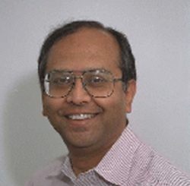
Bachelor of Technology - Indian Institute of Technology
M.S. and Ph.D. degrees from Stanford University
Recipient of the ACM/IEEE Eckert-Mauchly Award
Fellow of both the ACM and the IEEE

Slide 6
Taught at the University of Illinois, Urbana-Champaign
Consulting professor at Stanford University
Inventor on 15 patents
Numerous research publications in the areas of VLIW, high-performance computing and automated computer system design.

Slide 7
1984: Co-founded Cydrome Inc. and was the chief architect of the Cydra 5 mini-supercomputer.
1989: Joined Hewlett Packard and started HP Lab's research program in VLIW and instruction-level parallel processing. Director of the Compiler and Architecture Research (CAR) program, which during the 1990s, developed advanced compiler technology for Hewlett Packard and Intel computers.
At HP, also worked on PICO (Program In, Chip Out) project to take an embedded application and to automatically design highly customized computing hardware that is specific to that application, as well as any compiler that might be needed.
2002: passed away after losing a long battle with cancer

Slide 8
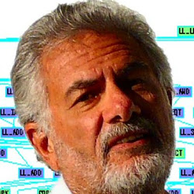
The 2012 B. Ramakrishna (Bob) Rau Awardee:
Dr. Joseph A. (“Josh”) Fisher

Slide 9
2012 Awards Committee:
Rich Belgard (Chair)
Tom Conte
Scott Mahlke
Yale N. Patt
Mike Schlansker
Mateo Valero

Slide 10
The 2012 B. Ramakrishna (Bob) Rau Awardee:
Dr. Joseph A. (“Josh”) Fisher
"For the development of trace scheduling compilation and pioneering work in VLIW architectures."

Slide 11
The 2012 B. Ramakrishna (Bob) Rau Awardee:
Dr. Joseph A. (“Josh”) Fisher
BA, MA, Ph.D. - Courant Institute at N.Y.U.
Taught at Yale – 1979-84
Co-Founder, first CEO and CTO –
Multiflow Computer – 1984-90
Hewlett Packard - 1990-2006
Currently: Aston & Flamingo Park Tennis Courts, Miami Bch.

Slide 12
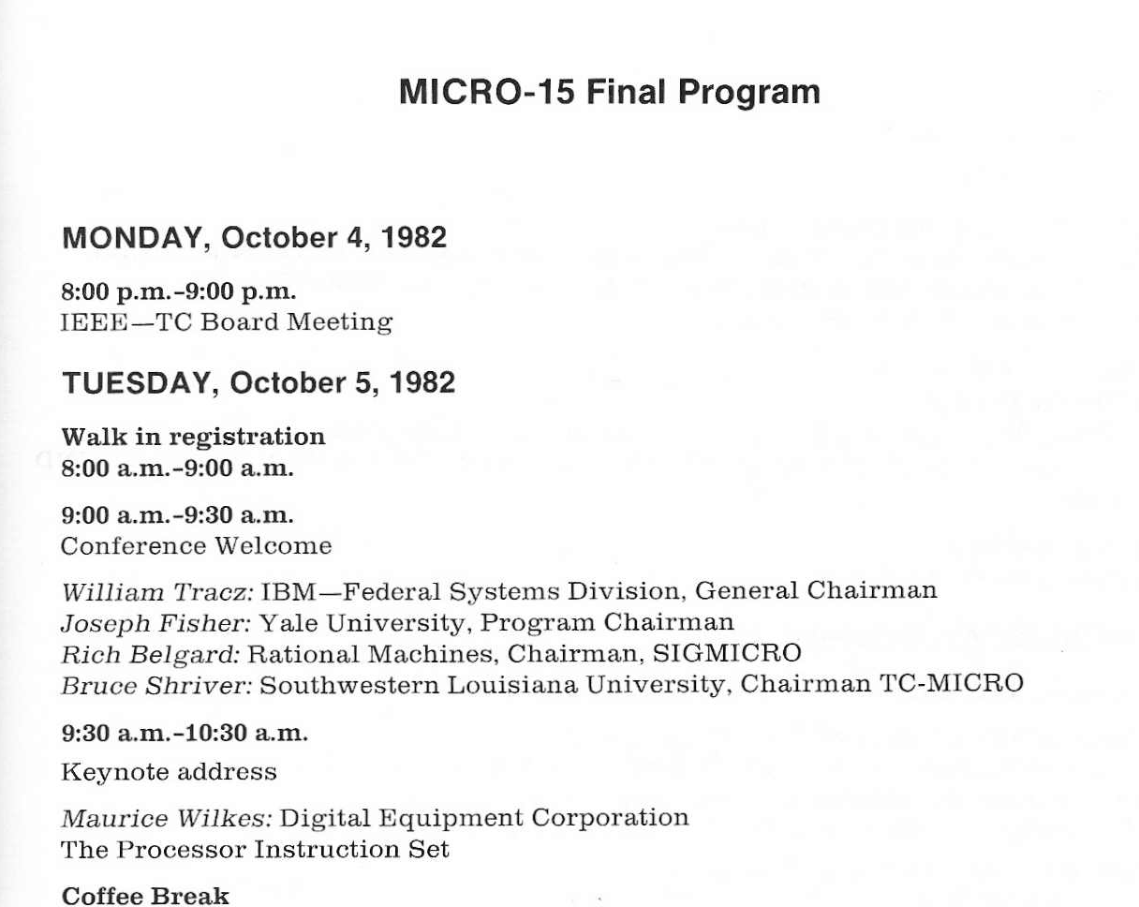
Josh has done many things throughout his career…

Slide 13
Josh has done many things throughout his career…
made pioneering contributions in both compilers and computer architecture.
developed the idea of trace scheduling, and, along with Bob Rau, is recognized as one of the fathers of VLIW.
introduced VLIW as a computer architecture design in 1981 .
co-founded Multiflow Computer, Inc.

Slide 14
Josh has done many things throughout his career…
made contributions to the HP Wide-Word architecture, which in turn led to the Itanium architecture.
once said “Carly Fiorina is doing a good job as H.P. CEO”
worked on VLIW embedded processors and on run-time translation at HP.
retired from HP in 2006. Now, a Senior HP Fellow Emeritus.

Slide 15
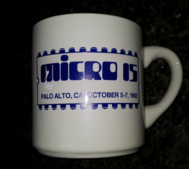
… Josh was Winner of the 1st (and LAST)
Annual Microprogramming Bowl
(the prize)

Slide 16
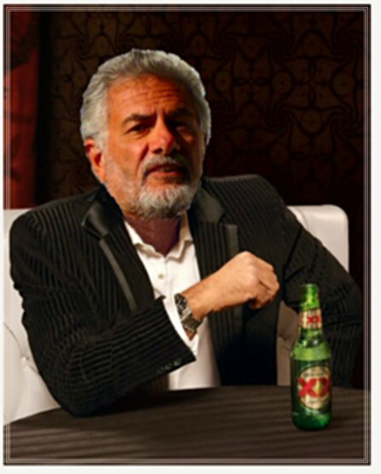
… but… most importantly, Josh is, in fact,
“The Most Interesting Man in the World”

Slide 17
The 2012 B. Ramakrishna (Bob) Rau Awardee:
Dr. Joseph (“Josh”) Fisher
It gives me great pleasure to present the Certificate and the Honorarium of the 2012, B. Ramakrishna Rau Award
(and yet another of the few remaining MICRO-15 coffee mugs)
to:
Joseph A. (“Josh”) Fisher

