Slide 1
Libra:Tailoring SIMD Execution using Heterogeneous Hardware and Dynamic Configurability
Yongjun Park¹, Jason Jong Kyu Park¹ , Hyunchul Park²,
and Scott Mahlke¹
December 3, 2012
¹University of Michigan, Ann Arbor
²Programmin Systems Lab, Intel Labs, Santa Clara, CA

Slide 2
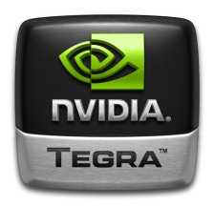


Current mobile Solutions & Challenges
ILP-based
DLP-based
1.6 GHz ARM Cortex-A9
ULP GeForce
1.7 GHz Krait
Adreno 320
1.6 GHz ARM Cortex-A9
ARM Mali-400 MP4
Good for ILP
Good for DLP
legacy workloads
media processing
web browsing
scientific computing
wireless communication
Image processing
Mixture of ILP/DLP
Goal: Design of a flexible & energy efficient unified accelerator

Slide 3
Libra: Loop-adaptive SIMD Accelerator
Application
Heterogeneous SIMD
High-DLP loops
Traditional SIMD
0
Int
Expensive unit
0
1
Int
Expensive unit
0
2
Int
Expensive unit
Low/No-DLP loops
1
3
Int
Expensive unit
4
2
Int
Expensive unit
5
Int
Expensive unit
ExOp-intensive loops
1
6
Int
Expensive unit
3
7
Int
Expensive unit
  Heterogeneous lane structure: less power/area
  Dynamic configurability: change ILP/DLP capability

Slide 4
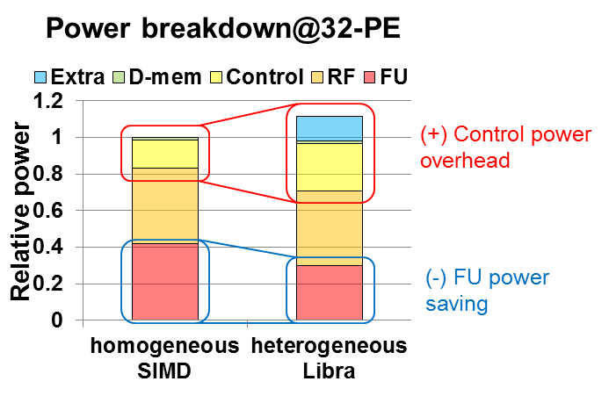
Homogeneous SIMD vs. Heterogeneous Libra
Control power overheads can be minimized by Functional Units power savings.

