Slide 1
NoCAlert: An On-Line and Real-Time Fault Detection Mechanism for Network-on-Chip Architectures
Andreas Prodromou, Andreas Panteli, Chrysostomos Nicopoulos, Yiannakis Sazeides

Slide 2
Wrong is NOT Always Illegal
  In Networks-on-Chip, checking for legality is the same as checking for correctness.
    Let the values be wrong. As long as they are legal…
  But checking for legality is much simpler
    Extremely fast and efficient fault detection
    Instantaneous detection

Slide 3
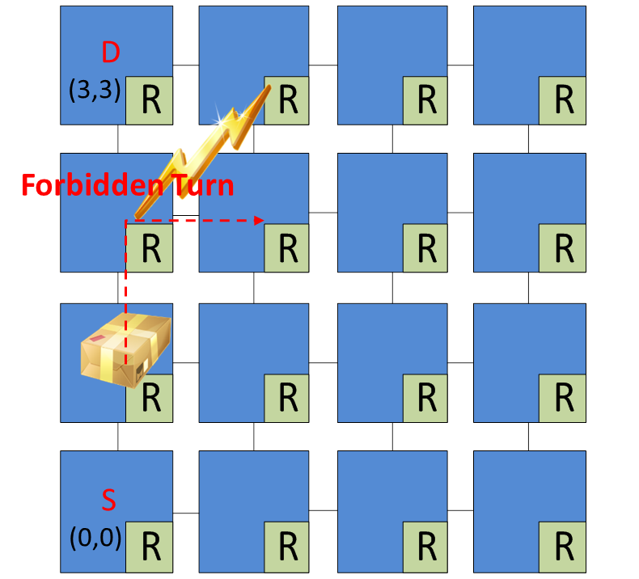
Invariance Checking
  How to achieve this: Invariance Checking
    Inputs and outputs of the main components are constantly monitored
  Extremely lightweight solution
    3% Area Overhead
    0.7% Power Overhead
    1% Delay Overhead
  Scales efficiently to more
  complex designs

Slide 4
Where and When
14:30 – 15:00
Section IB – Fault Tolerance
We would be glad to see you there

