Slide 1
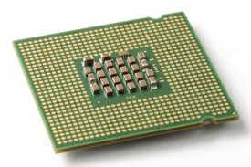
CoScale: Coordinating CPU and Memory System DVFS in Server Systems
Qingyuan Deng, David Meisner⁺, Abhishek Bhattacharjee, Thomas F. Wenisch*, and Ricardo Bianchini
Rutgers University +Facebook Inc. *University of Michigan

Slide 2
CoScale: Coordinating CPU and memory DVFS
Motivation
Lots of previous CPU DVFS works
MemScale: Active low-power modes for memory [ASPLOS’11]
Uncoordinated DVFS causes poor behavior
Need coordinated CPU and memory DVFS to achieve best results
Contributions
First coordinated DVFS strategy for CPU and memory
New performance counters to capture energy and performance
Policy to constrain the search space to good frequency combinations
Avg 16% (max 24%) energy savings for wide range of workloads
Framework for coordination of techniques across components

