Slide 1
H3VP: History Based Highly Reliable Hybrid Value Predictor
Kenichi Koizumi, Kei Hiraki, Mary Inaba
The University of Tokyo

Slide 2
Value Prediction (1/3)
Predict result values of executing instruction
Comparison to Branch Prediction
Branch Prediction
Single bit prediction (taken or not-taken)
Speed-up by solving control dependencies
Small penalty when prediction fails
Value Prediction
Multi-bit (32 or 64) prediction
Speed-up by solving data-dependencies
Large penalty when prediction fails

Slide 3
Value Prediction (2/3)
Most branch predictors are history-based
Simple predictors (e.g. last two values) have high hit-ratio.
SOTA predictor shows very high hit-ratio.
Value prediction is much difficult
Locality of result values exists but far less than that of branch
About 50% executed instructions output last values and
80% instructions output one of 16 latest results [Lipasti+,96]
Much lower hit-ratio than branch predictors

Slide 4
Value Prediction (3/3)
Miss penalty
Latency of normal instruction < branch instruction
Number of canceled instruction is much larger than that in branch prediction
Branch prediction
<<
Value prediction

Slide 5
Existing studies
History-based prediction
Last value [Gab96, LWS96] result of the last execution
Reuse of Register value [TuSe99] target register
Stride 2-delta [Gab96] Arithmetic sequence
Last four value [BuZo99b, LiSh96]
Context-based prediction
Finite context method [SaSm97a, SaSm97b]
History length = 4, Exor indexed hashing
Confidence counter
Selection for actual value prediction that are confident
Selective Value Prediction[ CaReTu99]

Slide 6
Our submission to CVP-1
We implemented three functions necessary to predict values and trigger speculation
All values are 64-bit.
Some vector instructions split 128-bit into 64 bits.
We submitted all the three tracks:
8kB, 32kB, Unlimited

Slide 7
Inside the simulator(1/3)
getPrediction() is used to trigger speculation
Successful speculation decreases the number of cycles
Unsuccessful speculation increases the number of cycles
After triggering speculation, speculativeUpdate() shows the outcome of speculation
IF
ID
EX
WB
Instruction pipeline
Seq#,PC
Trigger
Predicted value
Seq#,Actual result value
getPrediction()
updatePredictor()
Seq#,PC,speculation flag
Speculation result,type of the instruction , register values before execution
speculativeUpdate()
Three functions necessary for simulation

Slide 8
Inside the simulator(2/3)
updatePredictor() shows the correct result.
speculativeUpdate() shows register values (SRC, DST) before Execution.
Register predictor in existing works uses only DST register
We cannot know detailed information other than Seq# and PC by getPrediction()
Necessary value histories are stoted in tables. They can be accessed by
(Seq#, PC).
IF
ID
EX
WB
Instruction pipeline
Seq#,PC
Trigger
Predicted value
Seq#,Actual result value
getPrediction()
updatePredictor()
Seq#,PC,speculation flag
Speculation result,type of the instruction , register values before execution
speculativeUpdate()

Slide 9
Inside the simulator(3/3)
16 instruction fetch in a cycle
A number of getPrediction() and speculativeUpdate() are at first called without corresponding updatePredictor()
That means these three functions are not atomic.
16
IF
ID
EX
WB
IF
ID
EX
WB
IF
ID
EX
WB
16
IF
ID
EX
WB
IF
ID
EX
WB
IF
ID
EX
WB
16
IF
ID
EX
WB
IF
ID
EX
WB
IF
ID
EX
WB
getPrediction()
updatePredictor()
getPrediction()
getPrediction()
speculativeUpdate()
speculativeUpdate()
speculativeUpdate()

Slide 10
Observation of given traces(1/6)
Contents of 1M trace of CVP-1
90 % are ALU inst.
Remaining 10% are mostly memory loads
Instructio type | Prediction non-eligible | Prediction eligible | total
0 alu | 21013 | 476609 | 497622
1 load | 0 | 62695 | 62695
2 store | 218396 | 2870 | 221266
3 condBranch | 227459 | 0 | 227459
4 uncondDirectBranch | 3137 | 3164 | 6301
5 uncondIndirectBranch | 4589 | 58 | 4647
6 fp | 0 | 18 | 18
7 slowAlu | 0 | 846 | 846
total | 474594 | 546260 | 1020854

Slide 11
Observation of given traces(2/6)
Half of PCs show Periodicity
Period of most periodic instructions is 1 (i.e. Constant)
Period | # of PCs | # of Inst
1 | 895 | 41515
2 | 26 | 1652
3 | 17 | 702
4 | 6 | 256
5--8 | 26 | 1453
None | 840 | 499898
Total | 1810 | 545476
Our predictor
1M trace

Slide 12
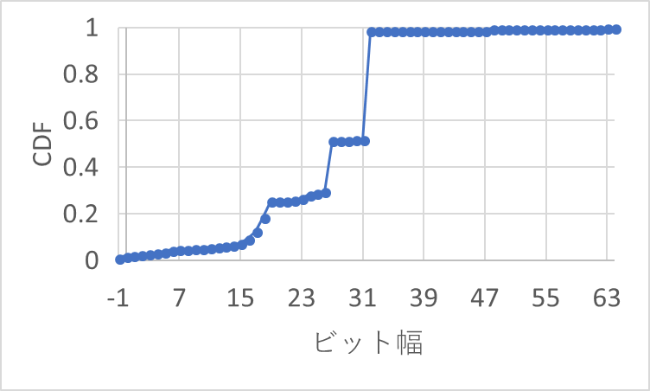
Observation of given traces(4/6)
CDF(cumulative distribution function) of actual values on 1M trace
Values more than 33 bits rarely become actual value to be predicted
32bit:98.7%
CDF
27bit:51.7%
26bit:29.5%
Bit width
19bit:25.7%

Slide 13
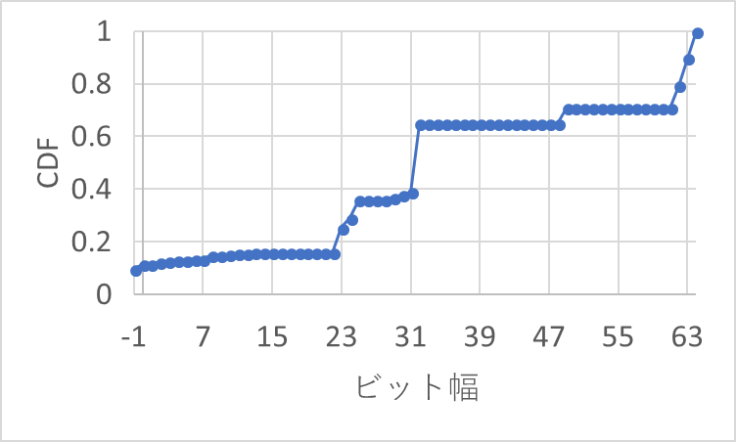
Observation of given traces(5/6)
13 traces are FP computations.
Distribution of values in compute_fp_4(first 1M instructions)
About 30～35% use 64 bit data
32bit:64.9%
25bit:35.9%
Bit width

Slide 14
Observation of given traces(6/6)
Large penalties on misprediction
Exact costs are unknown
Our estimation
80～100 hit ≒ 1 miss

Slide 15
Our strategies – (1)History-based Prediction
Forget PC without periodicity
Even when we use complicated predictor, learned by 30 execution history and it predict correctly 70 times, only one failure cancels all the benefit of complicated prediction.
We ignore long lengthy periodicity
The amount of memory is proportional to the max length of periodicity
We choose the length of period to 1, 2 and 3.
1 : Constant generation, loading constant
2 : Tuple data etc.
3 : 3D space computation

Slide 16
Our Strategies – (2)Hybrid Predictors
Predict for periodic sequences
Combine 2-peridoc predictor and 3-periodic predictor
Period 1(Constant value) can be predicted using 2-periodic and 3-periodic predicters
Predict for arithmetic sequences
Arithmetic sequence is easy to predict and use small amount of memory
When one of three predictor detects effective prediction, speculation is triggered.
Three predicters share History table to reduce memory use
Execution
information
(1) Arithmetic predictor
History
table
Speculation
command integrator
(2) Two-periodic predictor
(3) Three-periodic predictor
Speculation
command

Slide 17
Our Strategies – (3) High Reliability
To avoid speculation failures
Wait until confidence counter reaches the specified threshold
Use Two-step confidence threshold
A small threshold is used as long as no prediction miss occurs
A large threashold is used after the first misprediction
Effective use of storage
When another PC assigned to the already used hash entry is executed three successive times, entry assignment is updated

Slide 18
Periodicity Coverage of Our Predictor
Static periodicity
Periodicity determined statically by algorithm
Loop structure with fixed number of iterations
Dynamic periodicity
Periodicity determined dynamically by control flow of the program
Loop structure with variable number of iterations
Static periodicity | Dynamic periodicity | Coverage | Reason
Short(~3) | Short(~100) | × | Below 2nd conf. threshold Miss penalty is larger than benefit Forget speculation
Short(~3) | Long(100~) | 〇 | Our Target of speculation
Long(4~) | Any | × | Predictable by simple predictor Bad cost/performance Forget speculation
None | Any | × | Impossible by light-weight predictor Forget spaculation

Slide 19
State Machine for Speculation (1/3)
New PC
INIT
PREPARE
Different PC
Same PC
Different PC
Different PC
Correct &
under threshold
Same PC
FAILED
VERIFY
Miss
Miss
Correct & over threshold
Different PC
SPECULATE
Correct

Slide 20
State Machine for Speculation (2/3)
INIT
No instruction execution information has been provided
The entry has not been assigned to any PC
PREPARE
The entry has yet to obtain sufficient information to determine regularity
VERIFY
The entry has obtained sufficient information
Prediction reliability has not reached the threshold

Slide 21
State Machine for Speculation (3/3)
SPECULATE
Prediction reliability has reached the threshold
Speculating
FAILED
Misprediction has occurred
Change assigned PC
A PC that is different from the currently assigned PC is executed three times in succession
Discard the information about the currently assigned PC
Assign the entry to the new PC

Slide 22
H3VP Block Diagram (1/2)
PC is hashed to generate an index of history table
Hist0: value of the latest execution
Hist1: value of the previous execution
Hist2: value of the one preceding execution
Diff: Hist0 - Hist1
History table
PC
PC
Hist0
Hist1
Hist2
Diff
hash( )
$$⋯$$
$$⋯$$
Calculate prediction value
Actual value
$$−$$
$$=$$
Increment confidence counter
Predict value of the next execution
E.g., arithmetic predictor outputs Hist0+Diff
If prediction is correct, counter will be incremented

Slide 23
H3VP Block Diagram (2/2)
If at least one of three confidence counters exceeds threshold, speculation becomes active
Regardless of whether speculation is active, status is set to FAILED if prediction misses
Status & confidence counter of Predictors
Arithmetic
2-periodic
3-periodic
Status
Cnf
Status
Cnf
Status
Cnf
$$⋯$$
$$⋯$$
$$⋯$$
$$⋯$$
$$⋯$$
$$⋯$$
Confidence threshold
$$≥$$
$$≥$$
$$≥$$
Speculate

Slide 24
Storage Budget
Storage consumption of single entry
 | Field | Bit width [bit]
History table | PC, Hist0, Hist1, Hist2, Diff, NewPC | 64 * 6 = 384
 | Counter for NewPC | 2
Predictor (* 3 predictors) | State machine | 3 * 3 = 9
 | Conf. counter | 8 * 3 = 24
 | Failed flag | 1 * 3 = 3
Total |  | 422

Slide 25
Evaluation
135 traces of CVP-1
Geometric mean of IPC
Predictors for 8 kB 32 kB and Unlimited are exactly same
We use different # of entries and 1st confidence threshold
Tracks | 8 kB | 32 kB | Unlimited
# of entries | 128 | 512 | 1048576
Storage | 6.59 kB | 26.4 kB | 52.8 MB
1st conf. thres. | 24 | 10 | 10
2nd conf. thres. | 112 | 112 | 112

Slide 26
Overall Scores
No prediction (baseline): 3.211
H3VP (camera ready deadline)
8 kB: 3.341 (+4.06%)
32 kB: 3.378 (+5.19%)
Unlimited: 3.582 (+11.56%)
Reference (H3VP in first submission deadline)
8 kB: 3.226 (+0.47%)
32 kB: 3.251 (+1.25%)
Unlimited: 3.436 (+7.01%)

Slide 27
Benchmark Results of Individual Predictors
High IPC is achieved by integrating Periodic predictors and Arithmetic predictor

Slide 28
Selection of Confidence Threshold (1/2)
Too Small
We cannot avoid failure of speculation due to an appearance of an irregular value with a period length longer than the threshold value
Too Large
the beginning of speculation delays and the predictor will miss out rewards for speculation success
Performance varies greatly depending on 2nd conf. threshold
Optimal threshold is determined by the ratio of the acceleration rewards on speculation success to the rewinding penalty on speculation failure

Slide 29
Selection of Confidence Threshold (2/2)
Optimal value of 2nd conf. thres. is 112 in all tracks
Optimal value of 1st conf. thres.: 24 (8kB track), 10 (32kB and unlimited tracks)
112
112
112

Slide 30
Benchmark Results of Individual Traces (1/2)
633%
147%
8 kB
32 kB
633%
169%
Unlimited
633%
169%
compute_int
compute_fp
srv
H3VP IPC improvements for 135 CVP-1 traces

Slide 31
Benchmark Results of Individual Traces (2/2)
compute_fp shows low performance
Arithmetic predictor in H3VP uses integer adder/subtractor and can predict integer arithmetic sequences
Possibly arithmetic predictor using FP-adder/subtractor is effective

Slide 32
Summary
H3VP: History Based Highly Reliable Hybrid Value Predictor
Focus on speculation targets that can be characterized by arithmetic or periodic sequences
Suppresses the increase in storage consumption, while maintaining large history table for wide coverage
IPC improvements on CVP-1
+4.06% (8 kB), +5.19% (32 kB), +11.56% (Unlimited)

