Slide 1
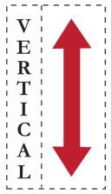
Cross-Architecture Performance Prediction (XAPP): Using CPU to predict GPU Performance
Newsha Ardalani
Clint Lestourgeon
Karthikeyan Sankaralingam
Xiaojin Zhu
University of Wisconsin-Madison

Slide 2
Executive Summary
Problem: GPU programming is challenging
Not clear how much speedup is achievable
Goal: Save programmers’ time from unnecessary porting effort
Insight:
Speedup is correlated with program properties and hardware characteristics.
Machine learning can learn the correlation
Results:
27% relative error across 24 benchmarks

Slide 3
Outline
Problem Statement
Insight
Overviews
Machine Learning Technique
Results
Future work

Slide 4
Problem Statement
For a given GPU platform, predict optimized GPU execution time obtainable for any CPU application prior to starting the code development process

Slide 5
Insight
GPU performance GPU hardware characteristics
Number of cores
GPU Performance Inherent program properties
Available parallelism: Inherent program property
Cache miss: platform-dependent program property
GPU Execution time =

Slide 6
Overview
CPU Program
GPU Program
CPU Program
GPU Program
CPU Program
GPU Program
CPU Program
GPU Program
Dynamic Binary Instrumentation
GPU Platform_{x}
Training data
GPU Execution Time
Feature Vector
…
…
CPU Program
Machine Learning Model
Dynamic Binary Instrumentation
Predicted
GPU Execution Time
F_{x} ( feature vector)

Slide 7
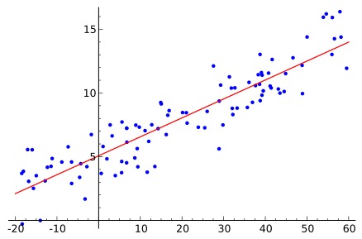
Machine Learning Technique:
Training Set
n
Training Subset₁
Training Subset₂
Training Subset_{p}
…
m
m
m
Step-wise Regression
Step-wise Regression
Step-wise Regression
…
Prediction₁
Prediction₂
Prediction_{P}
Majority Selection

Slide 8
Outline
Problem Statement
Insight
Overviews
Machine Learning Technique
Results
Future work

Slide 9
Results
Questions | Metrics | Results
How close is predicted speedup to actual speedup? | Accuracy | High
How robust across different GPU platforms? | Robustness | High
How much programmer involvement is required? | Usability | High
How quickly provide prediction? | Speed | High

Slide 10
Experimental Setup
Accuracy results on GPU GTX 750
Training Set: 112 datapoints
Rodinia, Lonestar, Parboil, Parsec Subset, NAS subset
Test Set: 24 datapoints
Feature Vector: 31 program properties
Program properties collected using MICA and Pin
Execution time measured on real GPU hardware

Slide 11
Accuracy results
Accuracy on platform 1 (GTX 750): 27% relative error
Accuracy on platform 2 (GTX 660): 36% relative error

Slide 12
How to use our tool? Model Construction Phase
CPU Program
GPU Program
CPU Program
GPU Program
CPU Program
GPU Program
Provided
GPU Platform_{x}
Training data
GPU Execution Time
Feature Vector
…
…
Machine Learning Model
F_{x} ( feature vector)

Slide 13
How to use our tool? Usage Phase
CPU Program
START
Dynamic Binary Instrumentation
STOP
F_{x} ( feature vector)
Speedup Prediction

Slide 14
One-time Cost Overhead
CPU Program
GPU Program
CPU Program
GPU Program
CPU Program
GPU Program
CPU Program
GPU Program
0 min
30 min
Dynamic Binary Instrumentation
GPU Platform_{x}
GPU Execution Time
Training data
Feature Vector
…
…
~ 2.5 hr
Machine Learning Model
F_{x} ( feature vector)

Slide 15
Recurring Overhead
CPU Program
GPU Program
CPU Program
GPU Program
CPU Program
GPU Program
CPU Program
GPU Program
Dynamic Binary Instrumentation
GPU Platform_{x}
Training data
GPU Execution Time
Feature Vector
…
…
CPU Program
Machine Learning Model
Dynamic Binary Instrumentation
Predicted
GPU Execution Time
~ 1 ms
F_{x} ( feature vector)

Slide 16
What it is not?
CPU Program
GPU Program
CPU Program
GPU Program
CPU Program
GPU Program
GPU Platform_{x}
Training data
…
…
Machine Learning Model
F_{x} ( feature vector)

Slide 17
Also in the paper
Why Ensemble Prediction?
Model Interpretation
End-to-End Case Studies

Slide 18
Summary
CPU
CPU
FPGA
GPU
GPU
XeonPHI

Slide 19
Questions?

