Slide 1

The CRISP Performance Model for Dynamic Voltage and Frequency Scaling in a GPGPU
Rajib Nath, Dean Tullsen
Micro 2015

Slide 2
Dynamic Voltage & Frequency Scaling
Power
Energy
Temperature
Reliability
Variability
Power
Energy
Temperature
Reliability
Variability
Performance
Performance
What is the performance impact of DVFS?
DVFS

Slide 3
DVFS Performance Model for GPGPUs
DVFS Opportunities in GPGPU
  GPGPU chips consume more power than CPU chips
  Provision for DVFS
  Voltage range is high
  Recent research shows energy saving opportunities
Challenges
  SIMD
  SIMT

Slide 4
Outline
DVFS Performance Models for CPUs
Limitation of Existing Models
Critical Stalled Path (CRISP)
  Model Component
  Model Parameterization
  Hardware mechanism and overhead
Experiment
  Execution Time Prediction
  Energy Savings
DVFS Performance Models for CPUs
Limitation of Existing Models
Critical Stalled Path (CRISP)
  Model Component
  Model Parameterization
  Hardware mechanism and overhead
Experiment
  Execution Time Prediction
  Energy Savings

Slide 5
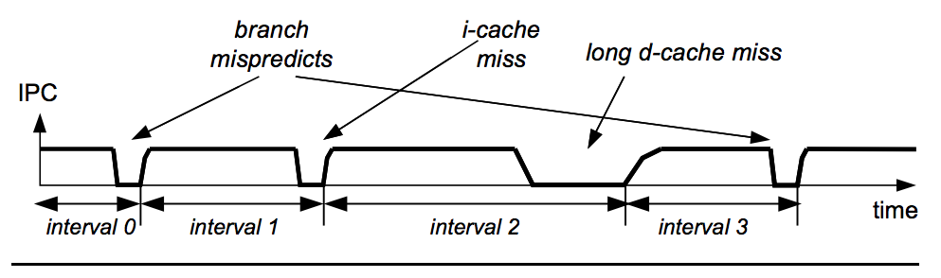
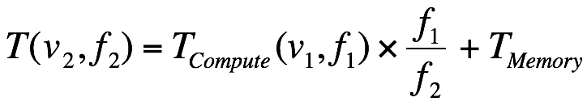



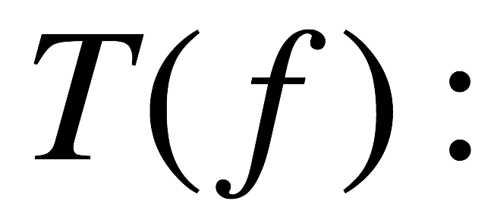
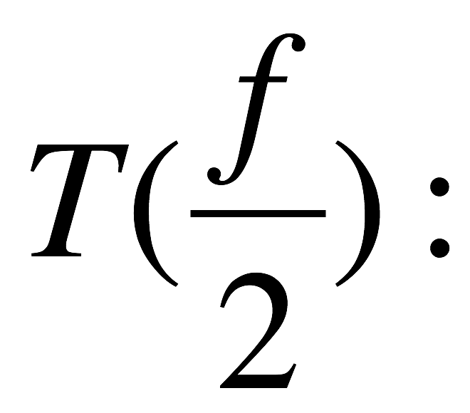
DVFS Performance Model for CPUs
Proportionate
Sampling
Empirical
Analytical
Proportionate
Sampling
Empirical
Analytical
β estimated from aggregate
metrics e.g., LLC miss counts
Does not account for MLP
×1
×2

Slide 6
Existing Analytical Models for CPUs
Stall counter [CF 2010]
Miss model [CF 2010]
Leading loads [TOC 2010]
Critical path [Micro 2012]
Accurate
Complex
Fundamental Assumption
  T_{memory} doesn’t scale with core frequency
  Cores never stall for stores

Slide 7
Outline
DVFS Performance Models for CPUs
Limitation of Existing Models
Critical Stalled Path (CRISP)
  Model Component
  Model Parameterization
  Hardware mechanism and overhead
Experiment
  Execution Time Prediction
  Energy Savings

Slide 8

Limitation of CPU Models on GPGPUs
L1 Cache Miss
Memory/Computation Overlap
Store Stalls
Complex Stall Classification
L1 Cache Miss
Memory/Computation Overlap
Store Stalls
Complex Stall Classification
Fundamental Assumption of CPU based model
  T_{memory} doesn’t scale with core frequency
  Cores never stall for stores
Challenges in GPGPU
SIMD & SIMT

Slide 9
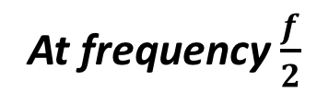
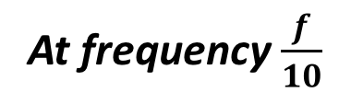
Limitation of CPU Models on GPGPUs
L1 Cache Miss
Memory/Computation Overlap
Store Stalls
Complex Stall Classification
At frequency f
At frequency $\frac{f}{2}$
At frequency $\frac{f}{10}$
Overlapped computations may make the kernel fully compute bound at a lower frequency

Slide 10
Limitation of CPU Models on GPGPUs
L1 Cache Miss
Memory/Computation Overlap
Store Stalls
Complex Stall Classification
At frequency f
At frequency $\frac{f}{2}$
Ignoring the scaling of overlapped computation causes under prediction of execution time

Slide 11
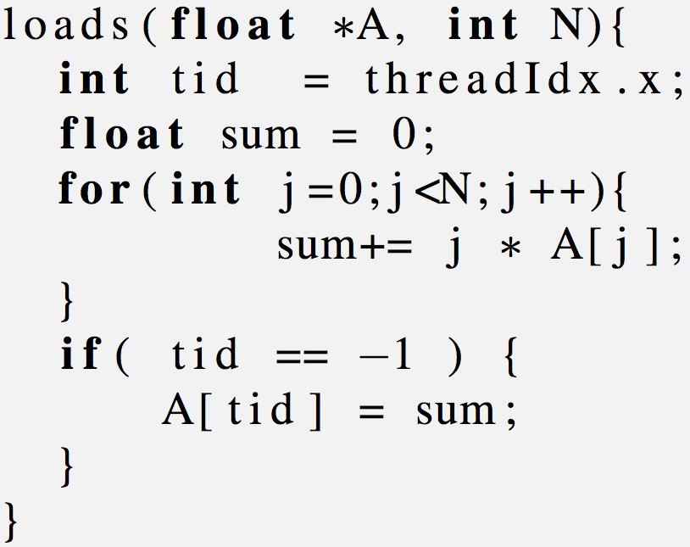
Limitation of CPU Models on GPGPUs
L1 Cache Miss
Memory/Computation Overlap
Store Stalls
Complex Stall Classification
prediction baseline frequency is 700 MHz
frequency is reduced from left to right
15 Core 48 Warp/Core
transition from memory bound to compute bound
Performance prediction
Ignoring the scaling of overlapped computation causes under prediction of execution time

Slide 12
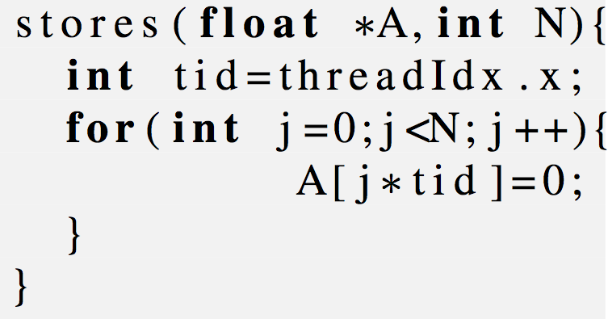
Limitation of CPU Models on GPGPUs
L1 Cache Miss
Memory/Computation Overlap
Store Stalls
Complex Stall Classification
1 SIMD store may fork into 32 stores
prediction baseline frequency is 700 MHz
frequency is reduced from left to right
1 Core 1 Warp(32 Thread)
1 Core 1 Thread
Settings | LSQ Full (Cycle%)
1 Core 1 Thread | 0
1 Core 1 Warp | 66
transition from memory bound to compute bound
Performance prediction
Ignoring store stall cycles causes over prediction of execution time

Slide 13
Outline
DVFS Performance Models for CPUs
Limitation of Existing Models
Critical Stalled Path (CRISP)
  Model Component
  Model Parameterization
  Hardware mechanism and overhead
Experiment
  Execution Time Prediction
  Energy Savings

Slide 14

CRItical Stalled Path (CRISP)
GPGPU kernel has 3 different phases
  load outstanding, pure compute, store stall
Execution time= Load critical path + compute store path
Both LCP and CSP scale independently with frequency

Slide 15



Load Critical Path (LCP) Portion
Load critical path
Overlapped computation
Dependent Loads
A → B
A → C
A → D
B → D
Load Stall
A=8
B=5
D=5
A=8
C=12
LCP is the longest sequence of dependent load latency [CRIT]
An LCP cycle is an overlapped computation or load stall

Slide 16





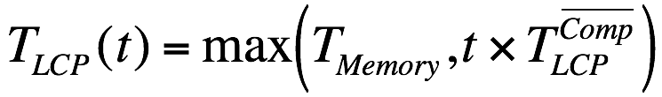
Load Critical Path (LCP) Portion
load
load
load
load
Load critical path
3
4
5
1
2
2
Overlapped computation
Frequency Scaling
transition
memory bound to compute bound
Load Stall
lm – kernel
Prediction of
LEAD or CRIT
Compute store path
frequency is reduced from left to right

Slide 17


Compute Store Path (CSP) Portion
Compute store path
Non-overlapped
computation
`
Store Stall
Load critical path
Cycles outside LCP belongs to CSP
All the pure compute and store stall phases belongs to CSP

Slide 18

Compute Store Path (CSP) Portion
3
4
5
1
2
2
Compute store path
Non-overlapped computation
Frequency Scaling
Store Stall
transition
Memory bound → Compute bound
cfd – kernel
frequency is reduced from left to right

Slide 19
CRISP Example
31
54
Existing Analytical Models
CRISP Model
54 = max(17*2, 20) + max(11,10*2)
Model | Prediction (units 1/f)
 | T_{Memory} | T_{Compute} | Time (at f/2)
STALL | 4 | 27 | 58
MISS | 24 | 7 | 38
LEAD | 18 | 13 | 44
CRIT | 20 | 11 | 42
CRISP | 20 |  | 54
CRISP Components
LCP | 20 | CSP | 11
Load Stall | 3 | Store Stall | 1
Compute | 17 | Compute | 10

Slide 20
Hardware Mechanism & Overhead of CRISP
Store Stall=
Load Stall=
Global LCP =
MSHR | ts | L | ts+L
 |  | 8 | 8
 |  | 5 | 13
 |  | 12 | 20
 |  | 5 | 18
Hardware requirements
  3 counters: Global LCP, Load Stall, Store Stall
  One time stamp register (ts) per MSHR
20

Slide 21
Hardware Mechanism & Overhead of CRISP
Store Stall= 1
Load Stall= 4
Global LCP = 21
MSHR | ts | L | ts+L
A | 0 | 8 | 8
B | 8 | 5 | 13
C | 8 | 12 | 20
D | 13 | 5 | 18
On load miss
  Update time stamp register (ts) with global LCP
On load stall
  Increment load stall counter and global LCP counter
On load returns after L
  Update global LCP with max(LCP, ts+L)
On store stall
  Increment store stall counter
21

Slide 22
Outline
DVFS Performance Models for CPUs
Limitation of Existing Models
Critical Stalled Path (CRISP)
  Model Component
  Model Parameterization
  Hardware mechanism and overhead
Experiment
  Execution Time Prediction
  Energy Savings

Slide 23
Execution Time Prediction
Example prediction kernel – lm
Kernel makes transition between memory bound and compute bound at 300 MHz
frequency is reduced from left to right
prediction baseline frequency is 700 MHz
Prediction error for all 6 target frequencies
Reduces maximum error by 3.66 ×
Average prediction error 4% vs 11% with best alternative

Slide 24
Energy Savings
EDP optimum:
  EDP savings 10.72% vs. 6.72%
  Energy savings 12.87%
  Performance overhead 3.44%
ED²P optimum:
  ED²P 8.98% vs. 4.91%
lm- prediction
frequency is reduced from left to right

Slide 25
Conclusion
Two fundamentals for performance models in GPGPUs
  Memory / computation overlaps
  Store related stalls
A runtime analytical model for DVFS in GPGPUs
  Better performance prediction accuracy
  Brings more energy savings
At frequency f
At frequency $\frac{f}{2}$

